Slide 1
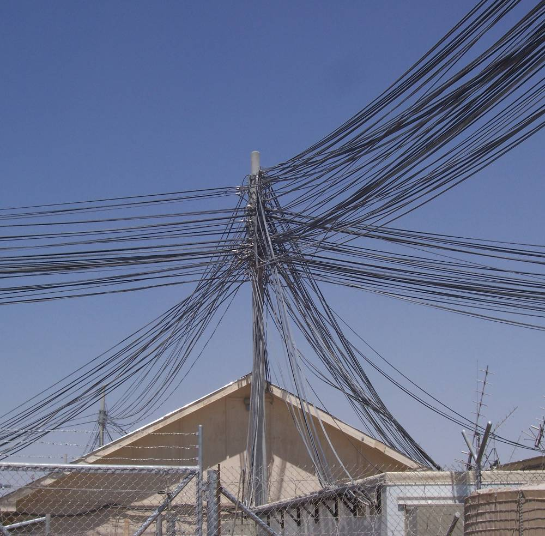
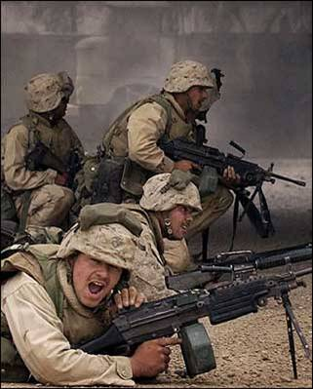
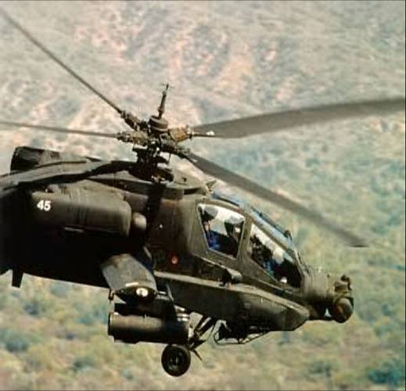
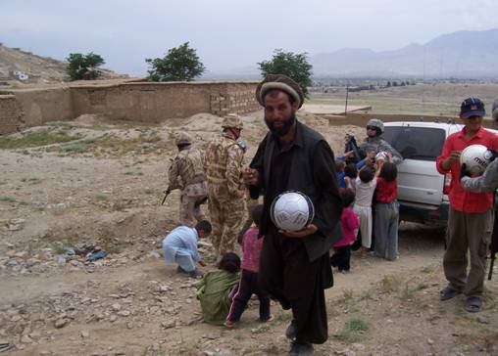
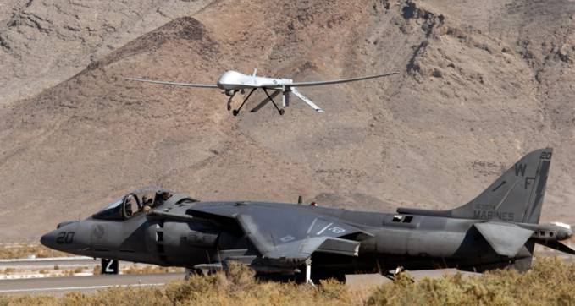
AMN Coalition Interoperability Assurance and Validation (CIAV)
CTTP No | N/A
Owner: | CIAV Management Group
Originator: | US CIAV Chairman
Version: | 20110926v1
Date : | 20110929
Style of Brief | Interoperability Panel Brief

Slide 2
Disclaimer
The information provided in this briefing is for general information purposes only. It does not constitute a commitment on behalf of the United States Government to provide any of the capabilities, systems, or equipment presented, and in no way obligates the United States Government to enter into any future agreements with regard to the same. The information presented may not be disseminated without the express consent of the United States Government.
2

Slide 3

Agenda
Operational Issue
Afghanistan Mission Network
Coalition Mission Threads
AMN Governance
Coalition Interoperability Assurance & Validation (CIAV)
Coalition Test & Evaluation Environment (CTE2)
Architecture Working Group (AWG)
CMT Review
Change Management

Slide 4
The Operational Problem-2008
Coalition forces within Afghanistan could not communicate effectively and share operational Commander’s guidance, information and intelligence
• Different networks with inadequate cross-domain solutions resulted in poor ops, planning and intelligence information exchange between U.S. and NATO forces in International Security Assistance Force (ISAF)
• Communication gaps between partner nations increased risks to life, resources, and efficiency

Slide 5
Operational Direction
The underlying importance of the AMN as a blueprint for future Alliance mission networks and for the governance model for new complex programs in theater is a fundamental underpinning of the AMN Capability Planning approach. AMN and its spiral development is proving to be a test bed for future capability development, stressing the importance of progressive development processes whereby increasingly adaptive and agile CIS delivery is being expedited in support of operations. The collapsing of traditional acquisition processes is bringing innovative and flexible solutions to the war-fighter in shorter timescales than hitherto deemed possible. This trajectory in CIS delivery is underpinned by COMISAF whereby he states that the AMN is the most important enabling capability he has as a commander. The approach is about ‘command – centric’ delivery that is ‘network –enabled’ and not ‘network – centric’.
Gen David Petraeus COMISAF, Dec 10

Slide 6
Afghanistan Mission Network (AMN)
Primary Coalition, Command, Control, Communications and Computers, Intelligence, Surveillance, and Reconnaissance (C5ISR) network in Afghanistan for all ISAF forces and operations
• Consists of the ISAF SECRET network as the core with connections to national extensions from numerous TCNs

Slide 7
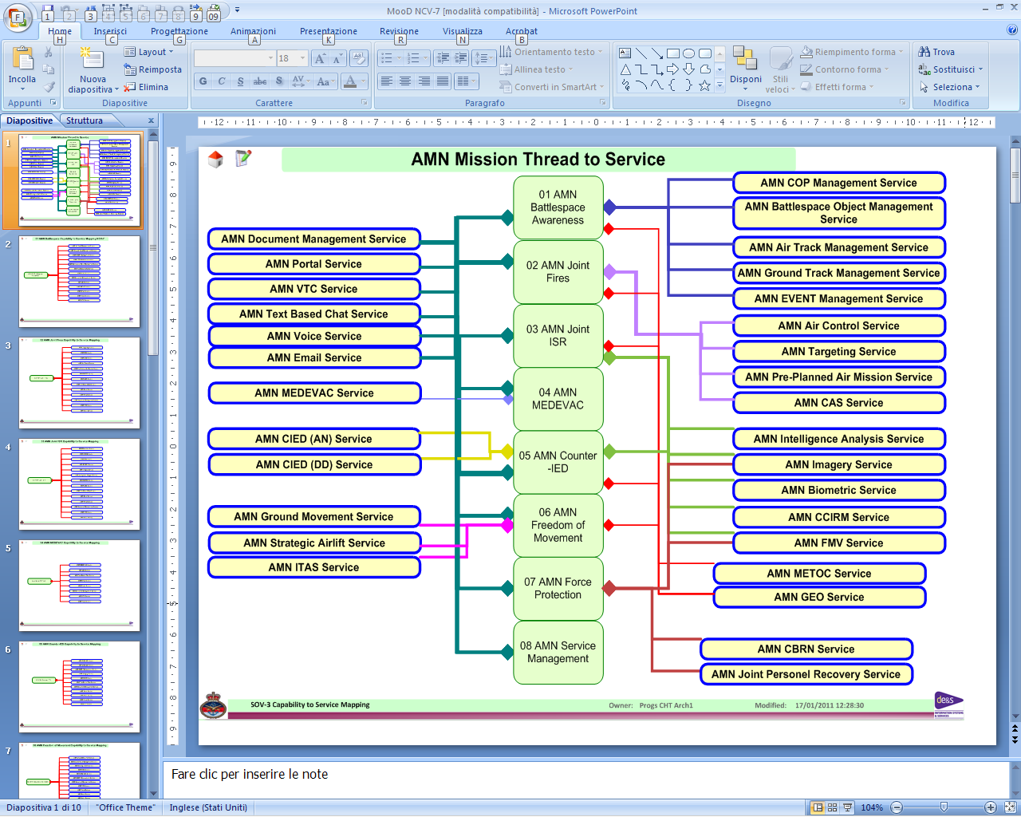
AMN Mission Threads
7

Slide 8
Mission Thread Interaction
Battlespace Awareness
Full COP requires
Vertical & Horizontal
Information Exchange
Freedom
of Movement
Joint
ISR
Service
Mgmt
C-IED
STRATEGIC
Force
Protection
Joint
Fires
MEDEVAC
OPERATIONAL
TACTICAL
COP
It must be understood that one mission thread drives the other threads in various ways.
8

Slide 9
What is CIAV?
Process and methodology for Assurance & Validation (A&V) of mission thread interoperability on the AMN
Process for validating Coalition Mission Threads (CMT) and Coalition Tactics, Techniques, and Procedures (CTTP)
Assures information exchanges and operational information exchange processes
Provides CMT Capability and Limitation Reports supported by Operational Impact Statements

Slide 10
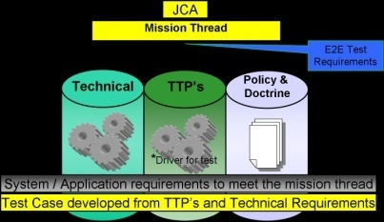
CIAV “Big Picture”
Developers
PMs
Op
Exercises
Policy &
Doctrine
DMZ
“landing site”
Push/pull data for training prep
Ops Data
CIAV
RESULTS
Training
RIP/TOA
MRE/MRX
AMN
Operational
Data Coordination
CAPS/LIMS RESULTS
Issues & TTP Requirements
Lessons learned
Ops Issues / Gaps
Issues & CIAV Requirements
Governance
Technical Req.
Interoperability AV
TTP Validation
CAPS/LIMS Report
Policy / Doctrine
Notes:
Wrap up

Slide 11
CIAV Mission and Vision
The CIAV Mission Statement:
Increase the exchange of critical Coalition Mission Thread (CMT) warfighting information and improve overall interoperability allowing Coalition forces to fight more effectively and efficiently.
The CIAV Vision:
To improve overall global interoperability through the implementation and execution of a Coalition focused, mission based interoperability process enabling multiple nations to fight as one.
Ensure a succinct exchange of critical warfighting information to multiple Coalition partners.
Assure & Validate interoperability of authorized mission threads and capabilities through standardized operational requirements.

Slide 12
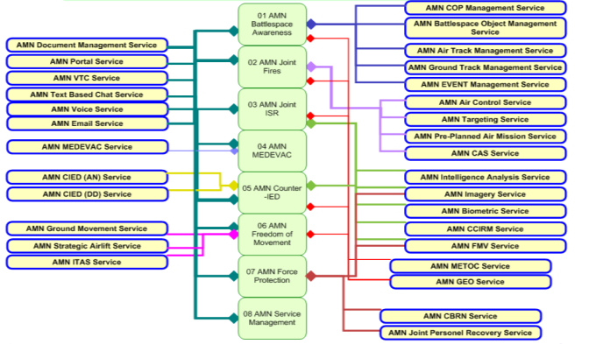
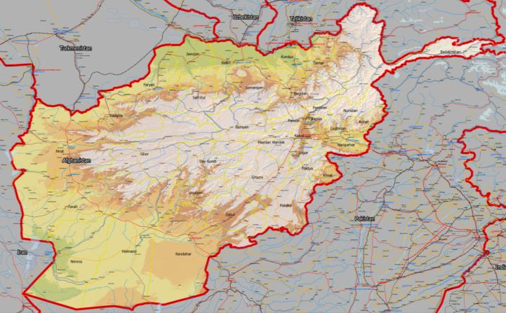
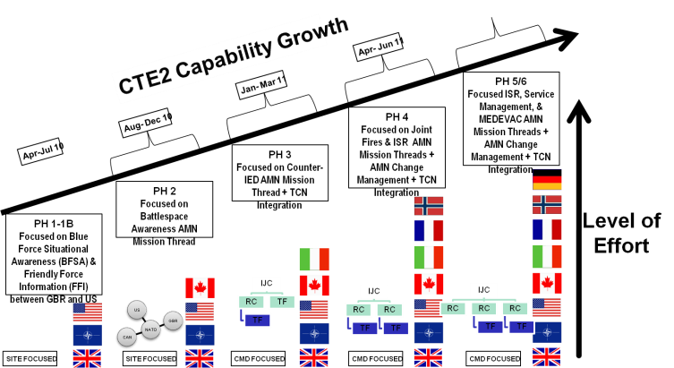
CIAV context
HQ IJC 8 CMTs
Change Management
NIRIS
JocWATCH
ICC
ICC
ICC
ICC
ICC
?
ICC
ICC
ICC
CHAT
ICC
ICC
TCS
ICC
ICC
CIDNE
ICC
NITB
ICC
ICC
ICC
ICC
ICC
ICC
New Joiners
CMT Review
12
Notes:
Process and methodology for Assurance & Validation (A&V) of mission thread interoperability on the AMN
Process for validating Coalition Mission Threads (CMT) and Coalition Tactics, Techniques, and Procedures (CTTP)
Assures information exchanges and operational information exchange processes
Provides CMT Capability and Limitation Reports supported by Operational Impact Statements

Slide 13
CIAV Principles
CIAV is a function that provides operational A&V of coalition interoperability based on authorized CMTs
CIAV interoperability is NOT about providing opinion; it is about providing C5ISR mission risk assessment and operational impact with appropriate mitigation
CIAV does NOT replace National/Joint/System testing activities
CIAV is tasked by the Capability Authority and is executed by the CIAV Management Group
CIAV is operationally relevant and persistent; it is enduring

Slide 14
What is Going to Change and When?
Network experts are not Operational Mission Thread experts-neither are aware of the others market space
Operational Requirement
Requirements change, funding cut
Design decisions not documented
Interoperability needs and testing given low priority
Development
Poorly defined IERs
Incomplete Operational requirements
Standards not identified or not a complete source of interoperability requirements
Testing occurs late
Expensive to resolve anomalies
Modification $ used to fix problems vice add capability
Integration
Acceptance
Service Use
Developer fills in missing requirements
Ambiguous requirements interpreted differently by developers and nations
In-Service Modifications
Source(s):
Software Engineering
Economics by B. Boehm. 1981
NCTSI research –Rissinger 2003
Interoperability Testing / A&V

Slide 15
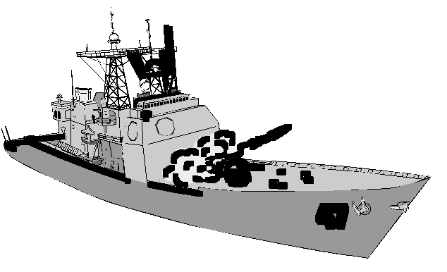
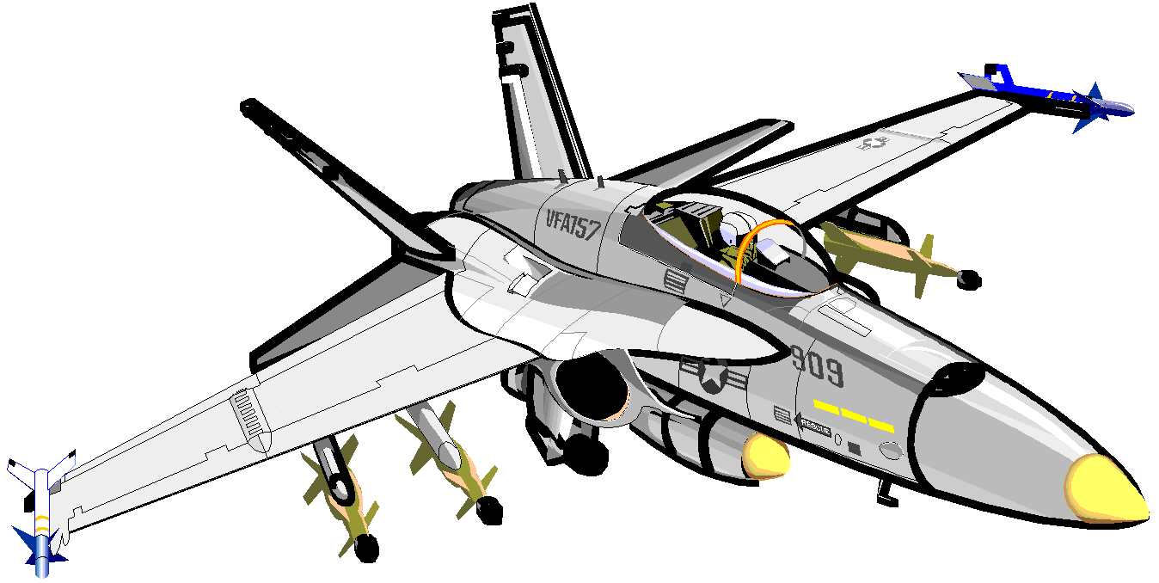
Problem Context: Message Level View
Surface C2
Air C2
Fighter
Fighter/Attack
J3.5
J3.5
J3.5
J3.5
J3.5I
J3.5I
J3.5I
J3.5I
J3.5E0
J3.5E0
J3.5E0
J3.5E0
J3.5C1
J3.5C1
J3.5C1
J3.5C1
J3.5C2
J3.5C2
J3.5C2
J3.5C2
J3.5C3
J3.5C3
J3.5C3
J3.5C3
15
Notes:
All four platforms implement the same five words of this message. So far, so good.

Slide 16
Problem Context: Bit Level View
Surface C2
Air C2
Fighter
Fighter/Attack
J3.5
J3.5
J3.5
J3.5
J3.5I
J3.5I
J3.5I
J3.5I
18 Elements
9 Elements
8 Elements
16 Elements
J3.5E0
J3.5E0
J3.5E0
J3.5E0
8 Elements
5 Elements
3 Elements
5 Elements
J3.5C1
J3.5C1
J3.5C1
J3.5C1
9 Elements
9 Elements
5 Elements
10 Elements
J3.5C2
J3.5C2
J3.5C2
J3.5C2
2 Elements
2 Elements
2 Elements
2 Elements
J3.5C3
J3.5C3
J3.5C3
J3.5C3
12 Elements
2 Elements
2 Elements
11 Elements
Example: Identity processing Deltas between C2 and Non-C2
16
Notes:
But the implementations are not fully interoperable. Each platform made an independent selection of data elements to implement. The details do matter.

Slide 17
Interoperability Maturity
Coalition of
Systems Test
(Platforms to
Network)
Family of
System Test
(Platform to
Platform)
System of
System Test
(System to
Platform)
System
Test
(Component
to System)
Component
Test
So
What!
What
Why
How
=
+
+
Mission
Operation
Task
Task
Purpose
Method
17
Notes:
Testing Maturation Flow (rissinger2009) This depicts the facts that components are put into systems and systems are put into platforms, platforms must interoperate with other families of platforms, and these family of platforms must interoperate via networks. Thus, testing is not a one stop deal, it is iterative and all testing must be focused on the end state and mission thread success requirements.

Slide 18
Notional Business Flow To Include Service Requirements
JCA
(CONOPS/AV)
Policy to Mission
(Top Down)
*can be standardized
UJTL-SN/ST
(ISP/OV)
UJTL-OP and Mission ID
(CDD/SV)
UJTL-TA and Mission Thread
(CPD/detailed SV)
METL
(detailed SV/TV)
Tie-In
C/S/A detailed METL (detailed KPP/SV/TV)
USA
USN
USMC
USAF
Agency
Other
Mission to Policy
(Bottom Up)
*should map to top down
Mission Area # / Task / KPP / IER
Min Imp (threshold) and FOC (Objective)
18
Notes:
Notional Business Flow (rissinger2009) This is a slightly different view of the previous JCA-METL slide and shows further detail in the service specific requirements depicted by the cylinders. The context is: The JCA to UJTL (OP and TA) can provide a standardized mission thread flow and shared with our coalition partners for interoperability considerations. The services, US/UK/NATO will all have specific methods of performing their detailed mission thread, however, all processes should map to a higher level that is standardized in order to achieve interoperability and mission success. The tactical techniques, and procedures (TTP) should drive all testing efforts and the technical requirements/rules, and policy and doctrine mandates should align as one complete package for testing. Thus, the test report will have a technical performance aspect tied to the mission thread based upon the TTP’s, and the policy and doctrine mandates can be applied to show they either align or changes may be addressed via the CCB. This coordinated effort will ensure the technical and policy guidance aligns to and from the TTP’s and the way the warfighting trains to fight with the equipment they will use in theatre.

Slide 19
















End to End (E2E) Process Context (US centric view)
TEST
REQUIREMENTS
S/N GOALS
ISP Details are supported here
MISSION / CAPABILITY
OPERATIONS
OPERATIONS
LCM
Supportability and Sustainment
UJTL- OP
CSFL
UJTL- OP
CSFL
DOTMLPF
TASKS
UJTL- TA
TASKS
UJTL- TA
METL
METL
FUNCTIONS
REF:
CJCSI 6212.01, DODI 4630.8, DODD 4630.5,
CJCSM 3500.04, CJCSM 3170.01, DODAF,
DOD 5000.2
FUNCTIONS
SYSTEM
SYSTEM

Slide 20
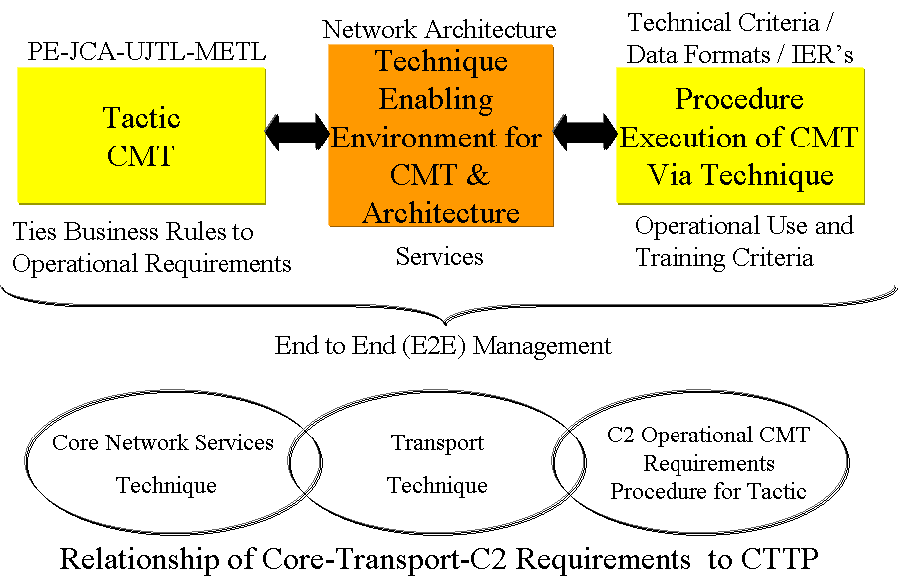
End to End (E2E) Mission to CTTP Relational Flow
20

Slide 21
TTP Construct
CMT
Battlespace Management
FAS
COP
Management
Technical Specification
Systems
“IER”
T1 of CTTP
CONOPS
Operational REQ (Fidelity)
MMR
T2 and P of CTTP
Technical REQ
Data Format
Data Standard
KPP
MOP
MOE
Coalition Tactics, Techniques, and Procedures (CTTP) present the end to end (E2E) mission thread performance criteria for Coalition Interoperability Assurance and Validation (CIAV) events. The T1 (tactic-mission thread) presents operational mission requirements and frames Information Exchange Requirements (IER). Functional Area Services (FAS) further parse the T1 to service specific tasking in which the T2 (enabling architecture) is designed and executed via country specific procedures (P). The physical systems utilized within the T2 are identified and depict the IER flow in order to meet the T1 operational requirements via country specific procedures.
21

Slide 22
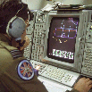


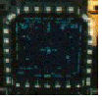




Operator to Operator Mission Interoperability
Operational
Operator
Operator
Display
System
Display
Host
Host
Technical
Decision-
Quality
Information
Terminal
(JTIDS/JTRS
GW)
Terminal
(MIDS/GW/etc)
Decision-
Quality
Information
Information
Information
Data
Data
010110
010110
IP/RF/SAT
Data
Protocol & Integration
MMI
Brain-to-Brain
Legend: Technical IO Procedural IO Operational IO
22
Notes:
TDL standards implementation impacts the interpretation of the information, on which tactical decisions are based

Slide 23
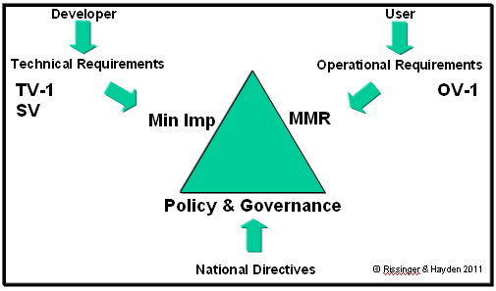
Coalition Interoperability Triangle
COP

Slide 24




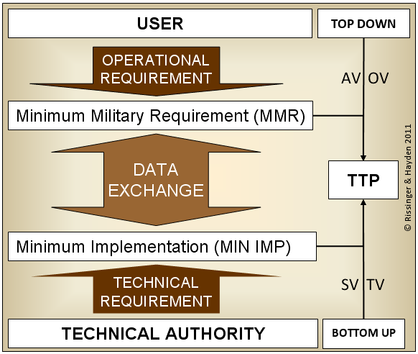












Coalition Interoperability View
CENTRIXS-I
AUSAX
SIMACET
CAESAR
AMN
CORE
OVERTASK
INTEROPERABILITY
NORAX
LCSS
BCIS
SICF

Slide 25
CIAV Working Group
Purpose: Responsible for assuring and validating services, systems and business processes supporting AMN mission threads
Interoperability execution arm for the AMN Governance structure
Managed by national heads of delegation from participating troop contributing nations (TCNs) and NATO
Coordinates Assurance & Validation events per AMN Secretariat and National direction and provides results/recommendations on mission and coalition interoperability improvement across AMN
Executing mission thread assurance for initial 8 AMN Coalition Mission Threads prioritized by IJC in 90 day sprints

Slide 26
CIAV WG Members
CAN
DEU
DNK
FRA
GBR
ITA
NLD
NOR
NATO (NC3A and NCSA)
SWE
USA
26

Slide 27
Generic 90 Day Cycle
Time
Phase X Report
 | Phase X CMG Decision Brief
 | Phase Y Planning
 |  | Phase Y SOVT
 |  |  | Phase Y A&V Phase X
 |  |  |  | Phase Y Combined Event
 |  |  |  |  | Phase Y Report
 |  |  |  |  |  | Phase Y CMG Decision Brief
 |  |  |  |  |  | Phase Z Planning
27

Slide 28













AMN Environment 2011
AMN FOC Concept
AFG Major
OVERTASK
Infrastructure
Software
CENTRIXS-ISAF
USA
GBR
ANSF
AMN Core
Guard
FAUST
DEU
CAESAR
SICF
ISAF SECRET
ITA
FRA
Guard
National Systems
NATO SWAN
CAN
Guard
LCSS
NOR
FISA
ESP
SECRET
SIMACET
NATO
SECRET
SV-1 Resource Interaction Specification
Owner:
Progs CHT Arch1
Modified:
27/10/2010 12:08:10

Slide 29
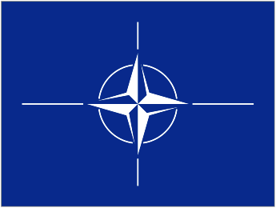







CTE2 – Current Sites
NCSA ISTF
Mons
BEL
NC3A Battlelab
The Hague
NLD
JITC
CX-I Lab
MD, USA
JS C4AD
VA, USA
JITC
Instrumentation
AZ, USA
LCSS-ISAF
Battlelab Ottawa
CAN
Army CTSF
Battlelab
TX, USA
Coalition Test & Evaluation Environment
(CTE2)
Euskirchen
DEU
Navy
Coalition Lab
CA, USA
Battle Lab
Kolsas
NOR
NGA/Navy
Michelson Labs
CA, USA
Blandford and
Porton Down
GBR
Battlelabs Pratica di Mare and Anzio, ITA
DGA MI
Bruz
FRA
Marine Corps
Battlelab
TBD
Air Force
CEIF Lab
MA, USA
6
Notes:
Sites with dashed lines are in the process of coming onto the CTE2
NATO UNCLASSIFIED
29

Slide 30
CTE2 CIAV Environment
(Phase 3: CIED)
CHAT
COP InfoManager
COP LM
ICC
IFTS Data Terminal
IFTS Server (R)
IFTS Server (S)
IGEOSIT
JOCWatch
NIRIS
JITC Labs
MD & AZ, USA
CHAT
GCCS-J
MOSS 2007
TransVerse Client [CHAT]
NC3A Battlelab
NLD
CFBLNet
CTSF Battlelab
TX, USA
ADSI
AFATDS
AMDWS
BC Server (PASS)
BCS3
C2PC
C2PC
C2PC Gateway
CHAT
CIDNE
CPOF Client Application
CPOF Data Bridge
CPOF Master Repository
CPOF Mid Tier Server
DCGS-A
FBCB2 - AIC (TOC)
FBCB2 – EPLRS
GCCS-A
JADOCS
JOCWatch
MIP Gateway
TAIS
TransVerse Client [CHAT]
Bowman
CHAT
CIDNE Web
CSD
HeATS & GrATS (H & G)
ICC
IPA
JADOCS GBR
NIRIS
NITB
TIGR
Porton Down
GBR
Italy Army Battle Lab
ITA
CFX-LSL
CAN
CHAT
CIDNE Web
ITA-BFT (NFFI)
JOCWatch
SIACCON 2
ATTAC
Battleview
CHAT
CSD-CAN [Service]
FMV [Feed]
Internet Explorer (CIDNE Web)
MIP2 Gateway
OpenFire (CHAT)
SC2PS Client
TransVerse Client [CHAT]
JSIC
VA, USA
DGA-MI RIT
FRA
CHAT
CIDNE Web
CORSOM
ICC Lite
IGEOSIT
LC2IS
JOCWatch
MIP
C2PC Gateway
CHAT
CIDNE Web
GCCS-J
JADOCS
TIGR
30
Notes:
30
This was the environment and capabilities that were online for Phase 3 and not a comprehensive listing of capabilities available on the CTE2.

Slide 31
Notes:
Rudimentary example of an SV-10c

Slide 32
AMN Architecture WG
Develops the overall AMN architecture and modeling of the AMN mission threads in order to support multinational C5ISR planning at the enterprise level. AWG activities are focused on supporting the conduct of safe operations and enable operational agility in the Afghanistan Area of Operations. The AMN AWG supported the following objectives:
  Migration to a common Coalition C5ISR network
  Identify common coalition “mission threads” and ensure each has adequate information systems support
  Ensure data consistency and availability across the AMN for the duration of the operation
  Enable nations to bring their own tools to the fight, yet fight using common AMN data
  Improve efficiency and effectiveness by reducing the number of systems and data sources
  Enable the sharing of information

Slide 33
AMN Governance Concept
JFCBS
SHAPE
P
U
R
P
L
E
B
R
I
D
G
E
THEATER
AMN Capability
Authority
Senior Responsible Officer –
COMISAF
Operating Authority - NCSA
Design and
Implementation
Authority
Operating
Authority
COM IJC
AMNOC
AMN Enterprise
Services
Federated Control
Joining Rules
AMN
Steering Group
AMN
NETOPS
NATIONS
AMN
Working Group
AMN CAB
TCN
Change Mgt
ACT
AMN
Secretariat
Secretariat
Forward
CIAV
Architecture
WG
ISAB
OPT
3
33

Slide 34
Change Management
CIAV embedded into AMN Change Management
  Identified Cat 3 and all Cat 4 changes must go through CIAV
TCNs must follow national Change Management requirements
TCNs must inform the AMN Change Manager about upcoming changes on the AMN for inclusion in the AMN Strategic Roadmap

Slide 35
Change Management
RFC Categories
Cat 3 - “Able to satisfy as a major change or enhancement to an existing OA Service.”
  Major Change Existing Service
  Solution not compliant with AMN Service Catalogue
  Solution compliant with AMN Capability Plan
  Implementation requires resources, testing or engineering beyond in-theatre capability
  CIAV assessment may be required

Slide 36
Change Management
RFC Categories
Cat 4 - “Able to satisfy through detailed planning, funding and delivery of a new service/solution.”
  Major Change New Service
  Solution not compliant with AMN Service Catalogue
  Solution not compliant with AMN Capability Plan
  Significant resource allocation, testing or engineering required
  New TCN joining the AMN

Slide 37
Theater CMT Review
Purpose:
  Capture and discover the RC’s operational and technical requirements, business processes, and systems utilized to conduct the successful execution of coalition mission threads
Authority:
  HQ IJC via FRAGO
Outputs:
  Recommend mission and coalition interoperability improvements across AMN
  Identify limitations (gaps) in process and technology
  Update AMN Architecture

Slide 38
CIAV Timelines
CUR AMN 1204
CUR 1021
AMN Core
FAS Up-grade to Support FOC AMN
CMT3
CIAV Phase 5 ISR
FOC AMN – Step 1 Dec 11
CWID/ CWIX/ EC II
JT Fires/ ISR
Oct 11
AMN Strategic Roadmap V 3.0
AMN Core plus GBR, USA, FRA, ITA, DEU, NOR, CAN, AUS ,POL, ESP
+ SWE, FIN
CUR 1204 (AMN 2012) Requirement
CMT2
Jul 11
CIAV Phase 3 C-IED
AMN OPT (End June, Norfolk, VA)
CMT1
Mar 11
Apr 11
AMN Strategic Roadmap V 2.0
AMN Core plus GBR, USA,
+ FRA, ITA, DEU, NOR, CAN, AUS
CUR 1204 (AMN 2012) Requirement
CIAV Phase 2 Battlespace Awareness
Feb 11
Jan 11
CIAV Phase 1a, 1b, 1c BFSA, UK, US, RC (SW)
Dec 10
AMN Governance Regime Nov 10
Operational Assessment (CX-I)
Mar 11 Activities:
1. ISR Wksp:
Early Wins in spt of FOC
2. CX-I OA Out-brief
3. AMN OA Out-brief
4. BG Donahue Brief
5. JIC – Ft Huachuca
6. CUR 1204 Requirement
CMT Review-IJC Sponsored (6-21 Feb)
ESB Workshop (9-11 Feb)
XMPP Ct Workshop (14-18 Feb)
CX-I FOC AMN IOC Jul 10
AMN Strategic Roadmap V1.0
- AMN Core plus GBR, USA
CX-I IOC OCT 09

Slide 39
Overall CIAV Findings (HIGH LEVEL)
Standards – ID, conformance and compliance
Standardisation of process
Common Operational Picture completeness
Redundancy of information
MS Office, voice & chat dependency
Training synergy with operational systems
Bandwidth constraints
Passing information across AMN boundaries
39
Notes:
Key Points CIAV has captured to date (High Level):
MilSTD vs STANAG is an ongoing issue and causing interoperability problems. (Standards are not Standard at this point)
2. Identification of Operational Requirements and establishment of Minimum Military Requirement (MMR) is incomplete and causes many issues for CIAV events. We have to determine this ourselves with interviews with SME communities, thus becoming the defacto SME community for CMT.
3. Standards conformance and compliance is tied to #1, but causing several other problems in the fidelity of information when attempting to integrate technical solutions in a Coalition environment.
4. Metadata is a problem as we all understand. This is exacerbated with the fact #1, #2, and #3 are not synchronized or done fully. This creates a naming convention issue for taxonomical flows as well as causes issues when populating data fields with information that proves non interoperable when executed in a CTE2 during a CIAV event.
5. Lack of training on automated processes has caused the work around SOP environment currently in place in theatre. This is a key issue for IJC and USCENTCOM and reason large Army training network was established. More work is needed there and CIAV output information can fuel that task and make it better for operational MRE/MRX and RIP/TOA
6. Ability to automate exchange of operational information is the mainstay of CIAV. The fact we have provided solutions to Program Offices around the TCN communities has gained us significant value, but exposes shortfalls in system design, development, and integration.
7. Battlespace Awareness and SA issues are the output of the interoperability shortfalls we have found. That said, we are attempting to fix several layers of the problem, starting at the policy/doctrine level which (for US) stops at the Joint level. Further issues are exposed when standards are utilized from different nations, originally designed to meet national interest, not coalition.
This is a generic hit-list we have been working based upon all the thread work we have done and similarity of the higher level problems identified across the collective. In order to adjudicate them, many agencies and levels of command must be engaged. To date, our Capabilities, Limitations, and Operational Impact slides post CIAV event have engaged Program Offices to work fixes and this has proven successful since it directly addresses the operational community directed effort.

Slide 40
CIAV Summary
AMN and its execution arm (CIAV) is setting the interoperability framework supported by Enterprise Architecture for how we wish to work;
AMN is assuring the standards, the limitations and how we wish to network our FE to ensure agile command and mission success;
AMN is setting the principle: it is not your information, or my information, it is OUR information;
AMN is taking the first steps in the move toward making the agile networked organization where the Chain of Information is not inhibited by the Chain of Command;
AMN is beginning to make us think practically about Services we provide… not Systems;
AMN is more than just assurance and validation and the use of technology tools;
AMN is identifying our shortfalls in funding alignment and how we collectively deliver “purple” Services, and how we deliver the picture aspect of capability…..and how this may look.
AMN is about the Coalition and the next Hop……
40
40

Slide 41
Overall CIAV Findings (HIGH LEVEL)
Standards – ID, conformance and compliance
Standardisation of process
Common Operational Picture completeness
Redundancy of information
MS Office, voice & chat dependency
Training synergy with operational systems
Bandwidth constraints
Passing information across AMN boundaries
Notes:
Key Points CIAV has captured to date (High Level):
1. MilSTD vs STANAG is an ongoing issue and causing interoperability problems. (Standards are not Standard at this point)
2. Identification of Operational Requirements and establishment of Minimum Military Requirement (MMR) is incomplete and causes many issues for CIAV events. We have to determine this ourselves with interviews with SME communities, thus becoming the defacto SME community for CMT.
3. Standards conformance and compliance is tied to #1, but causing several other problems in the fidelity of information when attempting to integrate technical solutions in a Coalition environment.
4. Metadata is a problem as we all understand. This is exacerbated with the fact #1, #2, and #3 are not synchronized or done fully. This creates a naming convention issue for taxonomical flows as well as causes issues when populating data fields with information that proves non interoperable when executed in a CTE2 during a CIAV event.
5. Lack of training on automated processes has caused the work around SOP environment currently in place in theatre. This is a key issue for IJC and USCENTCOM and reason large Army training network was established. More work is needed there and CIAV output information can fuel that task and make it better for operational MRE/MRX and RIP/TOA
6. Ability to automate exchange of operational information is the mainstay of CIAV. The fact we have provided solutions to Program Offices around the TCN communities has gained us significant value, but exposes shortfalls in system design, development, and integration.
7. Battlespace Awareness and SA issues are the output of the interoperability shortfalls we have found. That said, we are attempting to fix several layers of the problem, starting at the policy/doctrine level which (for US) stops at the Joint level. Further issues are exposed when standards are utilized from different nations, originally designed to meet national interest, not coalition.
This is a generic hit-list we have been working based upon all the thread work we have done and similarity of the higher level problems identified across the collective. In order to adjudicate them, many agencies and levels of command must be engaged. To date, our Capabilities, Limitations, and Operational Impact slides post CIAV event have engaged Program Offices to work fixes and this has proven successful since it directly addresses the operational community directed effort.

Slide 42
CIAV Co-Chair Listing
NOR Maj Morten Ulimoen
mulimoen@mil.no
CAN Mr. Bruce Morris
BMorris@BCMConsulting.ca
DEU LtCol Tom Erlenbruch
erlenbruch@deu-transformation.de
DNK Mr. Esben Andersen
esben@mil.dk
FRA Mr. Vincent Motte
vincent.p.motte@gmail.com
GBR LTC Jon Fraser
jonhfraser@yahoo.co.uk
ITA LTC Luigi Sambin
luigi.sambin@esercito.difesa.it
NLD Maj Hans Baltzer
HL.Baltzer@mindef.nl
NATO Mr. Mel Smith
melvin.smith@nc3a.nato.int
SWE Mr. Jan Engman
jan.engman@fmv.se
USA Mr. Jeff Phipps
jeff.phipps@disa.mil

Slide 43
Questions?
43
Notes:
43

Slide 44
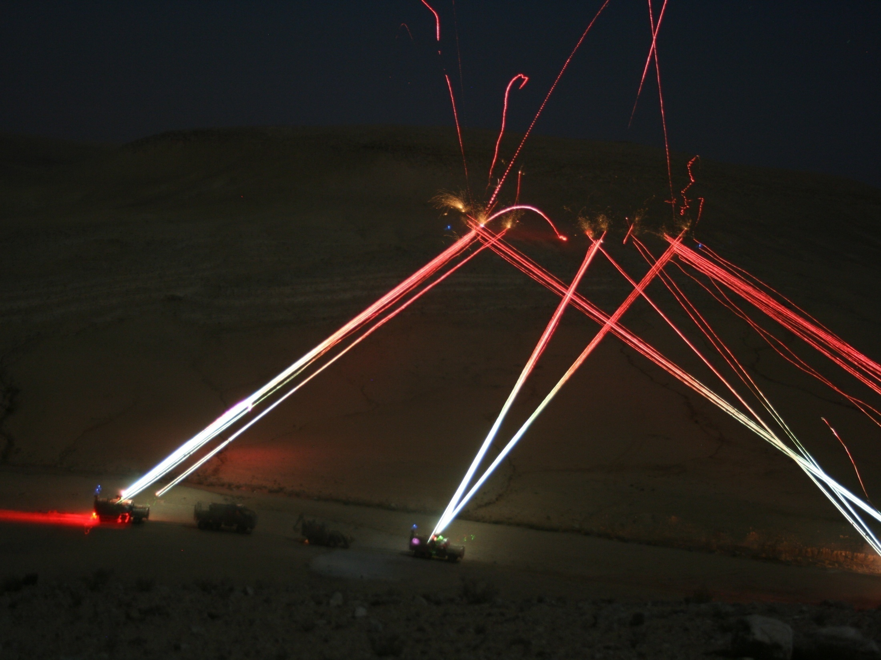
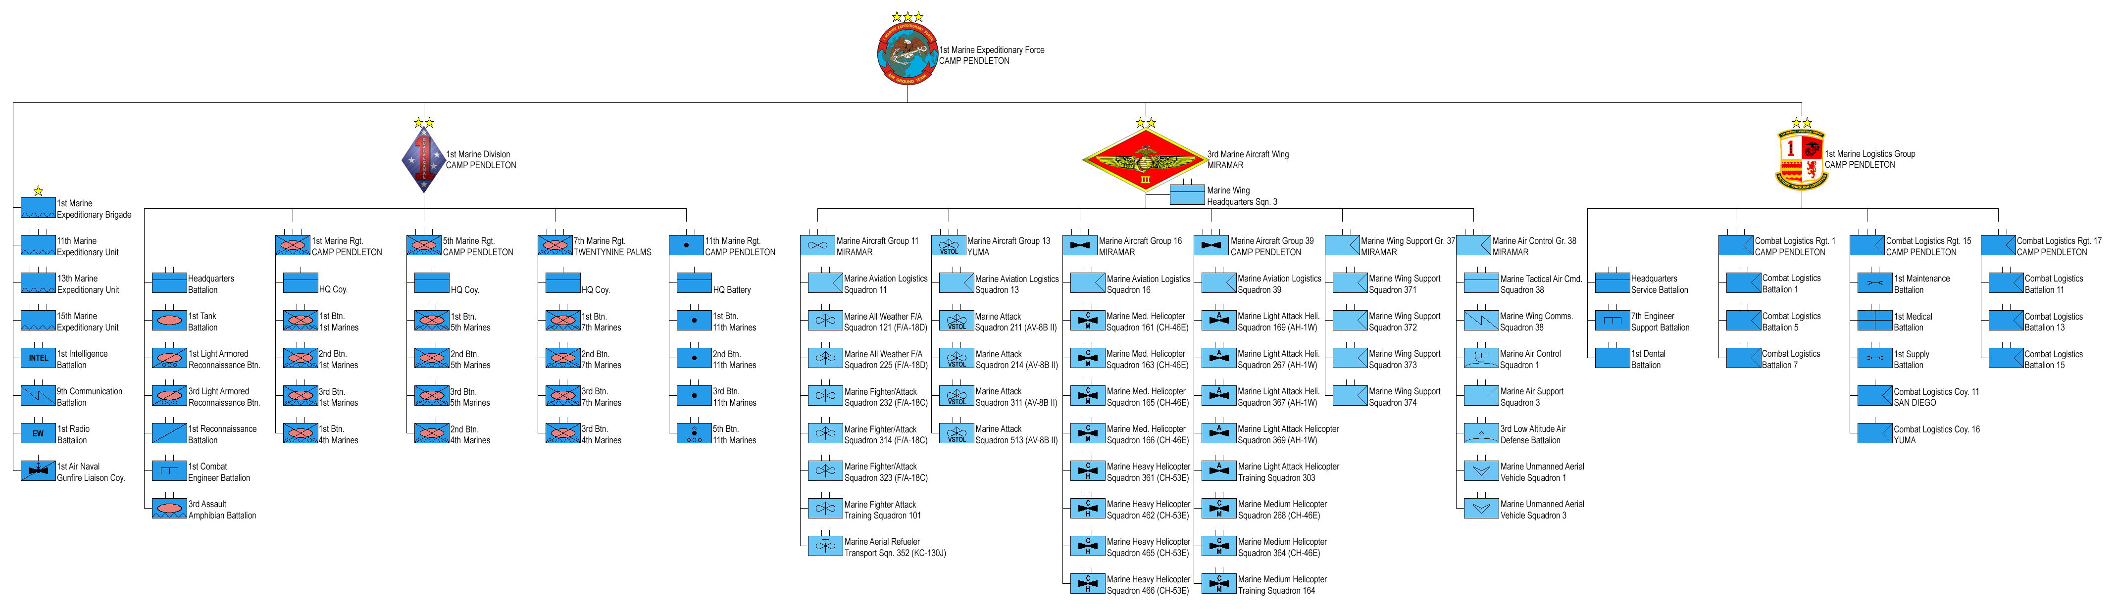
Minimum Military Requirement – Avoid This thru Good ISAF BFSA
COP
BFT
FFI
USMC Recon
GBR Recon
“Enable Safer Ops in ISAF” [Gen McChrystal]
Notes:
44

Slide 45
45
Notes:
45

