Slide 1
Model Based Systems Engineering (MBSE) Considerations for ESOH
Leo Kilfoy, General Manager
Engineering Lifecycle Management Business Unit
Oct 26, 2017

Slide 2
Agenda
Brief Intro to
MSC & ELM
ELM & MBSE
Use Cases
MBSE for ESOH

Slide 3
Brief Intro to MSC & ELM
Brief Intro to
MSC & ELM
ELM & MBSE
Use Cases
MBSE for ESOH

Slide 4
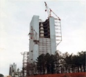


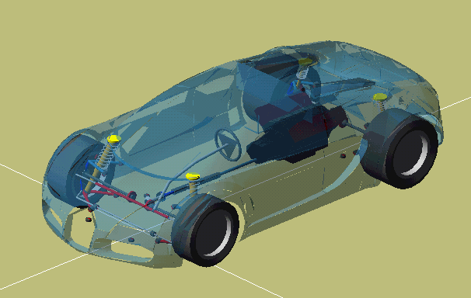


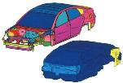




MSC Software Company at a Glance
Company Overview
Key Highlights
Leading provider of computer aided engineering (“CAE”) software solutions
  Mission critical simulation & analysis (”S&A”) products enabling engineers and analysts to validate and optimize their designs
  Complement and / or replace the traditional physical prototype-based “build-and-test” product design process
Value proposition: Improve quality, accelerate time-to-market and save costs associated with design and test of manufactured products
Recently acquired by Hexagon Manufacturing Intelligence
Founded: 1963
HQ: Newport Beach, CA
Total Offices: 27
MSC’s Value Proposition
Airbus Leverages MSC to Reduce Aircraft Noise
Noise Reduction
Strong Core Business
Virtually every auto, aero & heavy machinery OEM is a customer
25+ year relationship with the top 50 customers
Broad core product portfolio (built over 40+ years) complemented by investments in new in-house extensions and complementary acquisitions
Acquisitions – Best in class acoustics (FFT), multi-phase material modeling (e-Xstream engineering) and mechanical joining and welding (Simufact)
Key Results: Understand the effects of various parameters such as the excitation type, the presence of the floor, and the variable thickness on the interior noise levels
MSC Helps Bugatti Build The World’s Fastest Cars
Vehicle Dynamics
  Game changing CAE platform
  Complements and significantly extends the core simulation solutions
  19 patents filed so far, 5 awarded to date
  Award winning
Key Results: Successfully develop chassis and driveline performance prior to building first prototype
Game Changing CAE Platform: “Apex”
  Nissan Uses MSC To Design Quieter Cars
Noise Vibration and Harshness (NVH)
Key Results: Improvement of the fidelity of numerical models thanks to the accurate representation of trim components

Slide 5
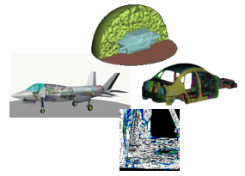
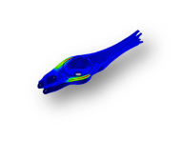
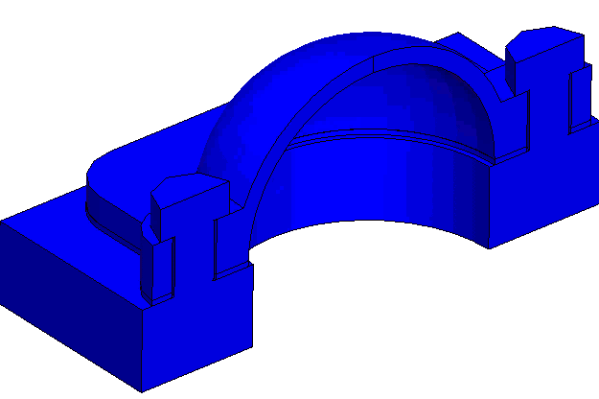
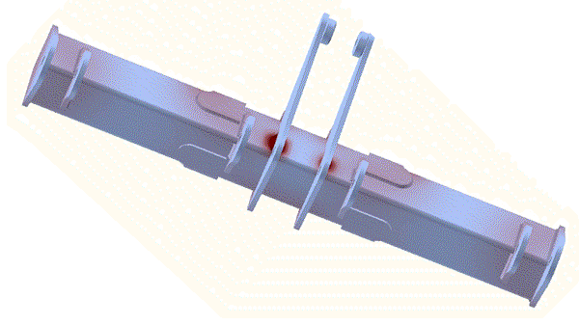
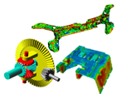

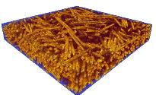
MSC Strategy
Simulating the Complete Product Engineering Process
Systems
Assembly
Parts
Fabrication
Materials
Engineering Lifecycle Management

Slide 6

ELM = Engineering Lifecycle Management
ELM manages process & data for engineering related domains across the product lifecycle
  Engineering information includes environment, simulation, materials and test
ELM integrates to the Enterprise
  Relation to PLM: ELM directly integrates across all phases (Concept, Design, Realize and Support) of Product Lifecycle Management (PLM)
  Relation to MBSE: ELM Tools supports MBSE by managing engineering information in engineering domain specific models
    Allows teams to build products and address problems in domain context
    Integrated Domain Modeling and Analysis supports Engineering Decision
MSC’s ELM Enterprise Tool Suite
  SimManager is the Engineering Model Factory for MBSE
  MaterialCenter is a Materials Lifecycle Management system for the enterprise

Slide 7


Who Uses ELM?
Target Company Profile
  Distributed geographically & organizational engineering teams
  Need for iteration to optimize performance
  Regulatory environment / Liability
  Unfilled headcounts
  Useful for Complex Design Environments
    Products (cars, planes, rockets, etc.)
    Duty cycles (100s of load cases)
    Multi-stage, multi-discipline simulations
Benefits
  Drives quality, consistency, and collaboration
  Managing engineering information across the Product Lifecycle
  Increased productivity
  Throughput

Slide 8

SimManager: Delivering the Digital Thread to Industry
Automotive
  Managing Vehicle Level Simulation & Teaming
  Developed across 17 years of Simulation Process & Data Management experience
  Covering a broad set of disciplines (Strength, Crash & Safety, CFD, Durability, MBD, NVH, etc)
  Global teaming at OEM and Tier 1 levels
    Audi, BMW, PSA, Daimler, VW, Ashok Leyland, Brilliance, FAW, FAW Car, ChangAn Auto, Scania,
    ZF, GKN Driveline, Dicastal, etc.
Aerospace & Defense
  Delivering consistent solutions faster across product lifecycle
  Managing
    Global/Internal Loads
    Test-to-Virtual Comparisons/Management
    Detailed Analysis/Sizing
    Sustaining fleet in service repair analysis (Digital Twin)
    etc.
  Broad customer base
    Airbus, Boeing, Leonardo, UTAS, Embraer, St. Gobain, Oshkosh Defense, Cobham, etc

Slide 9
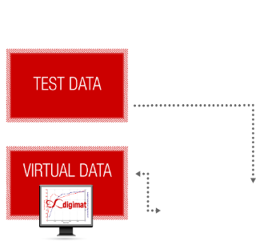
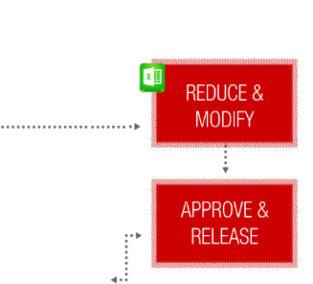

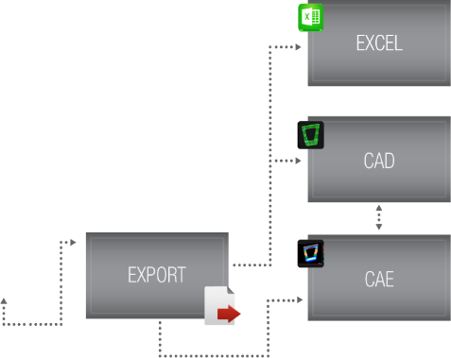

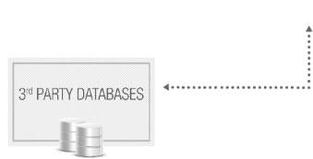
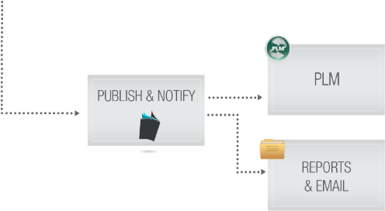
MaterialCenter: Managing Materials Lifecycle
MaterialCenter is a Material Lifecycle Management (MLM) system
Scope:
  Manufacturing & Process Data
  Physical & Virtual Test
  Materials Discipline
  Engineering: CAD, CAE, PDM/PLM
Integrates across all
PLM Lifecycle phases
Supports MBSE by managing multiple
material models (Test, Design, CAD, CAE),
material revision history and full traceability
PROCESS DATA

Slide 10
ELM & MBSE
Brief Intro to
MSC & ELM
ELM & MBSE
Use Cases
MBSE for ESOH

Slide 11
MBSE: Model Based Systems Engineering
MBSE
  is a Systems Engineering methodology focused on using domain models as opposed to documents for engineering
  includes behavioral, systems architecture, requirements, performance, simulation, test, etc.
  lowers risk and improves system understanding across the product lifecycle
MSC ELM
  is broadly focused on MBSE, specifically Simulation, Materials & Test domains
  supports MBSE providing system behavior, performance & risk to facilitate decision making process

Slide 12
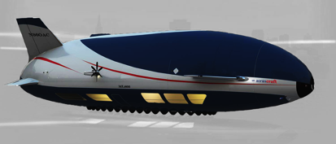

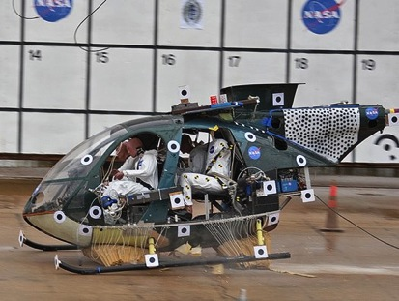
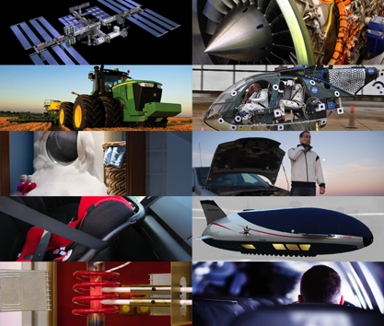
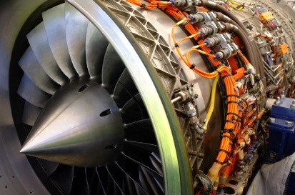

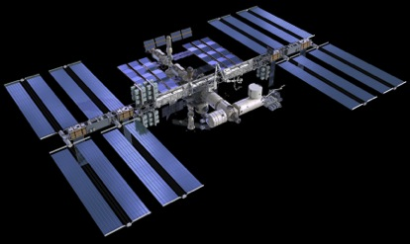
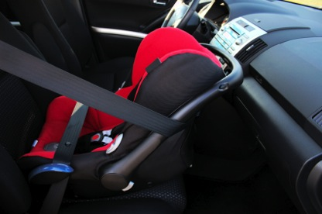

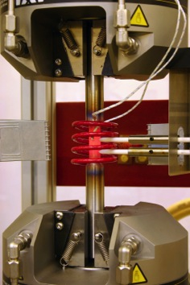

ELM Solution in the PLM
Interaction with PLM components of the Development Process
Addresses a Range of Questions
Can I build it?
Will it perform?
Is it durable?
Is it crashworthy?
Will it fail?
Why did it fail?
Is it safe?
Can it be lighter?
Can I test it?
Is it too loud?
Notes:
Simulation is performed when there are questions to be answered during the product lifecycle.
A question always has the two ingredients…

Slide 13
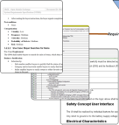

ELM Solution in the PLM
Interaction with PLM components of the Development Process
PDM
Can I build it?
Will it perform?
Product Requirements
& Objectives
Product Definition
Is it durable?
Question
Is it crashworthy?
Will it fail?
Why did it fail?
Answer:
Reports and Results
Environment for Simulation
Answer:
Optimized Designs
Is it safe?
Can it be lighter?
Can I test it?
Is it too loud?
Notes:
Any question to an analyst requires:
1: Requirements and Objectives for the product.
2: Definition of the product, being very sketchy in the early development phase and very precise from PDM in the late development phase.
The challenges with any question ask to the simulation department:
“When asking 4 engineers a question you typically get 5 answers.”
This requires to establish a simulation environment, where in a consistent, predictable, reproducible and documented manner the answers are delivered back into the development process

Slide 14
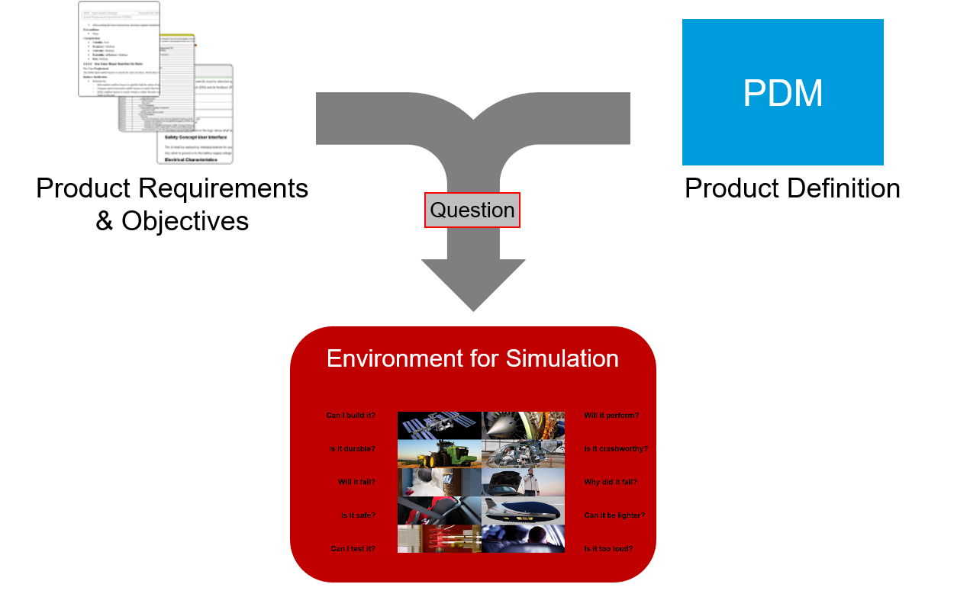
ELM Solution in the PLM
Interaction with PLM components of the Development Process

Slide 15
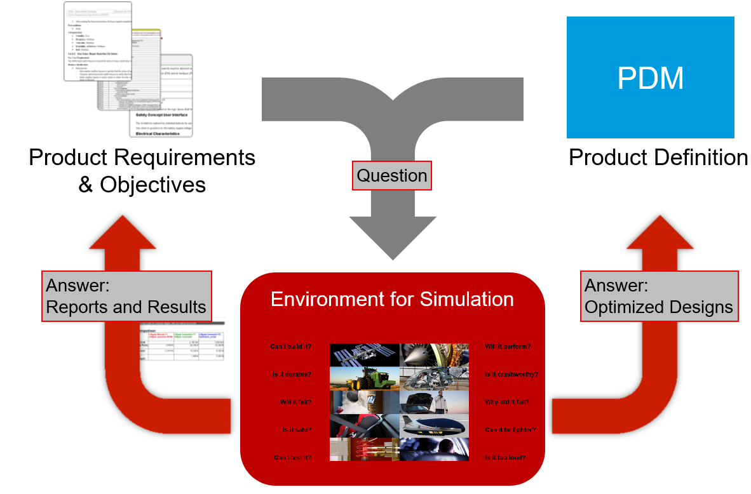
ELM Solution in the PLM
Interaction with PLM components of the Development Process

Slide 16
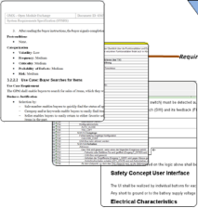



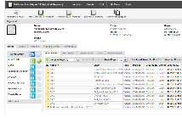
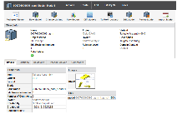
ELM Solution in the PLM
SimManager: Building the required Simulation Environment
PDM
Product Requirements
& Objectives
Product Definition
Question
Answer:
Reports and Results
SimManager
Answer:
Optimized Designs
Notes:
Creating such a consistent environment is the key focus of SimManager.
SimManager is an environment in which the analysts work, which:
Manages all the tools and methods
Manages all the “best practices” processes to answer to the questions
Manages and organizes all the simulation data generated during the work of the analysts
Provides the mechanism to communicate back to the PLM the results of the simulation

Slide 17

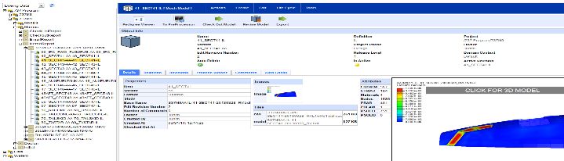
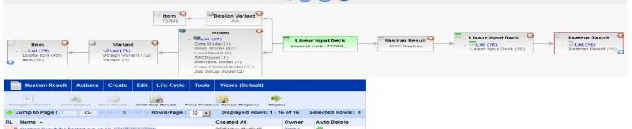
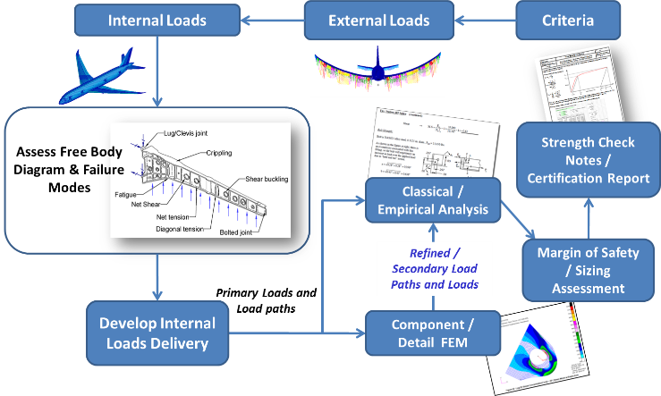

Boeing Internal Loads
Internal Loads…
  are critical in the airplane design process
  revisions have significant impact on engineering activities
  derive from an assembly of subsection component models
  must be consistent and authored through a controlled release process
Needs
  Support management across a long product lifecycles (30-50 years)
  Managing precise version control & pedigree of inputs/outputs
  Drive better performance & throughput
Project Status
  Production on 737 MAX project
  Rolling out other aircraft programs
NAFEMS 2016, Americas Conference

Slide 18

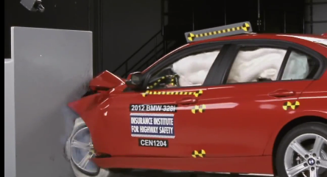

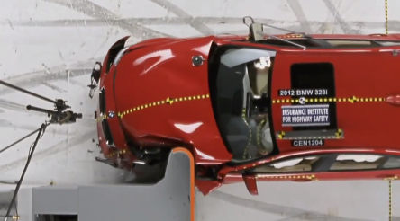

BMW
Need
  Build safer, more reliable product
  Innovate product quicker
  Improve engineering throughput
  Drive consistent, repeatable analysis from engineer to engineer
SimManager manages…
  all Occupant Safety, Head Impact, Pedestrian Safety, Crash, NVH, Forming, Interior, Exterior, Driveline, MBD, CFD disciplines for all vehicle programs
  a global simulation team across 4 continents
  all organizations in BMW including car, engine, sport & motorcycle
  Scale - 1000’s simulations, 100’s of users… every day… producing Pb’s of data every year

Slide 19
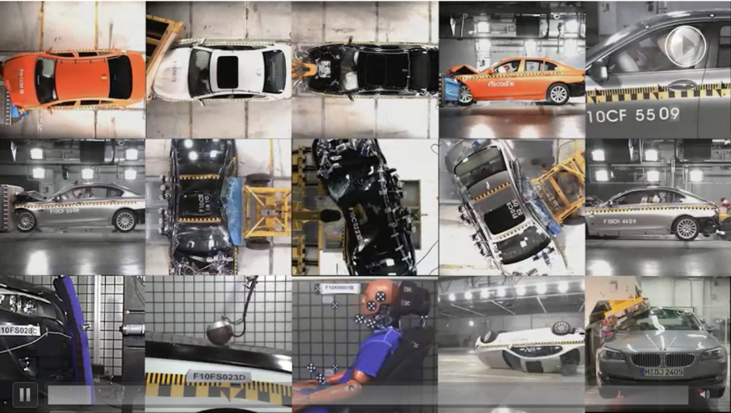
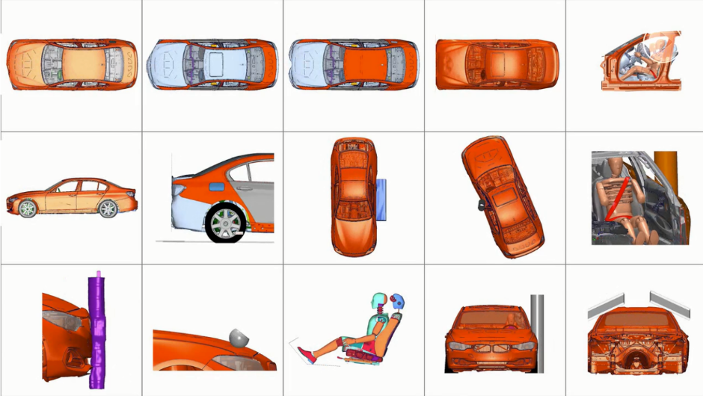
Physical Test
Example: BMW 5 Series Crash Tests
Notes:
MBSE System Level Example of full vehicle Crash & Occupant Safety

Slide 20

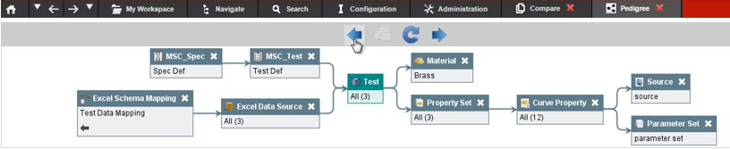
Managing Test & Design Data in Aerospace
Customer Need
  Integration of multiple business units to manage multiple material models (composites, metals, plastics, etc.) for multiple material disciplines (Test, Design, CAD, CAE)
MaterialCenter Solution
  Precise tracing the who, what, where, when, and why for Aerospace material management.
  ITAR and EAR compliant security methods.
Value
  Enabling collaboration of engineers from various geographical locations.
  Robust material object model for managing data from various sources and test standards supporting multiple disciplines (Test, Materials Engineering, CAD, CAE)

Slide 21
MBSE for ESOH
Brief Intro to
MSC & ELM
ELM & MBSE
Use Cases
MBSE for ESOH

Slide 22
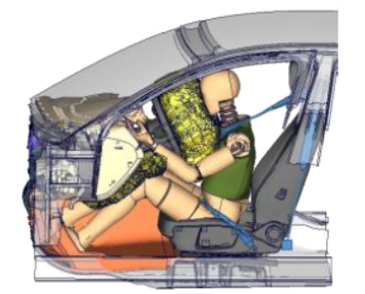
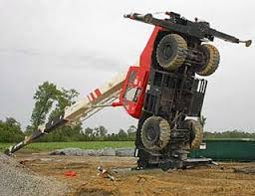
MBSE – ESOH: Safety Simulation
Simulation of Models across various disciplines provides evaluation of system safety and performance
Simulations can represent complex events of complex systems involving human interaction, such as occupant safety or pedestrian protection
Traceability across simulations is critical to relate outputs (results/reports) to specific revisable inputs and events (pedigree finger print)
Simulation automation provides for faster evaluation supporting
  Consistent, repeatable evaluation
  Potential changes in requirements from theater
MBSE simulation frameworks must support multiple representations (CAD, FEA, CFD, 1D, etc)

Slide 23

MBSE – ESOH: Chemical Compliance
Over 100 different organizations are defining governance for
chemical compliance & safety globally
  Common examples include REACH, RoHS, etc
Chemical compliance involves evaluation of
  Base material and composition
  Regulatory requirements, source & identification (CAS)
  Quantification & Usage (areas, volumes, etc)
  Processing information
Data comes from multiple sources
  Geometry (CAD/PDM), Supplier (ERP), Material (MLM)
MBSE Models must include Material, Supplier(s), Geometry, Processing Information, Regulations
  All Parts must have traceable material composition
  Models should reference regulatory information to support evaluations
  Data must be tracked across product lifecycle as regulations are continuously updated
MBSE models can provide history of past evaluations & provide fast evaluation against future regulations
Geometry
PDM
Regulation
MC
ERP
Material
Supplier

Slide 24
Questions

Slide 25
Thank you

