Slide 1
Systems of Systems Engineering Technical Approaches as Applied to Mission Engineering
Dr. Judith Dahmann
Dr. Aleksandra Markina-Khusid
Janna Kamenetsky
Laura Antul
Ryan Jacobs

Slide 2
Topics
Mission engineering (ME)
The relationship between system of systems engineering (SoSE) and ME
Particular challenges of SoSE applied to missions
Some SoSE technical approaches which address these challenges

Slide 3
Mission Engineering Challenge
Systems are acquired to meet user needs in a mission context
Mission operations are supported by sets of systems (or systems of systems) which work together to achieve mission objectives
Systems supporting each role in a mission (i.e. kill chain) will vary over the course of the operation and be used for multiple missions
Mission Engineering is the deliberate planning, analyzing, organizing, and integrating of current and emerging operational and system capabilities to achieve desired warfighting mission effects
Defense Acquisition Guide Ch 3

Slide 4
Systems of Systems in Defense
Considerations in mission SoS
  Mission environment
    Mission context - variable physical environments, threats and non-material elements - critical in driving SoS for missions
  Composition
    Execution of missions is based on the employment of the set of systems available and appropriate for the mission environment
    Performance needs of a system in the Mission SoS may vary depending on the performance of other systems in the SoS (‘AKA ‘Float and Flow’)
  Mission ‘webs’ versus ‘threads’
    While there may be a logical sequence of actions for a mission, in practice there are sets of systems which support missions under different situations

Slide 5
SoSE Wave Model Applied to ME
Conduct
SoS
Analysis
Develop SoS
Architecture
Like other SoS, SoS for missions
Are not ‘designed’ top down, green field systems
Evolve over time based on changing capability needs and systems
Engineering follows the an evolutionary ‘wave’ process versus traditional system ’V’
Plan SoS
Update
Implement
SoS
Updates

Slide 6


Mission Engineering
SoSE Engineering to Meet Mission Objectives
Baseline current SoS Against Mission Objectives
Assess end-to-end performance of SoS to implement mission effects/kill chain
Identify gaps
Evaluate options and trades across the SoS to improve or sustain mission performance
New TTP for the SoS
Reconfiguration of SoS
New/upgraded systems
New system interfaces
Implement changes in systems, integrate and test updated SoS mission capability
Negotiate with systems to make changes to support mission performance improvement
Plan coordinated capability package for mission improvement
Coordinate technical, program and budget plans
Notes:
Kendall Briefing 8 14

Slide 7
Key Activities in ME Process
A key starting point for ME is understanding current state of mission
  Operational mission objectives and CONOPS (mission threads)
  Current and planned systems
  Identifying critical, priority mission gaps
Technical assessment of options and trades
  Fault isolating sources of gaps
  Assessing alternative approaches to addressing capability gaps
Tracking implementation, integration and test
  Given independence of systems and development schedules
Planning and funding coordinated changes in systems
  ‘Capability package’ which cross systems owners and development schedules

Slide 8
Key Activities in ME Process
A key starting point for ME is understanding current state of mission
  Operational mission objectives and CONOPS (mission threads)
  Current and planned systems
  Identifying critical, priority mission gaps
Technical assessment of options and trades
  Fault isolating sources of gaps
  Assessing alternative approaches to addressing capability gaps
Tracking implementation, integration and test
  Given independence of systems and development schedules
Planning and funding coordinated changes in systems
  ‘Capability package’ which cross systems owners and development schedules

Slide 9
SoSE Technical Approaches to Address ME
Technical assessment of options and trades
  Fault isolating sources of gaps
  Assessing alternative approaches to addressing capability gaps
Scalable model-based approaches to SoS architecture representation
Analytic approaches to SoS architecture assessment
Assessing impacts of SoS architecture changes on operational mission outcomes
Mission environment
Composition
Mission ‘web’

Slide 10
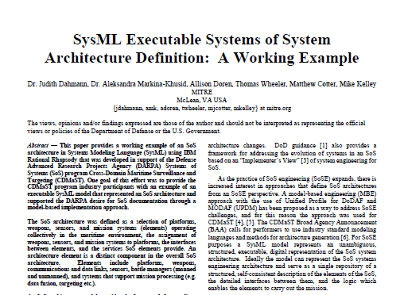
Model-Based SoSE
For SoSE purposes, SysML model represents an unambiguous, structured, executable, digital representation of the SoS system architecture
“SysML Executable Systems of Systems Architecture Definition: A Working Example”
IEEE International Systems Conference
http://2017.ieeesyscon.org/

Slide 11
Model-Based SoSE
Why is this important for mission engineering?
The systems composed into an SoS architecture to support a mission are typically drawn from a variety of specialty areas (sensors, weapons, platforms, communications) and diverse organizations which bring various perspectives to the mission
  Specificity provided by models can help avoid misunderstandings about system behavior, system interactions/interfaces (Have I addressed all the needed interfaces to execute the end to end sequence of actions? Value of executable)
A model allows for representation of the complexity of the interrelations among systems in the mission, reflecting the variety of paths in the ‘mission web’
It is important to have a commonly understood representation providing both the mission engineer and the constituent systems engineers a cross cutting integrated view across the systems and how they are expected to be employed in a mission context
  Value of standards-based modeling approaches
For SoSE purposes, SysML model represents an unambiguous, structured, executable, digital representation of the SoS system architecture, including…
SysML Executable Systems of Systems Architecture Definition: A Working Example
IEEE International Systems Conference
http://2017.ieeesyscon.org/

Slide 12
Scalable Model-Based SoSE
See NDIA paper XYZ for technical details
A key enabler of model-based SoSE is the ability to efficiently develop large complex SoS architecture model
  The effort required to build SoS architecture models can be reduced by starting the modeling process with a reusable base model template, independently of the architecture size
  Tools can facilitate integration of SoS connectivity information into MBE tools, tightening the coupling between subject matter experts (SMEs), software engineers, and analysts -- comma separated variable (CSV) importer tool
Reusable Base Model
CSV Importer

Slide 13
Scalable Model-Based SoSE
See NDIA paper 19804 for technical details
A key enabler of model-based SoSE is the ability to efficiently develop large complex SoS architecture model
Why is this important for mission engineering?
Missions can be large and comprise many systems, and the time required to develop a model framework for each mission architecture can raise the cost of entry for use of models to support mission engineering
Gathering the needed data to understand the current state of a large mission can be difficult given the diversity of knowledgeable mission stakeholders.
  Providing intuitive tools to allow stakeholders to share knowledge in a way familiar to them can build confidence and speed knowledge gathering
  Automated transform directly into a model again lowers the cost of entry for large mission architecture, and reduces likelihood of errors or misunderstandings
  The effort required to build SoS architecture models can be reduced by starting the modeling process with a reusable base model template, independently of the architecture size
  Tools can facilitate integration of SoS connectivity information into MBE tools, tightening the coupling between subject matter experts (SMEs), software engineers, and analysts -- comma separated variable (CSV) importer tool
Reusable Base Model
CSV Importer

Slide 14
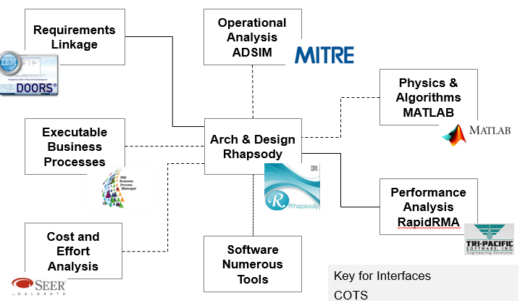
Analytic Approaches to SoS Architecture Assessment
(1 of 2)
Representing SoS architecture in a model opens the options for analysis
  Interfacing a SoS model with other tools to assess performance, cost, other aspects of the SoS, provides a shared representation of the architectures for analysis from different perspectives
  Developing approaches to assess alternative architectures is a challenge for the perspective of scalability
  How do you identify viable options for more detailed analysis when there is such a large trade space?

Slide 15
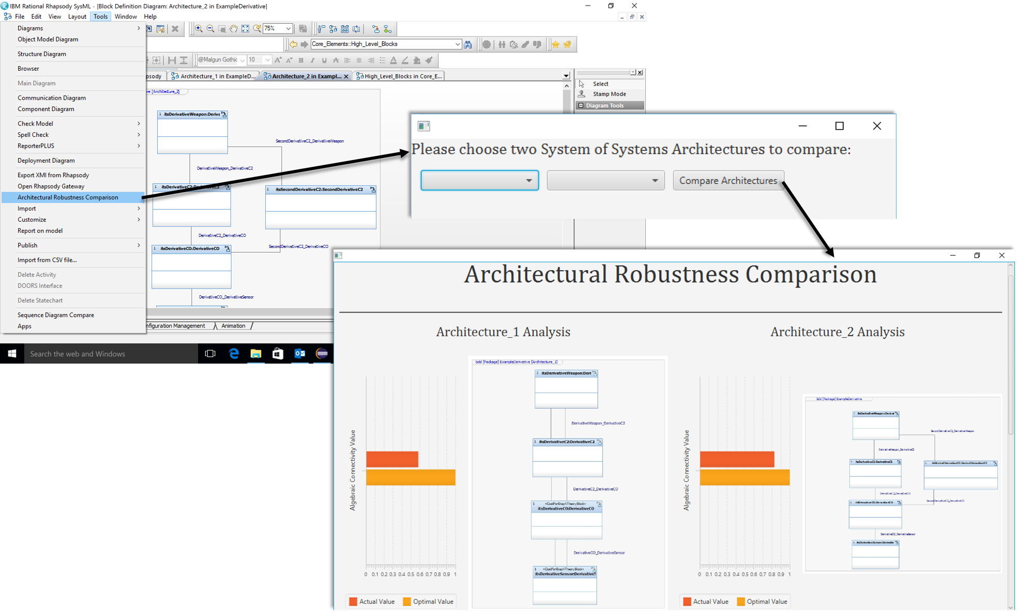
Analytic Approaches to SoS Architecture Assessment (2 of 2)
Use of architecture data in a graph theoretic analysis
See NDIA paper 19802 for technical details
Notes:
We have been looking at computationally light, objective measures that take into account only the structure of SoS architecture alternatives – not performance, and no subjective input. This allows us to recommend certain architectures for further, higher-fidelity analysis, which is more labor-intensive and computationally intensive. The graph theoretic measures are attractive because SysML representations of architectures are easy to convert to graph/matrix representations, so MBE gets immediate use beyond pure documentation.

Slide 16
Analytic Approaches to SoS Architecture Assessment
Use of architecture data in a graph theoretic analysis
Why is this important for mission engineering?
Scale and complexity of missions require trades across multiple metrics and many solution options
Lightweight analytic tools leverage architecture data to enable an initial quantification of mission impacts due to architecture changes
This initial analysis can be used to filter out undesirable architecture options prior to investing resources to assess options with more detailed modeling and simulation tools
See NDIA paper XYZ for technical details

Slide 17
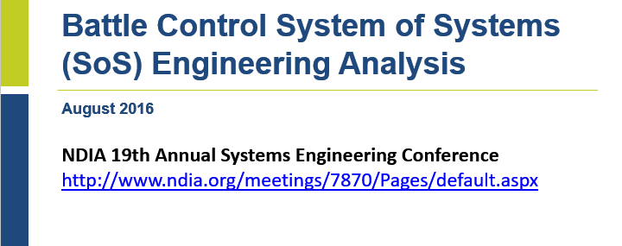
Linking SoS Architecture to Operational Outcomes
Effectiveness of SoS for missions is based on mission outcomes
  SE analysis of SoS for missions addresses the technical feasibility of the SoS options
  Analyzing alternative SoS architectures or specific SoS compositions also needs to consider the impact on mission outcomes, typically addressed in operational simulations or test environments
  This includes developing automated interfaces between architecture models and operational simulations, allowing for analysis of the effectiveness of the SoS in representation scenarios, following proposed concepts of employment
  Examples include Rhapsody to ADSIM, more recently to AFSIM

Slide 18
Linking SoS Architecture to Operational Outcomes
Effectiveness of SoS for missions is based on mission outcomes
  SE analysis of SoS for missions addresses the technical feasibility of the SoS options
  Analyzing alternative SoS architectures or specific SoS compositions also needs to consider the impact on mission outcomes, typically addressed in operational simulations or test environments
  This includes developing automated interfaces between architecture models and operational simulations, allowing for analysis of the effectiveness of the SoS in representation scenarios, following proposed concepts of employment
  Examples include Rhapsody to ADSIM, more recently to AFSIM
Why is this important for mission engineering?
Mission engineering is all about achieving user operational capability
Ensuring technical feasibility is an important prerequisite – it is key that systems work together as planned based on engineering across the systems supporting the mission
But it is key that the mission SoS composition is fit for purpose in the mission environment – physical, threat, etc. – and when executed leads to the expected mission outcomes under anticipated conditions
Mission SoS architectures can be complex, and it can be time consuming and error prone to have to manually instantiate these in today’s operational simulations
Automating this facilitates the conduct of the analysis of the mission effect or proposed or alternative SoS compositions, and it allows operators and commanders to see the proposed composition in their operation context

Slide 19
Summary
Mission engineering is an application of SoSE with specific driving characteristics
As SoSE technical approaches and tools evolve, they provide valuable capabilities to enable technically based approaches to addressing mission engineering challenges

Slide 20
Abstract
In the US Department of Defense there is increased interest in mission engineering - the deliberate planning, analyzing, organizing, and integrating of current and emerging operational and system capabilities to achieve desired warfighting mission effects. The Components have implemented mission engineering in areas where there is a critical interest in achieving mission capability such as ballistic missile defense or naval mission areas, and there is growing interest in addressing a broad set of mission areas through the implementation of mission integration management - the coordination all the programmatic elements - matching funding, schedules, technical improvements, resources (technical staff, development and test infrastructure, M&S etc.) across the relevant mission systems and supporting systems to develop, test, and field a phased set of mission capabilities. One element of this is engineering of the systems of systems supporting the mission area.
This presentation outlines the key activities involved in mission engineering and describes opportunities for application of systems of systems engineering technical approaches to these activities to provide the engineering base for mission integration and mission management. In particular, mission engineering often emphasizes the definition of the key activities need to execute the mission in the form of mission threads or kill/effects chains and assessing gaps in mission performance. Less attention has been paid to the various patterns of mission activities and the engineering required to identify and assess alternatives to addressing the gaps and engineering the SoS to implement the preferred approach. Drawing on work within the MITRE Systems Engineering Technical Center’s model based engineering center, this presentation will present approaches to developing, representing and evaluating systems of systems architectures using model based methods and evaluating SoS configurations to address the functional needs of the mission which provide a set of approaches to supporting mission engineering.

