Slide 1
DoD Digital Engineering Strategy
Ms. Philomena Zimmerman
Deputy Director, Engineering Tools and Environments
Office of the Deputy Assistant Secretary of Defense
for Systems Engineering
20th Annual NDIA Systems Engineering Conference
Springfield, VA | October 25, 2017

Slide 2
Digital Engineering Overview
Background
  Dynamic operational and threat environments
  Growth in system complexity and risks
  Linear acquisition process that lacks agility
  Cost overruns and delayed delivery of capabilities to the warfighter
  Current practices can’t keep pace with innovation and technology advancements
Need
  Outpace rapidly changing threats and technological advancements
  Deliver advanced capabilities more quickly and affordably with improved sustainability to the warfighter
  Foster a culture of innovation
Digital Engineering: An integrated digital approach that uses authoritative sources of systems' data and models as a continuum across disciplines to support lifecycle activities from concept through disposal.
Digital Engineering transforms the way the DoD innovates and operates
Notes:
Background:
Our workforce uses stove-piped infrastructure, environments and data sources in isolation to support various activities throughout the life-cycle
Communication, collaboration and decisions are through static disconnected documents and subject to interpretation
AT&L reorg
Chief Technology Officer, organization responsible for outpacing the threat and seizing on technological opportunities
Foster a culture of innovation within the Department
Deliver proven technology to the Warfighter more quickly and affordably with improved sustainability.
Primary sources of technical expertise using our unique talents and skills. Innovative thinking and problem solving will be critical for both USDs if we're going to be responsive to warfighter needs and continue to improve.

Slide 3
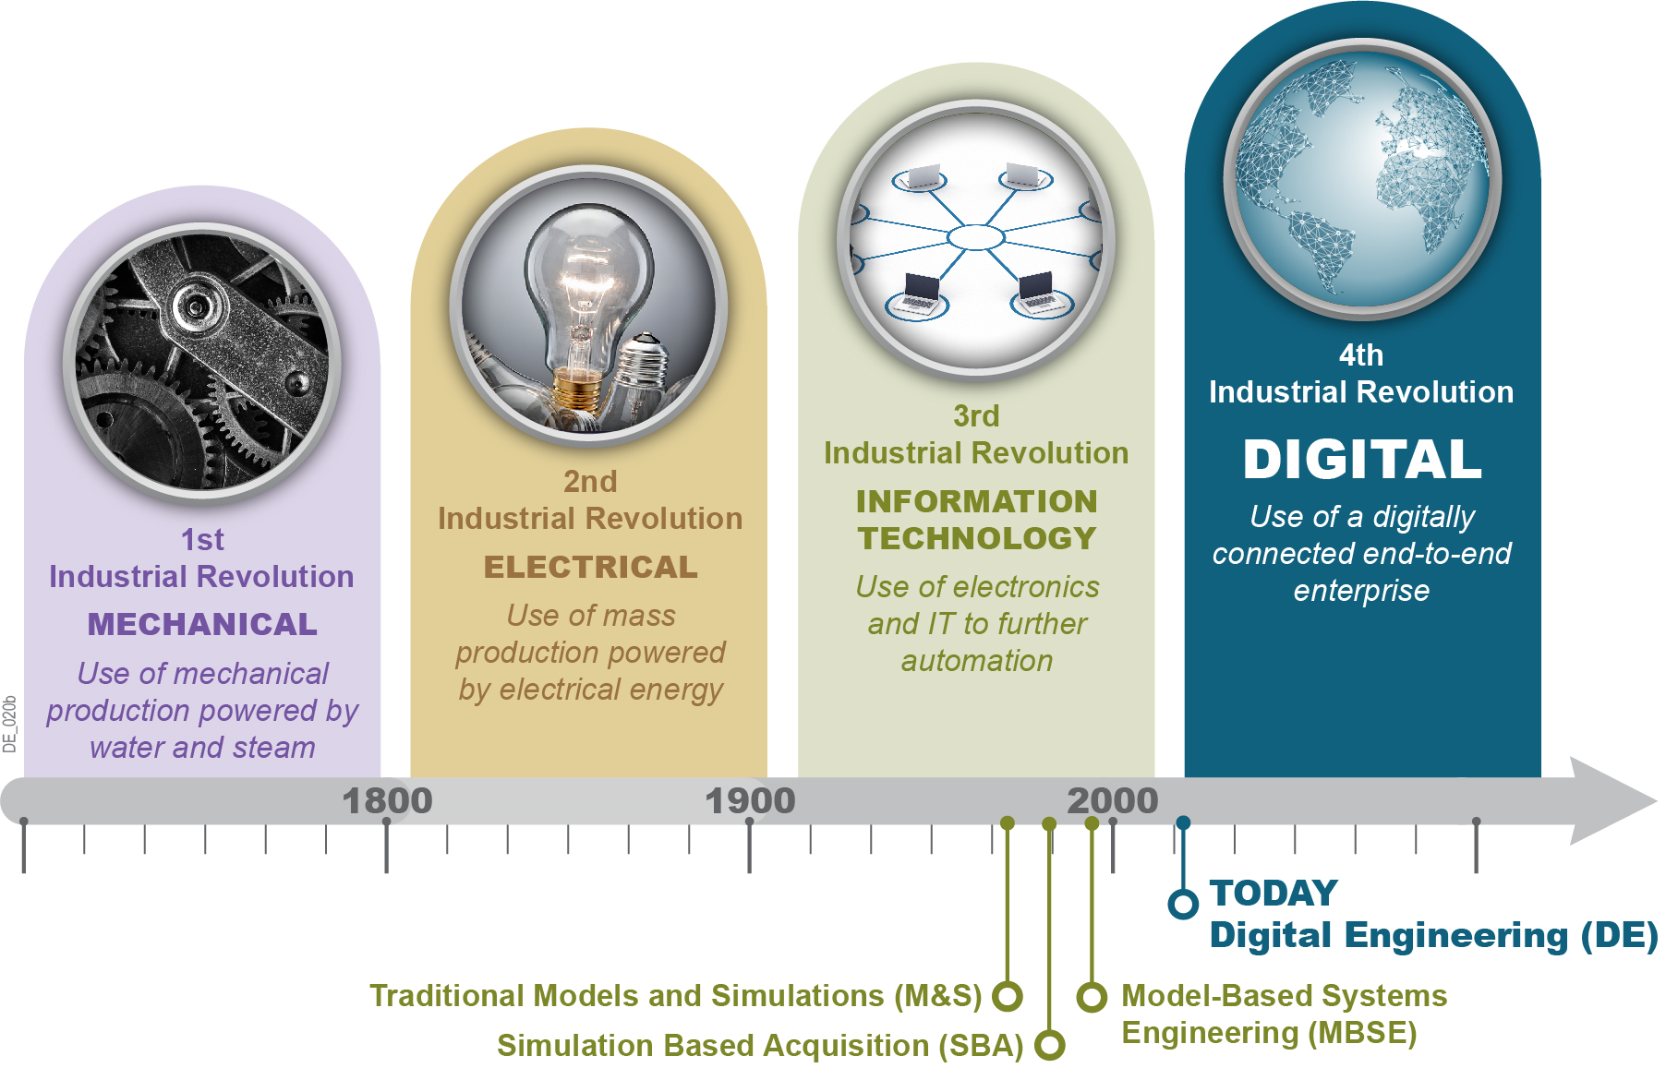
History
Notes:
1st: The first industrial revolution introduced machines into the production process. This included the use of mechanical production powered by water and steam.
2nd: By the 2nd Industrial Revolution, mass production was introduced and the electrification largely contributed to the success of this era.
3rd: The 3rd Industrial Revolution resulted from the introduction of the computer and information technology.
4th: We are entering an era of the 4th industrial revolution, in which digitalization reshapes the way that we innovate and operate.
SBA: the challenges are the same as in MBSE – but the focus on simulation was misleading and confusing
The DoD’s model and simulation initiatives have laid the foundation and evolved to Digital Engineering, which is an emerging DoD initiative that incorporates technological innovation into an integrated digital model-based approach to transform the state of engineering practice in support lifecycle activities.
Reference—the 4th industrial revolution (also referred to as “Industrie 4.0” by a group of representatives from different fields (such as business, politics, and academia) under an initiative to enhance the German competitiveness in the manufacturing industry. The German federal government adopted the idea in its High-Tech Strategy for 2020)

Slide 4
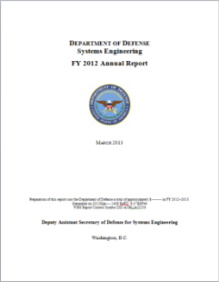
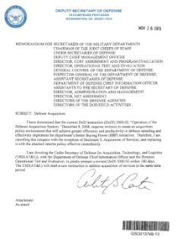




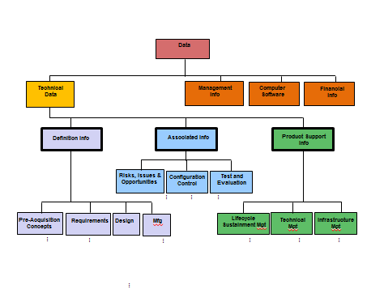




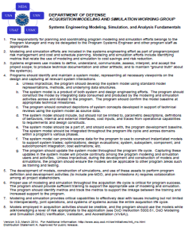
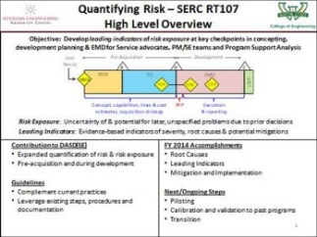
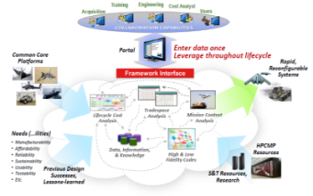



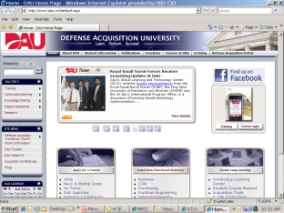



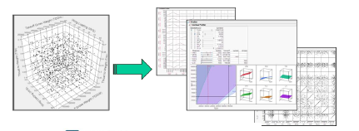
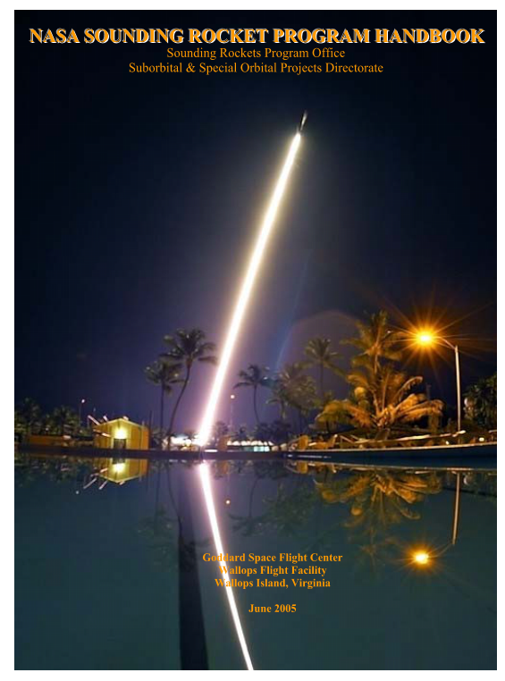






Leveraging Multiple Activities
Infusion in Policy & Guidance
ODASD(SE) Initiatives
Partnerships
http://www.acq.osd.mil/se/pg/guidance.html
Armed Services
DoDI 5000.02, Enclosure 3, Section 9: Modeling and Simulation
Digital Engineering Working Group
DoD Digital Engineering Working Group (DEWG)
Digital Engineering Strategy
DoD Components
Defense Acquisition Guidebook Chapter 3
Digital System Model (DSM) Taxonomy: Defining categories of data across acquisition
DoD Digital Engineering Fundamentals
Interagency
System Engineering Research Center (SERC): Model Centric Research
Defense Acquisition University
Engineered Resilient Systems: Adapting to changing requirements
Industry/OEMs/ Industrial Orgs
NASA – National Aeronautics and Space Administration
NNSA – National Nuclear Security Administration
NDIA – National Defense Industrial Association
INCOSE – International Council on Systems Engineering
AIA – Aerospace Industries Association
AIAA – American Institute of Aeronautics and Astronautics
OEMs – Original Equipment Manufacturers
High Performance Computing Modernization Program (HPCMP) Computational Research and Engineering Acquisition Tools and Environments (CREATE) : Physics Based Modeling
Academic
NASA: Sounding Rocket Program
Advancing the state of practice for Digital Engineering
Notes:
The Department is leveraging multiple activities to advance the state of Digital Engineering. There is evidence across the Services and industry has affirmed digital engineering as a contemporary
approach to advance defense acquisition engineering in an environment of increasing global challenges. We are infusing DE language in policy and guidance, leveraging DOD initiatives,
partnering with Services, industry and professional associations to advance the state of Digital Engineering.

Slide 5
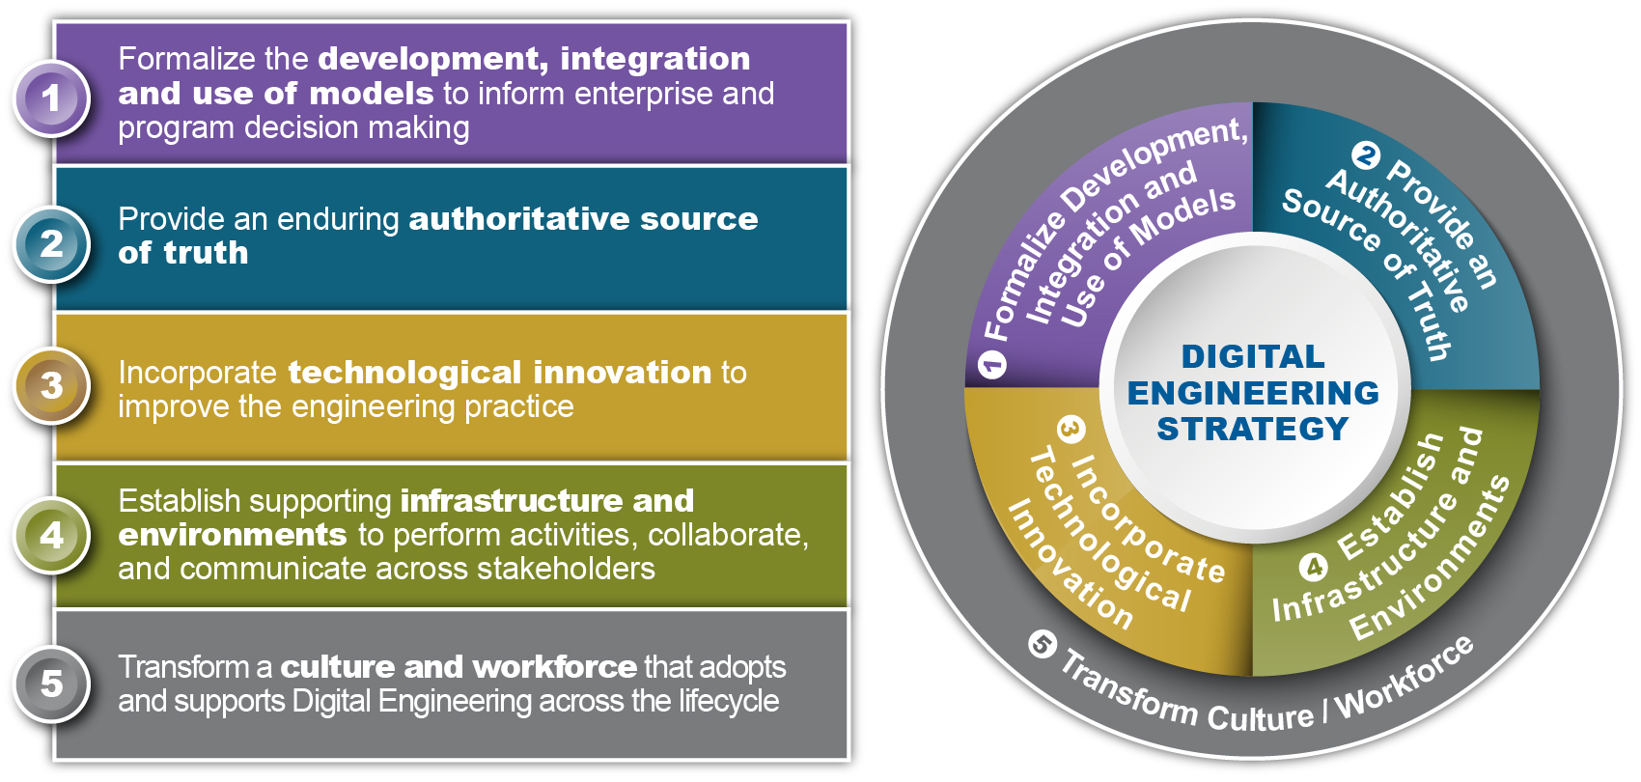
Digital Engineering Strategy:
Five Goals
Drives the engineering practice towards improved agility, quality, and efficiency, which results in improvements in acquisition
Notes:
Model is different from simulation
Model is data, process and/or algorithm
Formalize the development, integration and use of models to inform enterprise and program decision making. The first goal establishes the use of federated models as an integral part of planning, engineering, and eventually acquisition activities. This will support consistent analysis and decision making throughout all activities in the lifecycle for programs and across the enterprise.
Provide an enduring authoritative source of truth. This goal moves the primary means of communication from documents to digital models. This enables access, management, evolution, analysis use and distribution of information from a common set of digital models. As a result, authorized stakeholders have access to current authoritative, consistent digital models and data over the lifecycle of each program.
Incorporate technological innovation to improve the engineering practice. This goal extends beyond the traditional model-based approaches to incorporate advancements in technology. These advancements provide revolutionary capabilities that will transform engineering activities and enable a digitally connected end-to-end enterprise to realize warfighting capability.
Establish a supporting infrastructure and environment to perform activities, collaborate and communicate across stakeholders. This goal ensures the establishment of a robust infrastructure and environment to support the Digital Engineering artifacts products and goals. It incorporates advanced MPTs, as well as collaborative trusted systems that enforces protection of intellectual property and cybersecurity. In addition, the infrastructure and environment will be reinforced by policy, guidance, and standards that will be communicated across all stakeholders.
Transform a culture and workforce that adopts and supports Digital Engineering across the lifecycle. The final goal takes a systematic approach based on change management and strategic communications’ best practices to lead the change, and support the organization’s culture and workforces’ transition to and adoption of Digital Engineering.

Slide 6
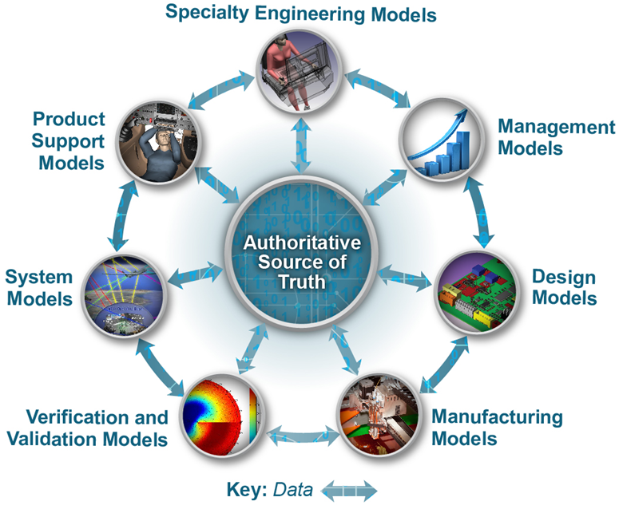
Goal #1: Formalize Development, Integration & Use of Models
Models as the cohesive element across a system’s lifecycle
Notes:
As Is:
Models are developed on an ad hoc basis
Models are not used across domains, acquisition phases or across programs
To Be:
Formalizes the practice of using digital models as a continuum
Discipline-specific models and data capture different aspects throughout the system’s lifespan
Models are used to connect data across all stages to support program and enterprise decisions
Benefits:
Enables prototyping, experimenting, and testing of solutions virtually before physical prototypes and full scale systems are available
Reduces cycle time
Shifts decisions left and provides early and continuous verification and validation
Provides a shared understanding
Enhances historical knowledge capture and reusability

Slide 7
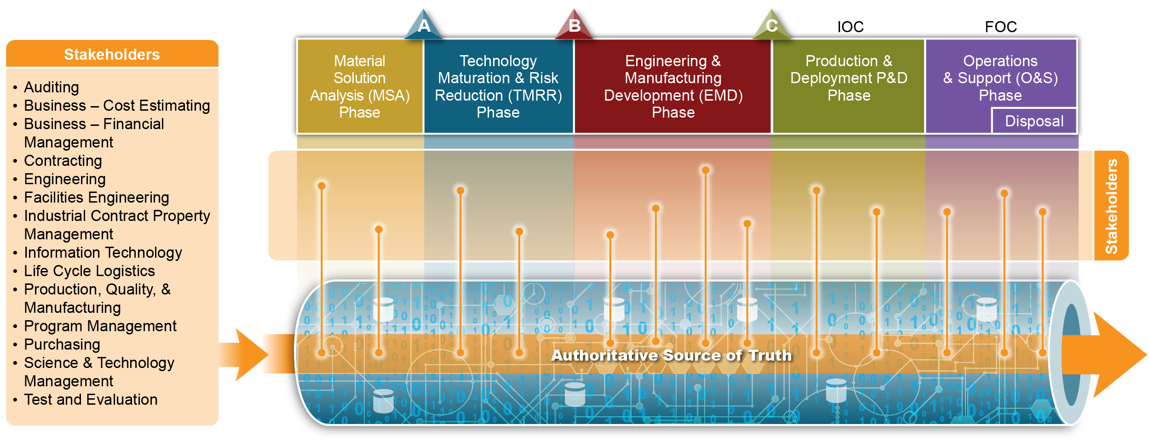
Goal #2: Provide an Authoritative Source of Truth
Right information, right people, right uses, right time
Notes:
As Is:
Data are scattered across multiple stove-piped systems in a variety of formats
Documents are the primary means of communication
Intensive manual process to piecemeal together the data and artifacts
To Be:
Data are accessed, managed, analyzed, used and distributed from the authoritative source
- Assembled from a federation of digital models and data sources
- Automatically generates digital artifacts (e.g., executable simulations, code, error-checked documents and contract deliverables)
Benefits:
Provides access to the same, up-to-date, and consistent data
Ensures consistency and traceability Impacts to changes are automatically propagated
Automates digital artifacts
Reduces manual hand-offs, finding right information, and manual review processes

Slide 8
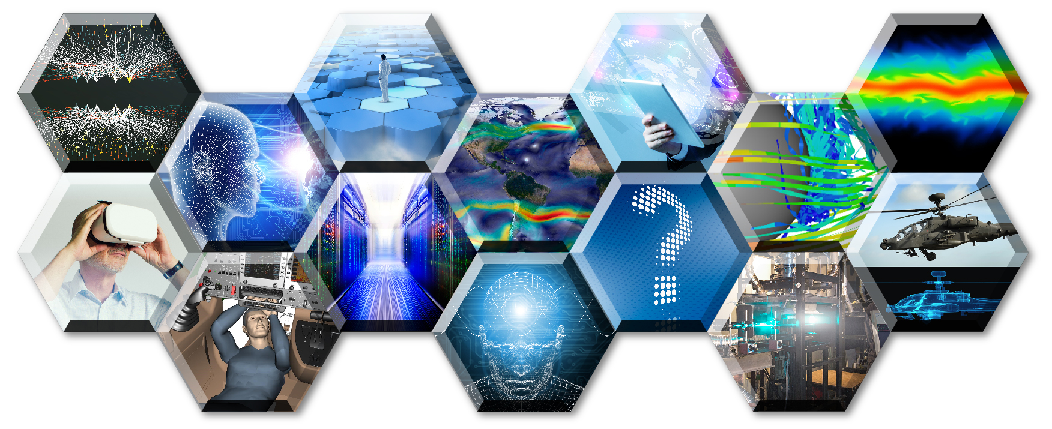
Goal #3: Incorporate
Technological Innovation
Big Data and Analytics
Cognitive Technologies
Computing Technologies
Digital-to-Physical Fusion Technologies
Harness technology, new approaches, and human-machine collaboration to enable an end-to-end digital enterprise
Notes:
Goal 3: Incorporate Technological Innovation
As Is:
Can’t keep pace with technology or changing needs
Pockets of the acquisition process are digital
To Be:
Digitally connected end-to-end enterprise for all elements of the acquisition process
Incorporates technology innovations (Big Data and Analytics, Cognitive Technologies, Computing Technologies and Digital-to-Physical Fusion Technologies)
Benefits:
Improve the engineering practice
Gain greater value from the data to drive decisions and the best course of action
Let humans to do what they do best and machines do best
Powerful machines to process, store and exchange data and to computationally solve problems
Optimizes design, development, delivery, operation, and sustainment complex systems
Big Data and Analytics: Big Data provides the ability to analyze massive and complex datasets containing a variety of data types from a multitude of sources (e.g., computers, mobile devices, sensing technologies). By processing searching, and discovering patterns in massive amounts of data, leaders can gain greater value from the data to drive decisions and actions. This process is referred to as analytics, which makes use of the data to support decision making by providing deeper insights into what happened (descriptive analytics), why something happened (diagnostic analytics), predicting what can happen (predictive analytics), and exploring the best course of action among various alternatives (prescriptive analytics).
Cognitive Technologies: Cognitive analytics and technologies are the next frontier of innovations that apply human like intelligence through a wide range of innovations. These include but are not limited to: artificial intelligence (to include deep learning and machine learning), semantics, speech, voice, image recognition, natural language processing and translation to automate or augment human decisions and actions. These technologies are at the core of autonomous learning systems, human-machine collaborative decision making, assisted human operations, advanced manned-unmanned system operations, and network-enabled and autonomous weapons that can operate in a future cyber/electronic warfare environment.
Computing Technologies: New frontiers have been forged to significantly improve the effectiveness and efficiency of the infrastructure and environments. The increase in the power and speed of machines, storage, and network connectivity spawned innovations in computing technologies to include: high performance computing, advanced networking, storage, and cybersecurity technologies.
Digital-to-Physical Fusion Technologies: These technologies (e.g., Digital Twin, 3-D printing, visualization, virtualization, augmented reality) will link the virtual and physical world. The expectation is that a digital models of the physical asset are created in the virtual environment. This digital copy of the physical world enables prototyping, experimenting, and testing out solutions virtually before they are delivered to the warfighter. The physical asset then ties back (e.g., through physical devices to include sensors and remote monitoring technologies) to the digital models that represent the system of interest.
Goal 4: Establish Infrastructure and Environments
As Is:
There is a wide range of organization-specific infrastructures and environments that are implemented on a program by program basis
Current solutions do not fully support the complexity of solutions being developed
To Be:
Consolidated collaborative trusted and secure environments
Delivers advanced capabilities that keep pace with technology, enhances cybersecurity and intellectual property protections, and improves information sharing across stakeholders
Benefits:
Provides the infrastructure and environments to enable the Digital Engineering goals
Goal 5: Transform Culture and Workforce
As Is:
Traditional acquisition culture
Driven in part by public law, regulation, policy, and guidance
The workforce operates in a stove-piped manner
To Be:
Institutionalize Digital Engineering across the DoD, industry and academia
Workforce operates in a collaborative, integrated, digital model-based environment
Benefits:
Takes a deliberate and systematic approach to plan, implement, and support the transformation
Effective transformation efforts depend on acquisition culture
Improve organizational and workforce readiness through key enablers

Slide 9
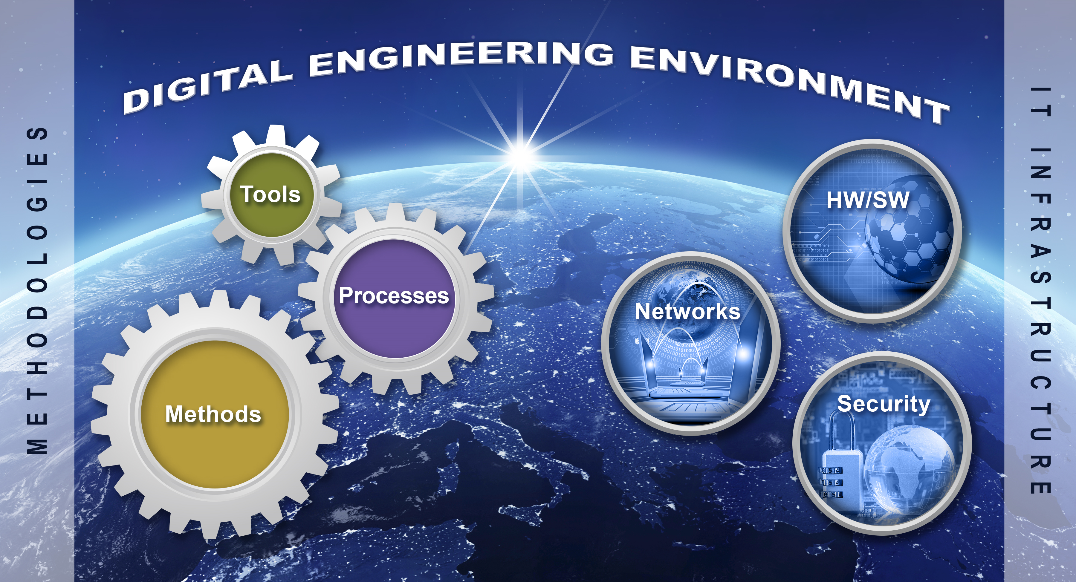
Goal #4: Establish Infrastructure & Environments
Foundational support for Digital Engineering environments
Notes:
Goal 3: Incorporate Technological Innovation
As Is:
Can’t keep pace with technology or changing needs
Pockets of the acquisition process are digital
To Be:
Digitally connected end-to-end enterprise for all elements of the acquisition process
Incorporates technology innovations (Big Data and Analytics, Cognitive Technologies, Computing Technologies and Digital-to-Physical Fusion Technologies)
Benefits:
Improve the engineering practice
Gain greater value from the data to drive decisions and the best course of action
Let humans to do what they do best and machines do best
Powerful machines to process, store and exchange data and to computationally solve problems
Optimizes design, development, delivery, operation, and sustainment complex systems
Big Data and Analytics: Big Data provides the ability to analyze massive and complex datasets containing a variety of data types from a multitude of sources (e.g., computers, mobile devices, sensing technologies). By processing searching, and discovering patterns in massive amounts of data, leaders can gain greater value from the data to drive decisions and actions. This process is referred to as analytics, which makes use of the data to support decision making by providing deeper insights into what happened (descriptive analytics), why something happened (diagnostic analytics), predicting what can happen (predictive analytics), and exploring the best course of action among various alternatives (prescriptive analytics).
Cognitive Technologies: Cognitive analytics and technologies are the next frontier of innovations that apply human like intelligence through a wide range of innovations. These include but are not limited to: artificial intelligence (to include deep learning and machine learning), semantics, speech, voice, image recognition, natural language processing and translation to automate or augment human decisions and actions. These technologies are at the core of autonomous learning systems, human-machine collaborative decision making, assisted human operations, advanced manned-unmanned system operations, and network-enabled and autonomous weapons that can operate in a future cyber/electronic warfare environment.
Computing Technologies: New frontiers have been forged to significantly improve the effectiveness and efficiency of the infrastructure and environments. The increase in the power and speed of machines, storage, and network connectivity spawned innovations in computing technologies to include: high performance computing, advanced networking, storage, and cybersecurity technologies.
Digital-to-Physical Fusion Technologies: These technologies (e.g., Digital Twin, 3-D printing, visualization, virtualization, augmented reality) will link the virtual and physical world. The expectation is that a digital models of the physical asset are created in the virtual environment. This digital copy of the physical world enables prototyping, experimenting, and testing out solutions virtually before they are delivered to the warfighter. The physical asset then ties back (e.g., through physical devices to include sensors and remote monitoring technologies) to the digital models that represent the system of interest.
Goal 4: Establish Infrastructure and Environments
As Is:
There is a wide range of organization-specific infrastructures and environments that are implemented on a program by program basis
Current solutions do not fully support the complexity of solutions being developed
To Be:
Consolidated collaborative trusted and secure environments
Delivers advanced capabilities that keep pace with technology, enhances cybersecurity and intellectual property protections, and improves information sharing across stakeholders
Benefits:
Provides the infrastructure and environments to enable the Digital Engineering goals
Goal 5: Transform Culture and Workforce
As Is:
Traditional acquisition culture
Driven in part by public law, regulation, policy, and guidance
The workforce operates in a stove-piped manner
To Be:
Institutionalize Digital Engineering across the DoD, industry and academia
Workforce operates in a collaborative, integrated, digital model-based environment
Benefits:
Takes a deliberate and systematic approach to plan, implement, and support the transformation
Effective transformation efforts depend on acquisition culture
Improve organizational and workforce readiness through key enablers

Slide 10
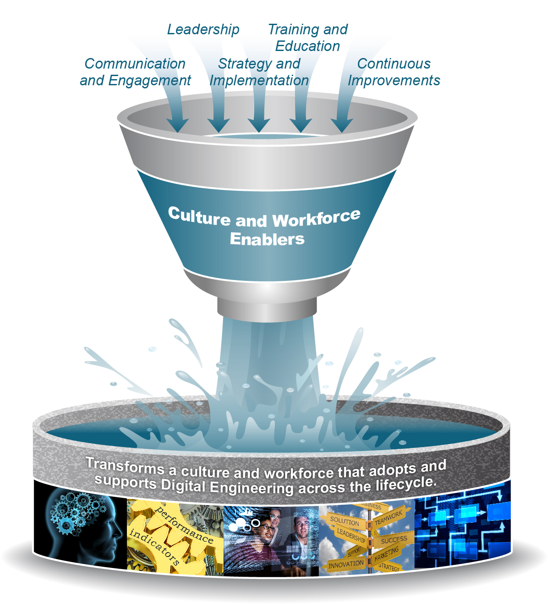
Goals #5: Transform Culture and Workforce
Institutionalize Digital Engineering across the acquisition enterprise
Notes:
Goal 3: Incorporate Technological Innovation
As Is:
Can’t keep pace with technology or changing needs
Pockets of the acquisition process are digital
To Be:
Digitally connected end-to-end enterprise for all elements of the acquisition process
Incorporates technology innovations (Big Data and Analytics, Cognitive Technologies, Computing Technologies and Digital-to-Physical Fusion Technologies)
Benefits:
Improve the engineering practice
Gain greater value from the data to drive decisions and the best course of action
Let humans to do what they do best and machines do best
Powerful machines to process, store and exchange data and to computationally solve problems
Optimizes design, development, delivery, operation, and sustainment complex systems
Big Data and Analytics: Big Data provides the ability to analyze massive and complex datasets containing a variety of data types from a multitude of sources (e.g., computers, mobile devices, sensing technologies). By processing searching, and discovering patterns in massive amounts of data, leaders can gain greater value from the data to drive decisions and actions. This process is referred to as analytics, which makes use of the data to support decision making by providing deeper insights into what happened (descriptive analytics), why something happened (diagnostic analytics), predicting what can happen (predictive analytics), and exploring the best course of action among various alternatives (prescriptive analytics).
Cognitive Technologies: Cognitive analytics and technologies are the next frontier of innovations that apply human like intelligence through a wide range of innovations. These include but are not limited to: artificial intelligence (to include deep learning and machine learning), semantics, speech, voice, image recognition, natural language processing and translation to automate or augment human decisions and actions. These technologies are at the core of autonomous learning systems, human-machine collaborative decision making, assisted human operations, advanced manned-unmanned system operations, and network-enabled and autonomous weapons that can operate in a future cyber/electronic warfare environment.
Computing Technologies: New frontiers have been forged to significantly improve the effectiveness and efficiency of the infrastructure and environments. The increase in the power and speed of machines, storage, and network connectivity spawned innovations in computing technologies to include: high performance computing, advanced networking, storage, and cybersecurity technologies.
Digital-to-Physical Fusion Technologies: These technologies (e.g., Digital Twin, 3-D printing, visualization, virtualization, augmented reality) will link the virtual and physical world. The expectation is that a digital models of the physical asset are created in the virtual environment. This digital copy of the physical world enables prototyping, experimenting, and testing out solutions virtually before they are delivered to the warfighter. The physical asset then ties back (e.g., through physical devices to include sensors and remote monitoring technologies) to the digital models that represent the system of interest.
Goal 4: Establish Infrastructure and Environments
As Is:
There is a wide range of organization-specific infrastructures and environments that are implemented on a program by program basis
Current solutions do not fully support the complexity of solutions being developed
To Be:
Consolidated collaborative trusted and secure environments
Delivers advanced capabilities that keep pace with technology, enhances cybersecurity and intellectual property protections, and improves information sharing across stakeholders
Benefits:
Provides the infrastructure and environments to enable the Digital Engineering goals
Goal 5: Transform Culture and Workforce
As Is:
Traditional acquisition culture
Driven in part by public law, regulation, policy, and guidance
The workforce operates in a stove-piped manner
To Be:
Institutionalize Digital Engineering across the DoD, industry and academia
Workforce operates in a collaborative, integrated, digital model-based environment
Benefits:
Takes a deliberate and systematic approach to plan, implement, and support the transformation
Effective transformation efforts depend on acquisition culture
Improve organizational and workforce readiness through key enablers

Slide 11
Expectations & Big Rocks
Digital Engineering Expectations
Informed decision making/greater insight through increased transparency
Enhanced communication
Increased understanding for greater flexibility/adaptability in design
Increased confidence that the capability will perform as expected
Increased efficiency in engineering and acquisition practices
Digital Engineering Big Rocks
Investments
Culture and workforce
Policy, guidance, contracting
Governance
Security
Intellectual property protection
Tool/model portability
Infrastructure and environments
Model quality and assurance
From Inter-Agency Working Group: Model-Based System Engineering (MBSE) Infusion Task Team, "Digital Model-based Engineering: Expectations, Prerequisites, and Challenges of Infusion," 2017
Synthesized from Digital Engineering Working Group; National Defense Industrial Association Model-Based Engineering Report, Aerospace Industries Association Model-based Engineering reports
Coordinating with the Services/Agencies to develop and implement Digital Engineering strategy
Notes:
DE Expectations are excerpts from Inter-Agency Working Group: Model-Based System Engineering (MBSE) Infusion Task Team, "Digital Model-based Engineering: Expectations, Prerequisites, and Challenges of Infusion," 2017
Big Rocks or Common Challenges synthesized from DEWG, NDIA, AIA MBSE studies and reports
Big Rocks Resources
DMbE: Expectations, Prerequisites, and Challenges of Infusion, Model-Based Systems Engineering Infusion Task Team
MBSE Guidance for Government Acquired Programs, Aerospace
Final Report: Model Based Engineering Subcommittee, NDIA SE Division M&S Committee
Life Cycle Benefits of Collaborative MBSE Use for Early Requirements Development, AIA

Slide 12
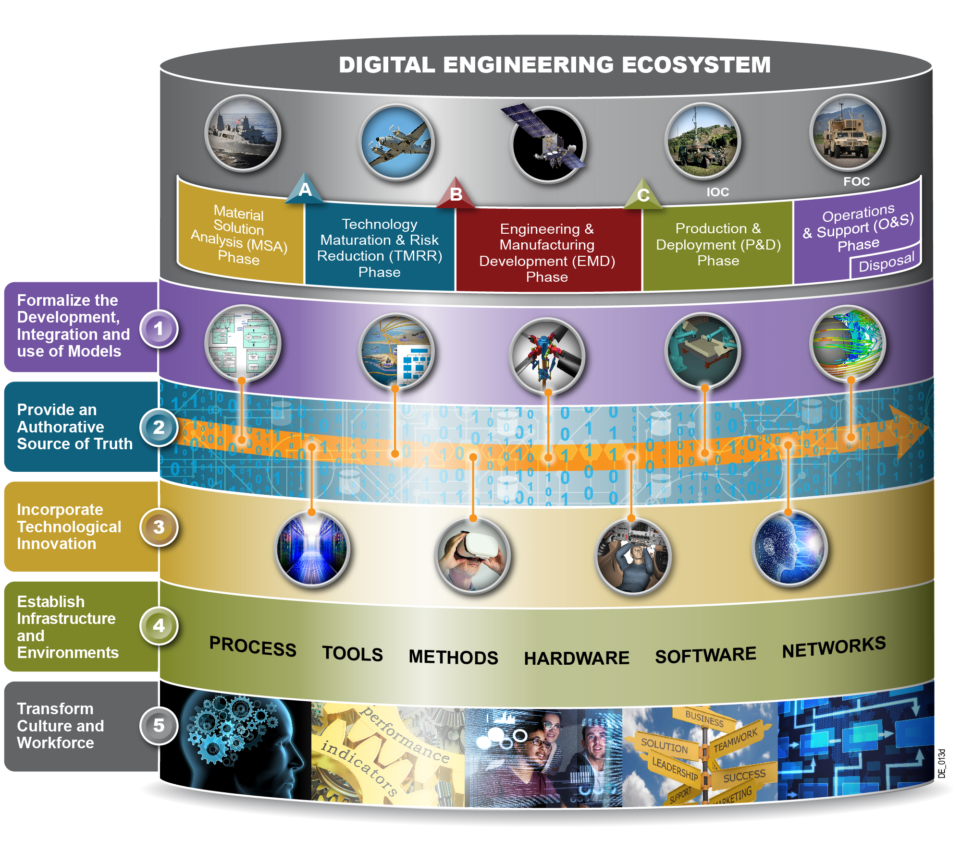
A Holistic View of
Digital Engineering Ecosystem
DoD is shifting towards a Digital Engineering ecosystem that will transform the culture, people, technology, and environments
Notes:
DoD is shifting towards a Digital Engineering ecosystem that will transform the culture, people, technology, infrastructure, and environments (to include MPTs).
Digital Engineering is DoD’s initiative to transform the way it designs and delivers complex systems in a formidable and changing threat and mission environment
Digital Engineering is “an integrated digital approach that uses authoritative sources of systems’ data and models as a continuum across disciplines to support lifecycle activities from concept through disposal.”
5 Goals explained on the next slide
DE Expectations (Taken from IAWG paper)
Informed decision making/greater insight through increased transparency
Enhanced communication
Increased understanding for greater flexibility/adaptability in design
Increased confidence that the capability will perform as expected
Increased efficiency in engineering and acquisition practices
Explicitly define what we mean by model, data, DSM Digital Thread, Digital Twin, Ecosystem, Artifact and the relationship between Digital Engineering and MBSE

Slide 13
There Is Much More to Do…
Publish the Digital Engineering Strategy
  Support development of implementation guidance/direction in Services/Agencies
Engage with Acquisition Programs
  Establish criteria for use of Digital Engineering artifacts for decision points
Update Competencies across Acquisition Curricula
  Identify education and training outside of acquisition curricula
Update Policy and Guidance (Engineering, et al)
  Develop/update governance processes, policy, guidance and contracting language
Transform Acquisition Practice
  Engage acquisition users and incorporate rigor into Digital Engineering practices across the lifecycle
Notes:
Indication in the FY18 NDAA that MBE will play a major role in the use of technical analyses and engineering support to address acquisition challenges and program support.
Digital Engineering Starter Kit: DSM Data Taxonomy, a Readme file for using the DSM, Digital Engineering Fundamentals, and the link to the Digital Engineering Initiative webpage http://www.acq.osd.mil/se/initiatives/init_de.html. The starter kit provides foundational information and a construct for capturing program data.
CLE011 Models, Simulations, and Digital Engineering in Systems Engineering. Pilot released for deployment the week of August 7th, there are 97 (government/industry) individual schedule to participate.
Informal request from MPS to include Digital Engineering language in the SEP Outline

Slide 14
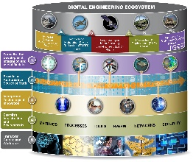

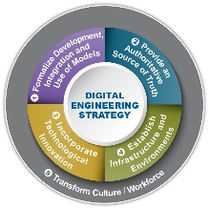
Digital Engineering Road Map
Institutionalization
7
Sustain the change
Adaptation
Expand roll-out of change in engineering and acquisition practices
Internalization
6
We are here
5
Initial Use
Develop governance, policy & guidance to Instantiate into use
Understanding
4
MATURITY
3
Conduct pilot programs(i.e. initial operational environment); engage programs
Foster understanding within organic workforce(training, pilot programs, etc.)
2
Promote organizational awareness (e.g. conferences, journals/articles, working groups, etc.)
Awareness
1
Initiation
TIME

Slide 15
Digital Engineering Transition
Across DoD
Transition Digital Engineering into Acquisition Use
December 2019
Update Competence in Acquisition Curricula
October 2017
DE Assessments on Programs
June 2018
Develop DE Education & Training (CLE011)
November 2016
Update Policy & Guidance
June 2018
Digital Engineering Strategy
(Document)
December 2017
DE Starter Kit
June 2017
Outreach
Collaboration w/ Industry Partners (INCOSE, NDIA, etc. )
January 2015 –present
DASD(SE) Website
August 2016
Instantiate OSD Digital Engineering Working Group
August 2015

Slide 16
Summary
Business processes and behaviors (culture) need to be changed to realize the benefits of Digital Engineering implementation.
Multiple activities in government, industry, academia and professional organizations are being leveraged to advance digital engineering concepts within DoD enterprise.
Expected benefits of implementing digital engineering practice outweigh the monetary, time and training needed up front.
Basic elements of Digital Engineering are in place; we need to weave them together and instantiate with policy, guidance and training.

Slide 17
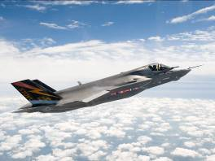
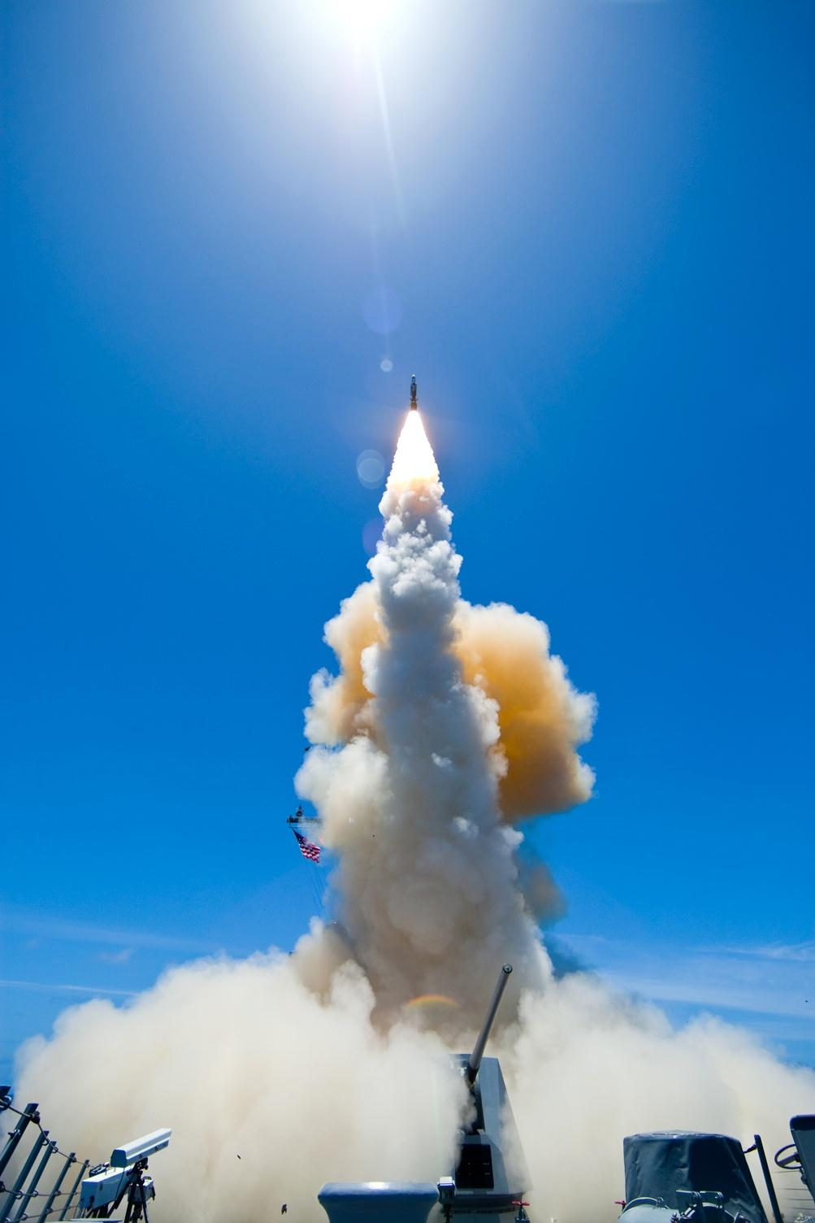

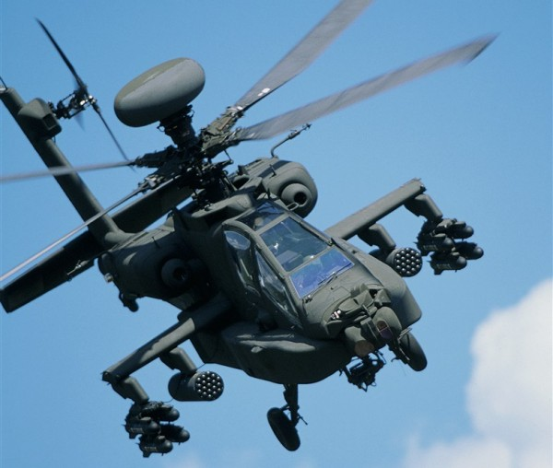
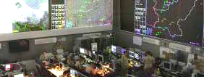

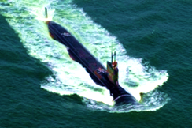
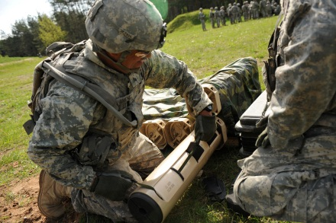
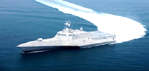
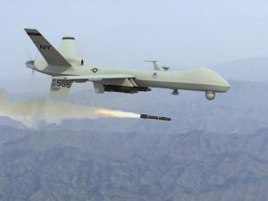
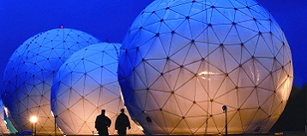
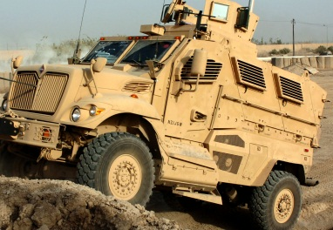
Systems Engineering:
Critical to Defense Acquisition
Defense Innovation Marketplace
http://www.defenseinnovationmarketplace.mil
DASD, Systems Engineering
http://www.acq.osd.mil/se

Slide 18
For Additional Information
Philomena Zimmerman
ODASD, Systems Engineering
571-372-6695 | philomena.m.zimmerman.civ@mail.mil
Other Contributors:
Tracee Walker Gilbert, Ph.D.
571-372-6145 | tracee.w.gilbert.ctr@mail.mil
Frank Salvatore
973-265-9837 | frank.j.salvatore.ctr@mail.mil
Tyesia Pompey Alexander, Ph.D.
571-372-6697 | tyesia.p.alexander.ctr@mail.mil
Darryl Howell
571-372-6699 | Darryl.l.Howell.ctr@mail.mil

