Slide 1
Applying Multi-Agent Swarm Artificial Intelligence to Armament Systems
Mr. Ross D. Arnold
DISTRIBUTION STATEMENT A
Senior Research Engineer, CCDC – Armaments Center, FCDD-ACW-FM
Visiting Research Scientist, USMA – Robotics Research Center, West Point, NY
05 JUNE 2019

Slide 2
Overview
Background
Artificial Intelligence
Swarms and Multi-Agent Systems
Benefits and Current Efforts
Challenges
Recommended Skillsets for AI Engineering
Applications
Swarm vs. Swarm
Target Acquisition
Swarming Munitions
Threat Detection
Remote Sensing
Combat Search and Rescue
Battlefield Networking
Future Work

Slide 3
Swarm AI Background
Notes:
To break into the field, what skillset is needed? Obviously you’d be looking for someone with previous AI experience but if you can’t find any, how do you build that skill set?

Slide 4
Armament system problem domain
Many broad problem areas lie within the armament system domain
Target acquisition
Mapping
Intelligence, Surveillance, and Reconnaissance (ISR)
Distribution of fires
Rapid decision-making
Information dissemination
Improvements to these areas can significantly improve our Warfighting effectiveness

Slide 5
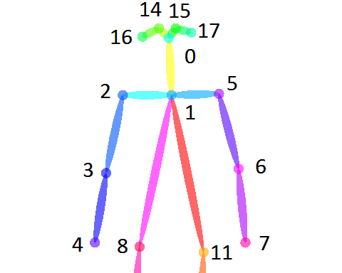
Artificial intelligence
Artificial intelligence as a problem-solving tool
Many of these defense problems can be approached using AI
AI is actually a large field; it can be applied to many disciplines
Robotics
Machine learning
Computer vision
Decision-making
Behavior prediction
Etc.
In particular, swarming AI
A type of multi-agent AI
Uses cooperative behavior to solve hard problems
Notes:
So how do we do that? How to improve those areas? AI is one new way to do that.

Slide 6
Cooperative behavior
Cooperative behavior occurs when entities work together towards a common goal
Sum is different than the parts
Multiple entities working together to create an emergent effect
May not be intentional
Communication between entities not required
Occurs in swarms
*R. Arnold, H. Yamaguchi, and T. Tanaka, Search and rescue with autonomous flying robots through behavior-based cooperative intelligence, Journal of International Humanitarian Action, 2018.
Notes:
So first let’s talk a little about cooperative behavior.

Slide 7
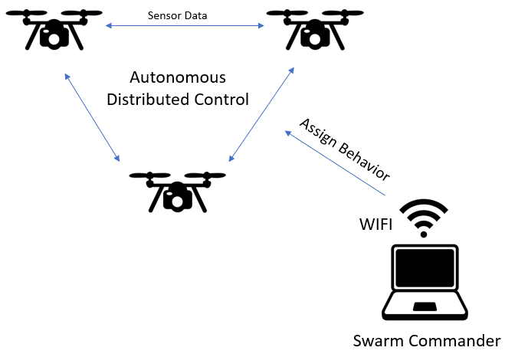
swarms
Swarms are groups of entities using cooperative behavior
A “large” number of animate or inanimate things massed together and usually in motion
How large: As few as 3*
*R. Arnold, K. Carey, B. Abruzzo, and C. Korpela. What is Swarming Robotics, and Why Swarms? 2019.
Notes:
To talk about swarming AI, we first need to talk about swarms. What actually is a swarm? We have a few different types of swarms, well many in fact but a few relevant types. The bottom left is a tiny nano-robot swarm with a lot of small entities with very little intelligence. On the right is a much smaller swarm with entities that contain much greater intelligence. Both count as swarms.

Slide 8
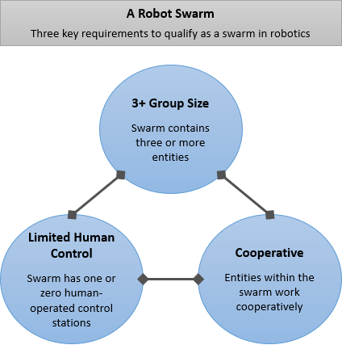
Robot swarms
*
*R. Arnold, K. Carey, B. Abruzzo, and C. Korpela. What is Swarming Robotics, and Why Swarms? 2019.
Notes:
And in robotics, which is where we use a lot of swarming in the DoD, what is a swarm? These are the criteria for a robot swarm, which really covers swarms in general as well without the need to describe limited human control.

Slide 9
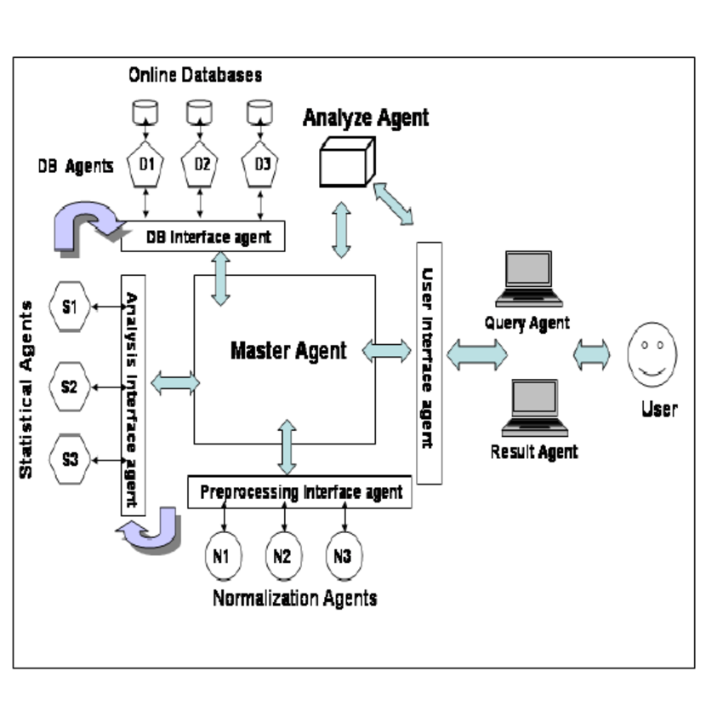
multi-agent systems
Swarms are all multi-agent systems, but not all multi-agent systems are swarms
Multi-agent software
system
Not considered a
swarm

Slide 10
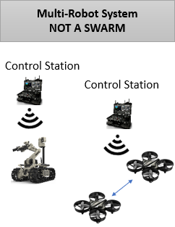
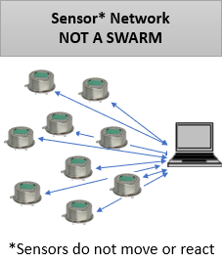
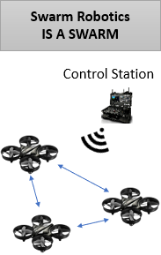
Swarms and multi-agent systems
Examples of swarms vs other types of multi-agent systems

Slide 11
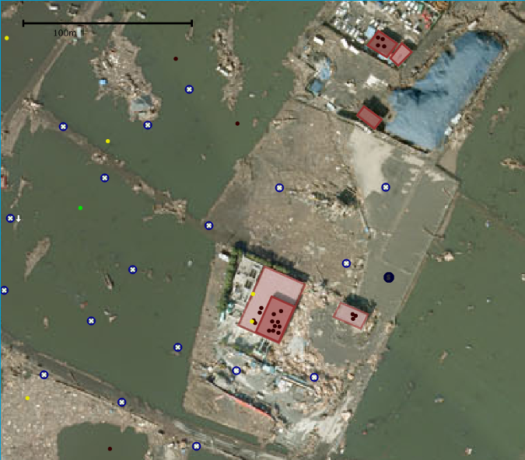
Swarms and artificial intelligence
Swarm intelligence is the resultant intelligent behavior of groups of independent heterogeneous entities behaving as a single system*
Swarm AI: Swarm intelligence
is created artificially, generally
using software algorithms
Not just a physical swarm;
Swarming algorithms are used
in many ways
Simulations
Particle swarms
Mathematical modeling
Optimization
*J. F. Kennedy, R. C. Eberhart, and Y. Shi, Swarm Intelligence. Morgan Kaufmann Publishers, 2001.
Notes:
So we’ve talked about cooperative behavior, how it’s used by swarms, and what swarms are as opposed to the broader multi-agent system term. How do we use swarms in AI? How do these things relate?

Slide 12
Swarm AI benefits
Swarm AI provides us with a number of high-payoff benefits
Rapid decision-making with wide range of ISR data
Speed
Movement
Computing and processing
Intelligence gathering
Coordinated effects and efforts
Collective and distributed control of hundreds and thousands of agents
Dynamic decision-making
Autonomous systems (UAS, UGV)
Intelligent munitions
Notes:
To talk about swarming AI, we first need to talk about swarms. What actually is a swarm, and why is it useful?

Slide 13
Swarm AI programs
Existing swarm AI research and development efforts
Building a general-purpose, replicable, swarm-capable unmanned aircraft system (USMA, CCDC-AC)
Object classification and swarm reactions to object presence (USMA)
Counter-UAS and counter-swarming (CCDC-AC)
Radiation detection and heat-mapping (USMA)
Target localization (USMA)
Swarm vs. swarm tactics (DARPA, NPS, USNA, USAFA, USMA)
Notes:
These are some of the things we’re doing at CCDC-AC and at USMA in particular. Certainly there are more across the army and DoD.

Slide 14
Swarm Ai challenges
Why don’t we see many swarm systems?
Why is swarming hard?
Federal regulation placed on UAS systems
Difficult to fly outside of private property
Security risks with UAS communication
High technical barrier to entry
Constant updates and obsolescence of parts
Replicable swarm-capable software architecture
Required knowledge in swarm software and algorithms
Reusable swarm software and swarm-capable hardware is key*
Swarming benefits not well-documented
*R. Arnold, A. Kopeikin, B. Abruzzo, and C. Korpela. Towards a General-Purpose, Replicable, Swarm-Capable Unmanned Aircraft System, 2019.
Notes:
So those are mostly research efforts. Really almost nothing on the dev side, no real swarm systems that do anything yet. So why is that? What makes it hard? In particular with swarming UAS, which is where a lot of the swarm capability can be found,

Slide 15
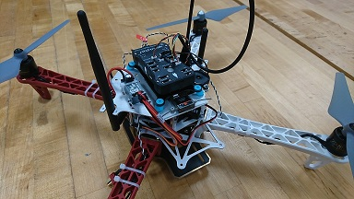
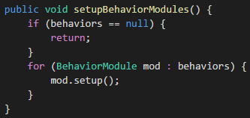
Swarm AI engineering skillset
Engineering skillset recommendations for swarm AI R&D
Robotics engineering
Computer science and software
engineering
Electrical engineering
Systems theory and systems science
Micro vs. macro systems
Wholes and parts, interaction of components
System as cause of behavior
Notes:
To break into the field, what skillset is needed? Obviously you’d be looking for someone with previous AI experience but if you can’t find any, how do you build that skill set?

Slide 16
Swarm AI Applications
Notes:
To break into the field, what skillset is needed? Obviously you’d be looking for someone with previous AI experience but if you can’t find any, how do you build that skill set?

Slide 17
Swarm Vs. swarm
Swarms can be used to counter other swarms
Service Academies Swarm Challenge in 2017
Cheap, replaceable UAS used to defeat more expensive UAS
Swarms can follow tactics found in nature; sharks vs. schools of fish, etc.

Slide 18
Target acquisition
Apply swarms to target acquisition
Cooperatively search for and locate targets
Dynamically change position to improve target certainty*
Arbitrate between target priority based on sensor data
*R. Arnold, B. Abruzzo, and C. Korpela. Towards a Heterogeneous Swarm for Object Classification, IEEE National Aerospace and Electronics Conference, 2019.

Slide 19
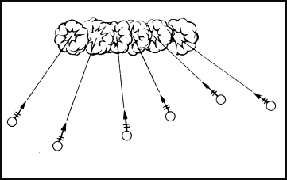
Swarming munitions
Apply swarms to munitions
Target selection: dynamic arbitration between multiple targets
Munitions that auto-distribute over a sheaf in fire control processing
Swarm of loitering munitions
Multiple passes over targets
Dynamically select targets
Select number of munitions
per target based on priority
such as proximity or payload
Army Field Manual 23-91 Chapter 4

Slide 20
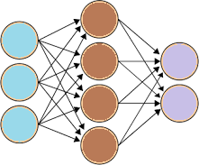
Threat detection
Apply swarms to threat detection
Use machine learning and neural networks to detect threat posture*
Equip a swarm with on-board detection software
Pinpoint and react to presence of threat in useful ways
High Threat Posture*
*B. Abruzzo, K. Carey, C. Lowrance, E. Sturzinger, R. Arnold, and C. Korpela. Cascaded Neural Networks for Identification and Posture-Based Threat Assessment of Armed People, 2019.

Slide 21
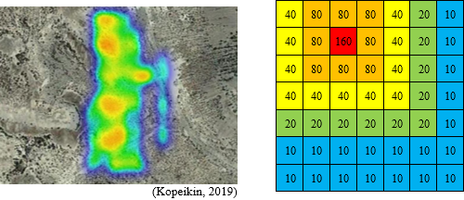
Remote sensing
Apply swarms to remote sensing
Swarms can cover large areas efficiently using pattern search algorithms
Different sensor payloads can be used for different purposes
Cameras for overwatch, etc.
Example: Radiation detection*
*B. Savidge, A. Kopeikin, R. Arnold, and D. Larkin. UAS Swarm Shares Survey Data to Expedite Coordinated Mapping of Radiation Hotspots, 2019.

Slide 22
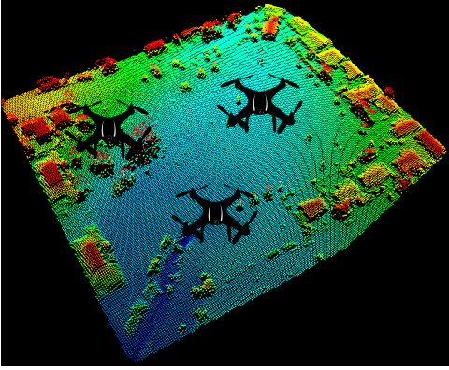
mapping
Apply swarms to mapping
UAS can build maps of difficult-to-reach areas
Swarms allow many areas to be reached at once
Low cost assets
High reliability and availability; if 1 swarm asset fails, others compensate
Distributed mapping algorithms

Slide 23
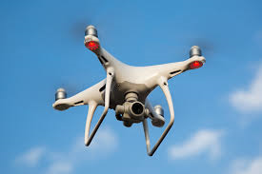
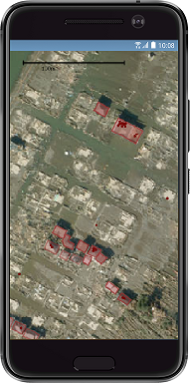
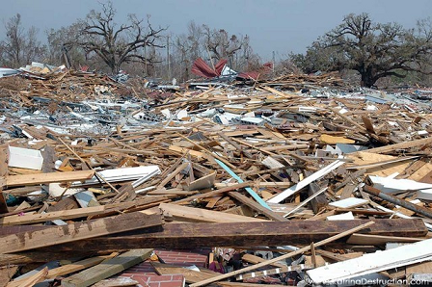
Combat Search and rescue
Apply swarms to search and rescue
Cooperative, behavior-based AI highly effective in swarm search and rescue simulations*
Difficult, dangerous, well-suited
to robotics
Swarms can cover large
areas simultaneously while
communicating data and
adjusting paths dynamically
*R. Arnold, H. Yamaguchi, and T. Tanaka, Search and rescue with autonomous flying robots through behavior-based cooperative intelligence, Journal of International Humanitarian Action, 2018.

Slide 24
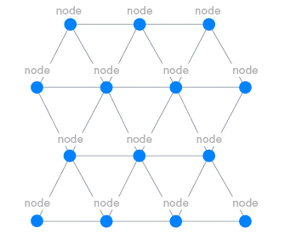
Battlefield networking
Swarms can be used to facilitate ad-hoc mesh networks
Battlefield networking is challenging as distance from Tactical Operations Center (TOC) increases
Swarm systems equipped with radios and WiFi hubs can create mesh networks
Increased range
Increased reliability
Notes:
At TOCs and TACs, networking is often supported by fiber lines and high-bandwidth infrastructure. However as you get out towards the tactical edge, mounted and dismounted units have increasingly less network support. Swarms can be used to create ad-hoc mesh networks intelligently, cooperatively to provide increased coverage when needed. This could even be done in conjunction with other functions like overwatch and remote sensing.

Slide 25
Future work
Swarming AI is an emerging field with applications in many armament-related areas
If we don’t do it, other nations will (and already are)
Government and industry are starting to use swarms across many domains
Ongoing research and development at CCDC-AC and USMA
Live demonstration of swarm reacting to classification of target object
Building and improving replicable swarm-capable hardware and software platform
Implementing threat detection on-board a swarm
Counter-UAS
Improved ISR

Slide 26
references
USMA Robotics Research Center / CCDC-AC collaborative publications:
R. Arnold, K. Carey, B. Abruzzo, and C. Korpela. What is Swarming Robotics, and Why Swarms? 2019.
R. Arnold, B. Abruzzo, and C. Korpela. Towards a Heterogeneous Swarm for Object Classification, IEEE National Aerospace and Electronics Conference, 2019.
B. Abruzzo, K. Carey, C. Lowrance, E. Sturzinger, R. Arnold, and C. Korpela. Cascaded Neural Networks for Identification and Posture-Based Threat Assessment of Armed People, 2019.
R. Arnold, A. Kopeikin, B. Abruzzo, and C. Korpela. Towards a General-Purpose, Replicable, Swarm-Capable Unmanned Aircraft System, 2019.
B. Savidge, A. Kopeikin, R. Arnold, and D. Larkin. UAS Swarm Shares Survey Data to Expedite Coordinated Mapping of Radiation Hotspots, 2019.
Other references:
R. Arnold, H. Yamaguchi, and T. Tanaka, Search and rescue with autonomous flying robots through behavior-based cooperative intelligence, Journal of International Humanitarian Action, 2018.
J. F. Kennedy, R. C. Eberhart, and Y. Shi, Swarm Intelligence. Morgan Kaufmann Publishers, 2001.

Slide 27
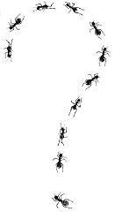
Questions and contacts
Questions
Mr. Ross D. Arnold
Senior Research Engineer, CCDC-Armaments Center
Visiting Research Scientist, USMA-Robotics Research Center
ross.d.arnold4.civ@mail.mil
ross.arnold@westpoint.edu
973-724-8618

