Slide 1
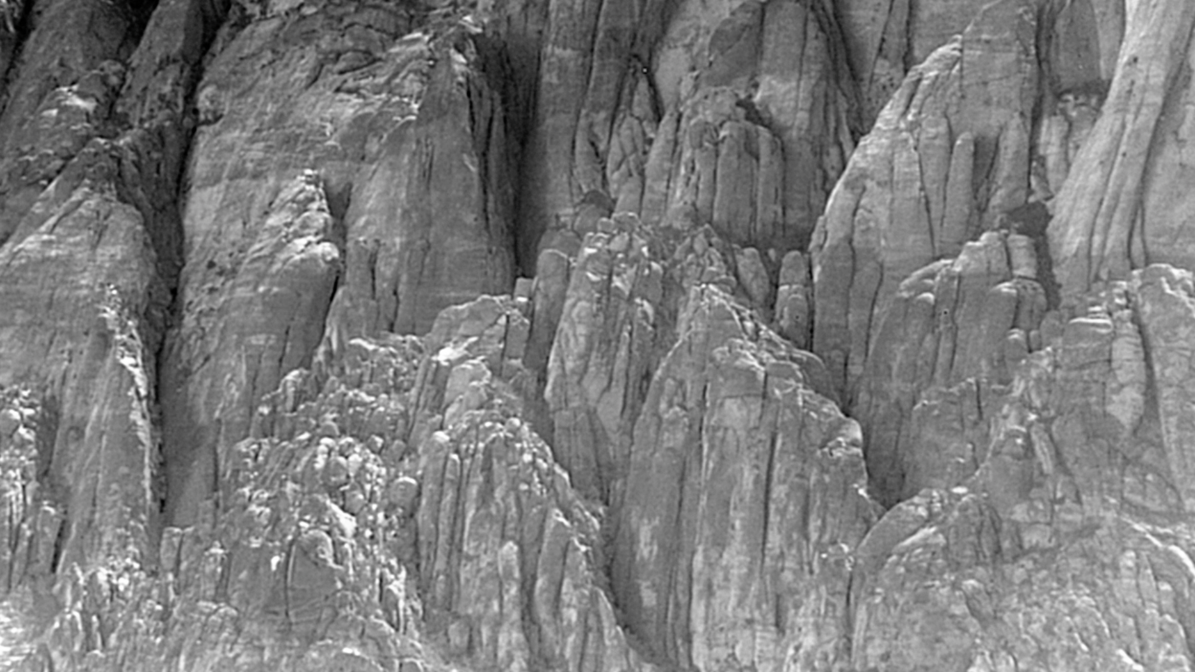



Modular Mission Payloads for Manned/Unmanned Ground Vehicles
Dr. Richard Pettegrew
General Manager
IEC Infrared Systems/Precision Remotes

Slide 2
Agenda
Company Background
Defining Modularity
Purpose
Design Methodology/Approach
  Core Elements
  UGV used for illustration: GD-MUTT
  Modular Payload Blocks
Configuration
  CUAS
  Situational Awareness: Short Range
  Situational Awareness: Long Range
  Lightweight ROWS
Summary

Slide 3
Company Background
IEC Infrared Systems LLC
  Founded in 1999: NASA Spinoff company
  In-house engineering & manufacturing of tactical surveillance systems
  Complete surveillance and sensor systems integration
  Intuitive command & control middleware
Precision Remotes LLC
  Founded in 1997
  In-house engineering & manufacturing of remotely operated weapon systems (ROWS)
  Lethal and non-lethal threat mitigation solutions

Slide 4
Defining Modularity
What is meant by the term ‘modularity’?
Broadly speaking, ‘modularity’ can be defined as the degree to which a system’s components can be separated and re-combined, providing flexibility and variety of usage.
Clearly, a ‘modular’ approach to mission payloads would be beneficial to both manned and unmanned (robotic) military platforms….
What might that look like?

Slide 5
Purpose
IEC/PRL have develoed flexible (reconfigurable) mission payloads for unmanned ground vehicles, to include:
    360º Situational Awareness
    Long Range Surveillance for ISR
    CUAS capability
    Lightweight Remote Weapon Station with heavy machine gun (M2)
All of these are adapted variants of our proven products.

Slide 6
Design Methodology/Approach
To achieve ‘modularity’, must use common ‘module’ interfaces:
        Mechanical
        Software
        Electrical
Systems should be built around common, core elements, then “mission-tailored” with specialty modules, to the greatest degree possible*.
Connections/Interfaces should be fast and easy to change
*In some cases, core elements may need to change as well, but interfaces to vehicle must remain common

Slide 7
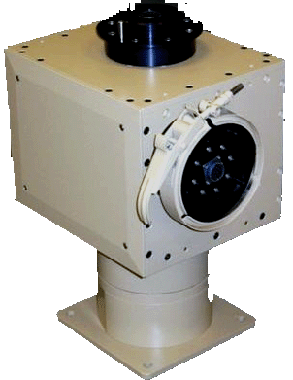
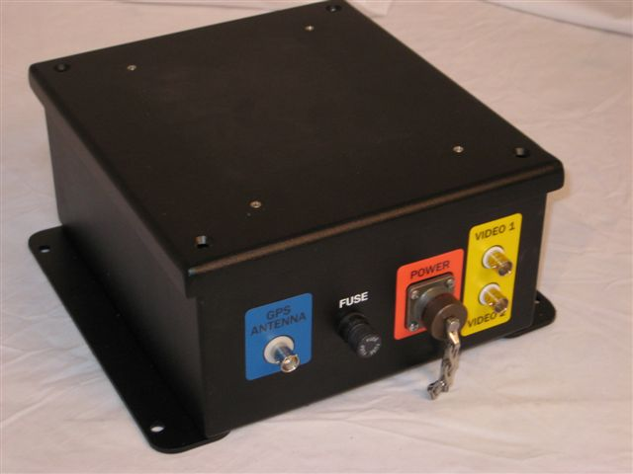
Design Methodology/Approach
Core Elements:
Positioner is common to most configurations
IEC’s ‘WereWolf positioner
Three payload mounting positions
Tools-Free, Blind-Mate Payload mounts, allowing for quick re-configuration
Common Electronics Module
power management
Video Processing
Payload control
Common Control Software
Controls most payloads

Slide 8
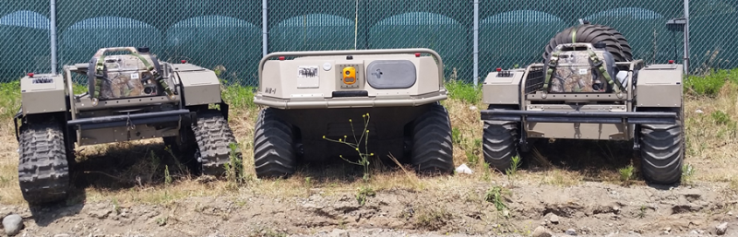
Design Methodology/Approach
UGV used for illustration: GD-MUTT
For purposes of this presentation, all configurations are illustrated on General Dynamics’ MUTT (wheeled version).
IEC/PRL have experience with the MUTT in several experimental exercises, but used here as illustration: other vehicles also very feasible

Slide 9
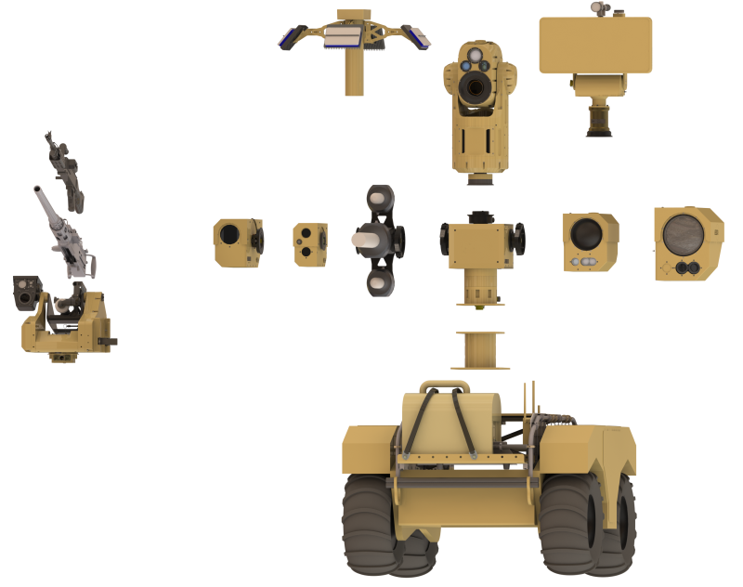
Design Methodology/Approach
  Modular Payload Blocks
Payloads reconfigured using modular blocks
Most payloads built around common positioner

Slide 10
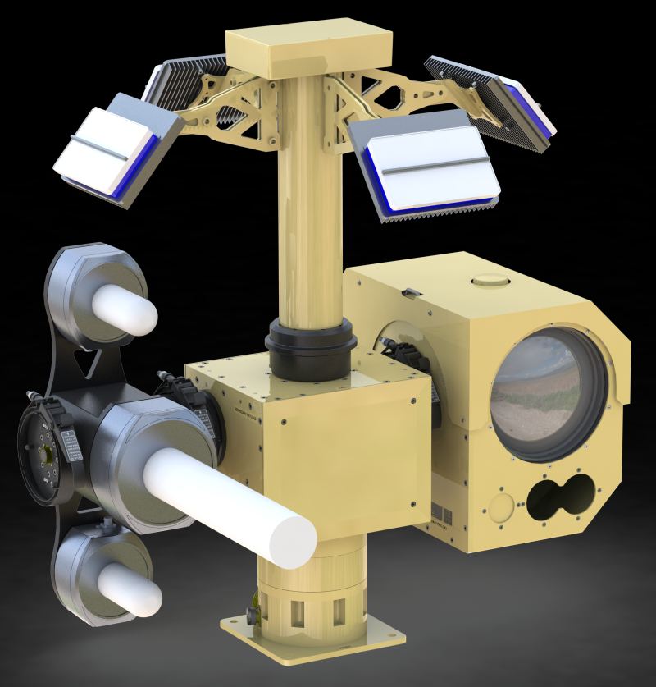
Configuration: CUAS
Detection of Class I UAS up to 700 meters
Thermal/visual imaging for target assessment, optical tracking
AI engine for clutter rejection
Tri-band RF jamming (control, video, nav)
Built on common WereWolf positioner

Slide 11
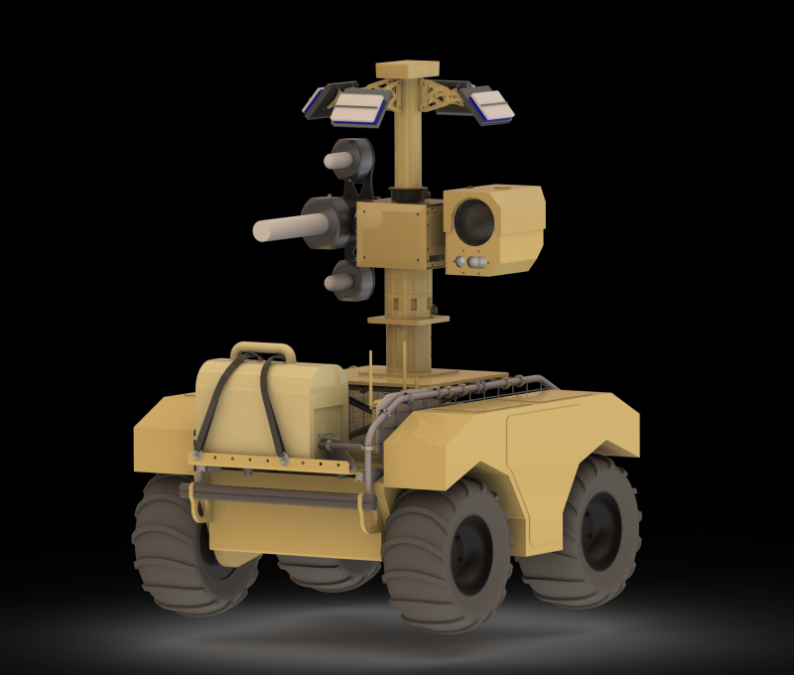
Configuration: CUAS
Built on common WereWolf positioner

Slide 12
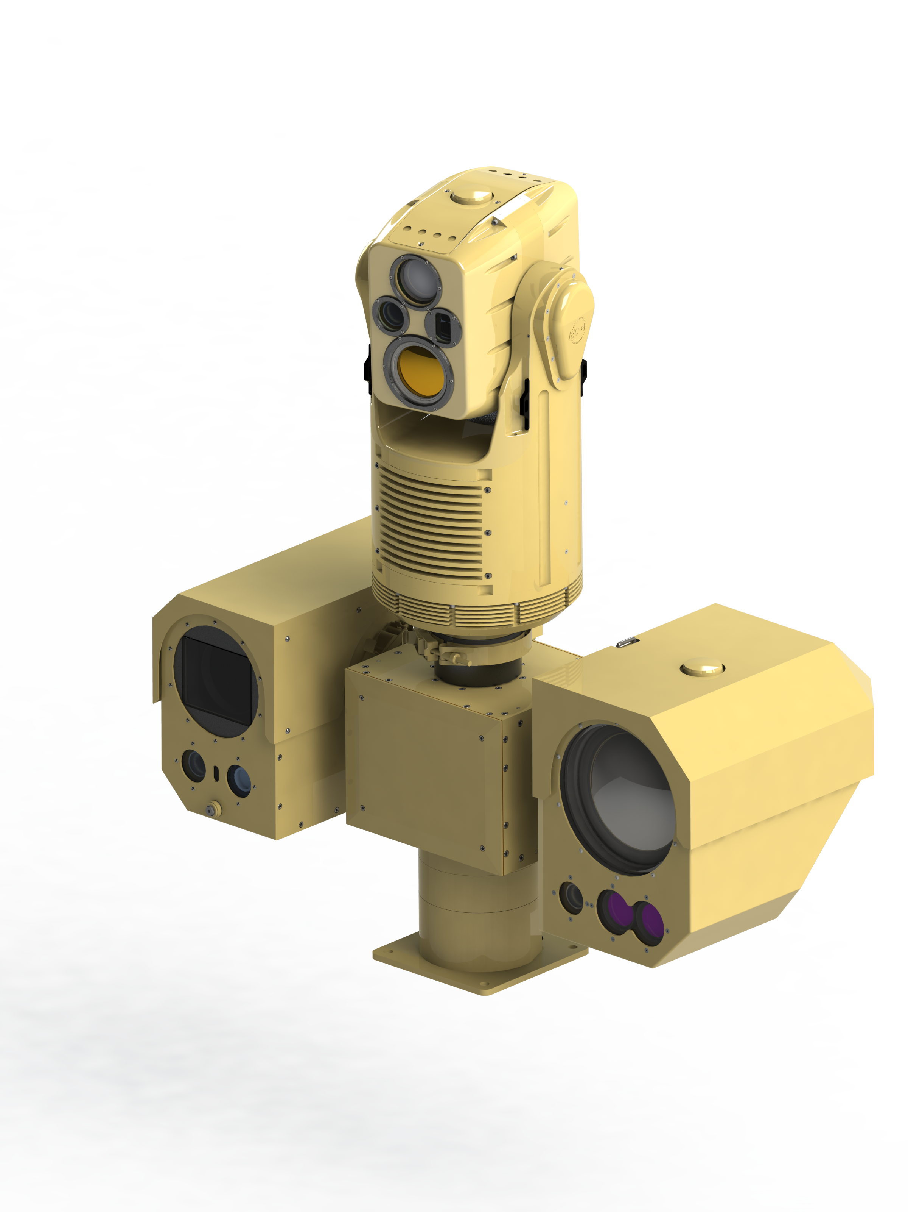
Configuration: Situational Awareness (short range panoramic surveillance)
Panoramic thermal/visual imaging & detection system
360º Day/night Situational Awareness
Completely Passive (Thermal/Visual)
1 Hz update rate (360o)
2 km upright human detection (with clear L.O.S.)
Co-Located Assessment Imager
LWIR 225mm & 120mm visual imager
Target recognition beyond 2 km
LRF & GPS for target geolocation
Built on common WereWolf positioner

Slide 13
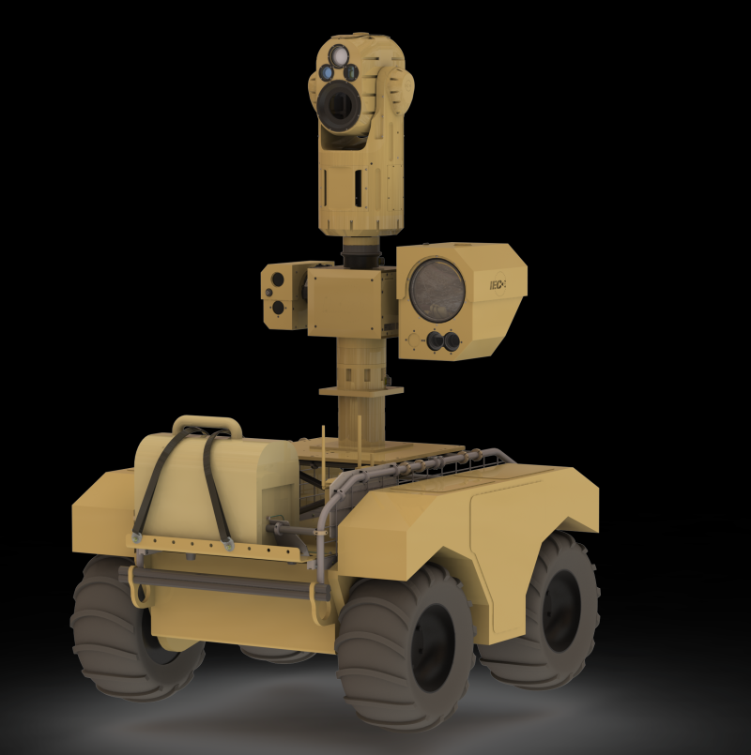
Configuration: Situational Awareness (short range panoramic surveillance)
Built on common WereWolf positioner

Slide 14
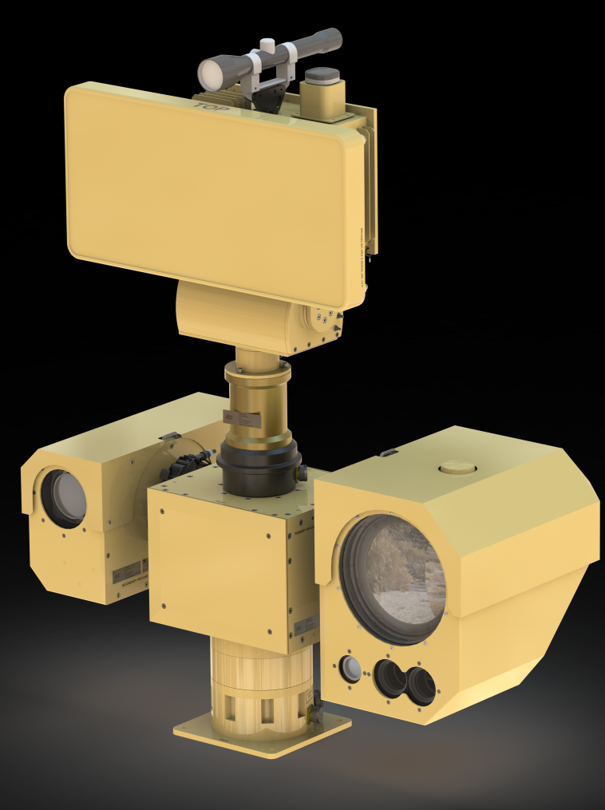
Configuration: Situational Awareness (Long range surveillance)
Ground Surveillance Radar Detection System
12 km upright human detection
18-20 km vehicle detection
Co-Located Assessment Imager
825mm MWIR & 2000mm Visual imager
Target recognition beyond 8 km
LRF & GPS for target geolocation
Built on common WereWolf positioner

Slide 15
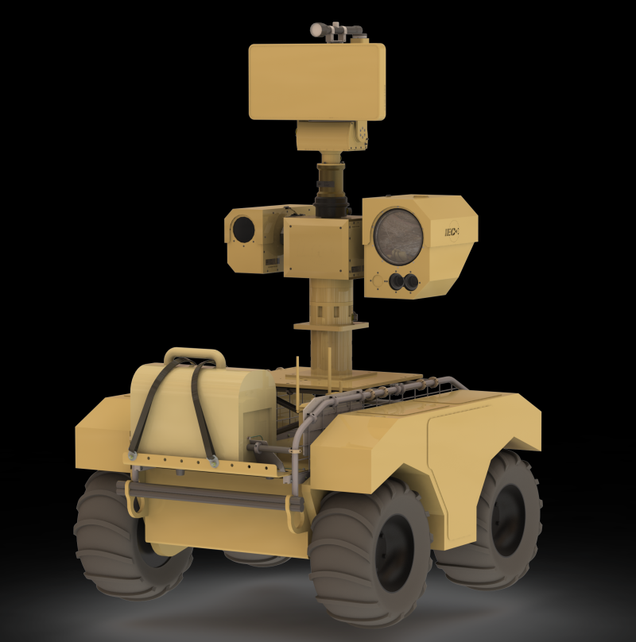
Configuration: Situational Awareness (Long range surveillance)
Built on common WereWolf positioner

Slide 16
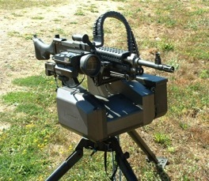
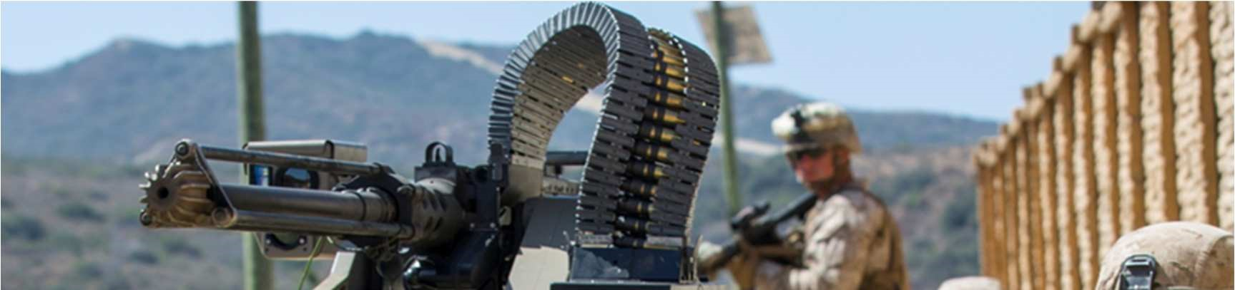
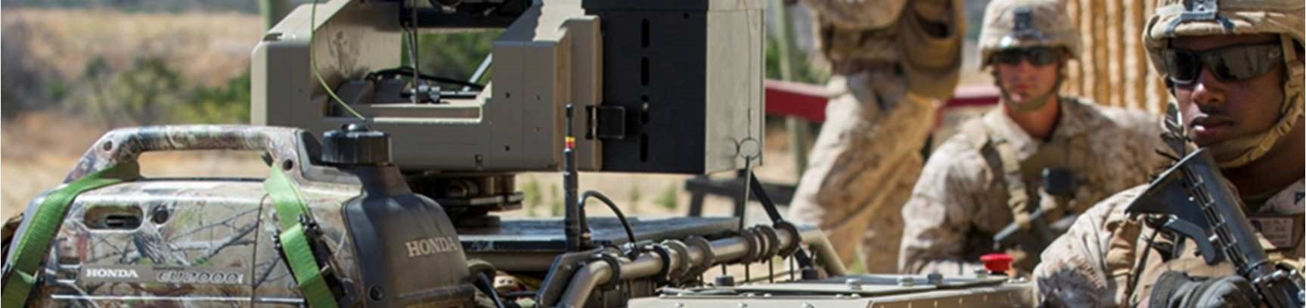
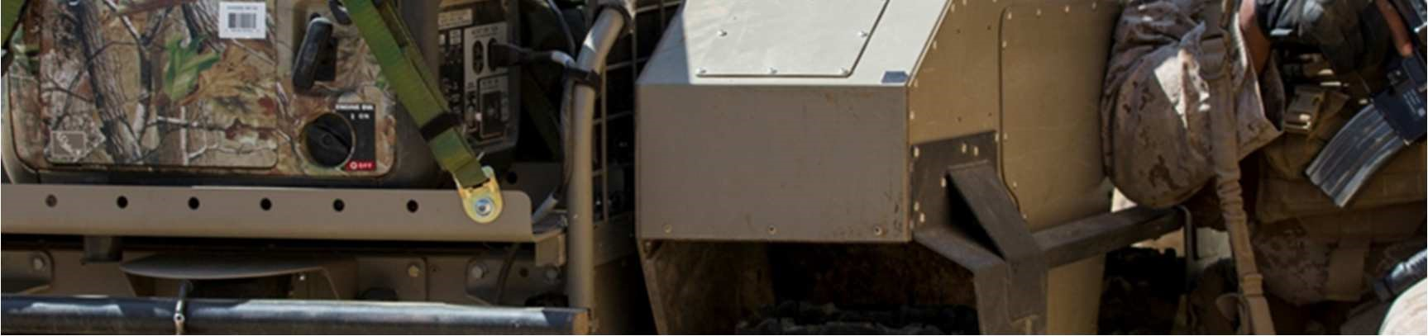
Configuration: Lightweight ROWS
T360 platform from Precision Remotes
Positioner <75 lbs (without gun & ammo)
Light weight provides easy payload change, easy logistics/maintenance
Can support M2 0.50 cal, M240
Brings heavy firepower of M2 to M2 to dismounted infantry
Weapon can be fired remote or manually

Slide 17
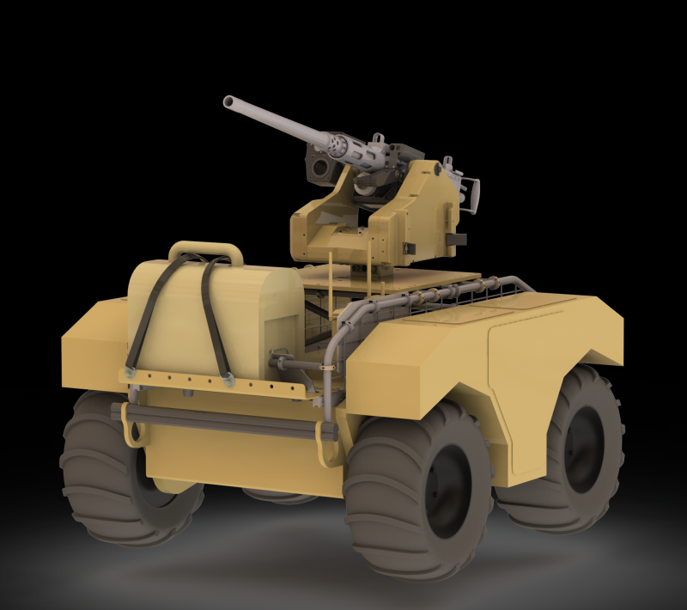
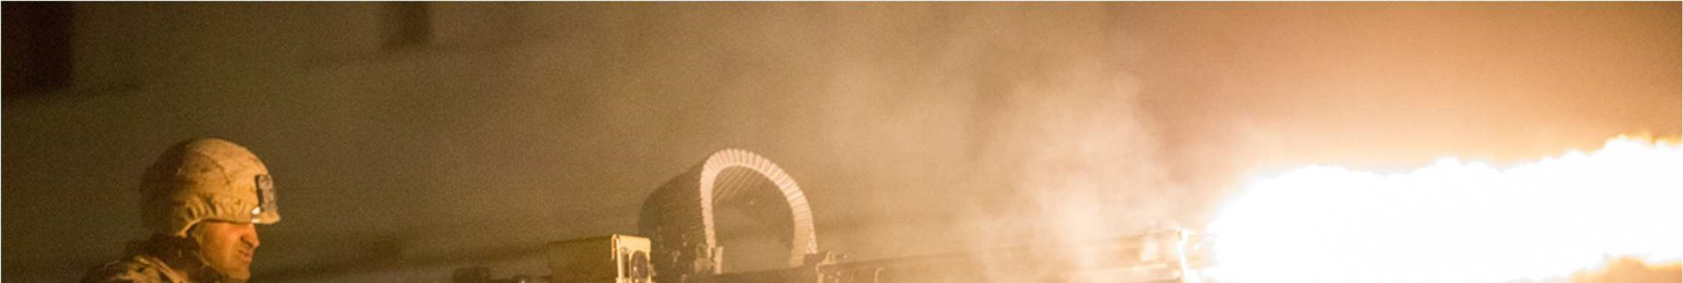
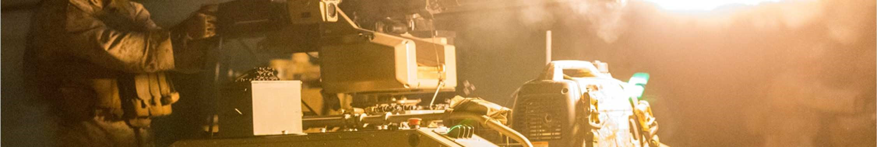
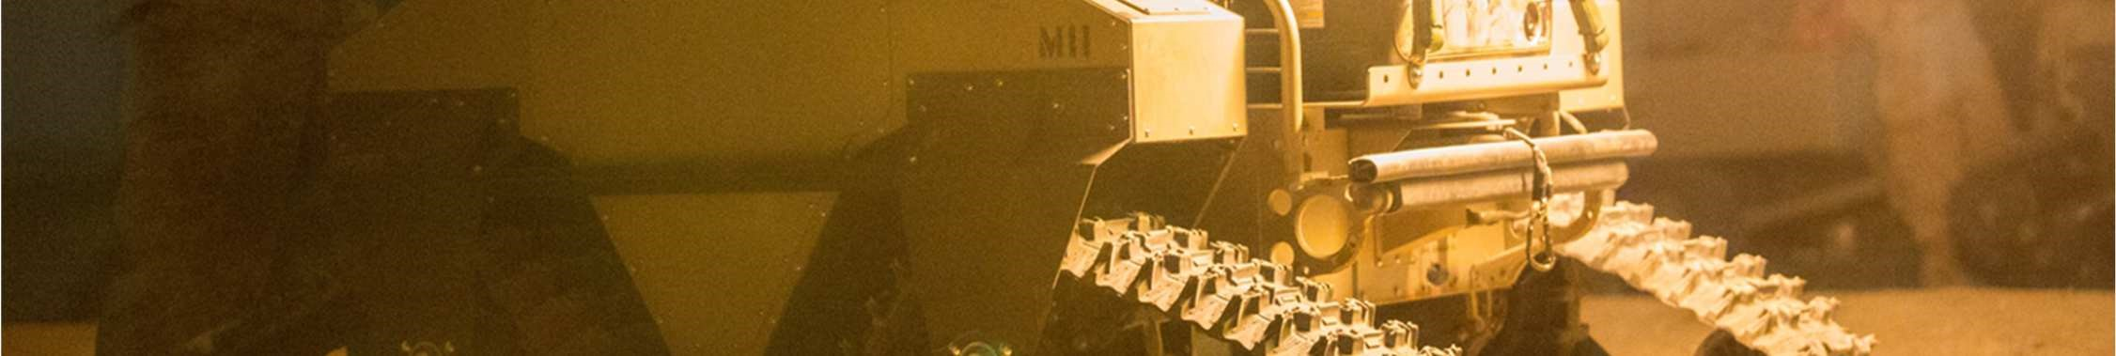
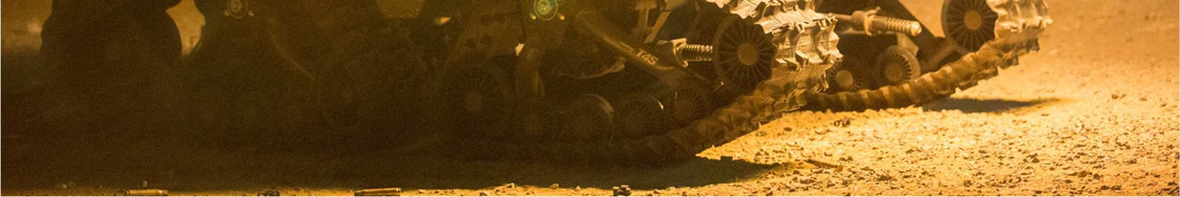
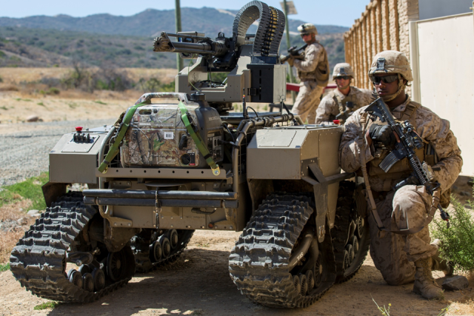
Configuration: Lightweight ROWS

Slide 18
Summary
Modularity requires:
  Commonality (mech, elec, sw)
  Quick change capability
  Easy reconfiguration
  Simplified Logistics
IEC/PRL have developed modular mission payloads for a variety of missions, with these requirements in mind
CUAS
M2 ROWS
Short Range ISR/SA
Long Range ISR

Slide 19
End of Briefing
Dr. Richard Pettegrew
General Manager
IEC Infrared Systems/Precision Remotes
www.iecinfrared.com
rick.Pettegrew@iecinfrared.com
(office) 440.234.8000, x114
(mobile) 440.382.1135

