Slide 1
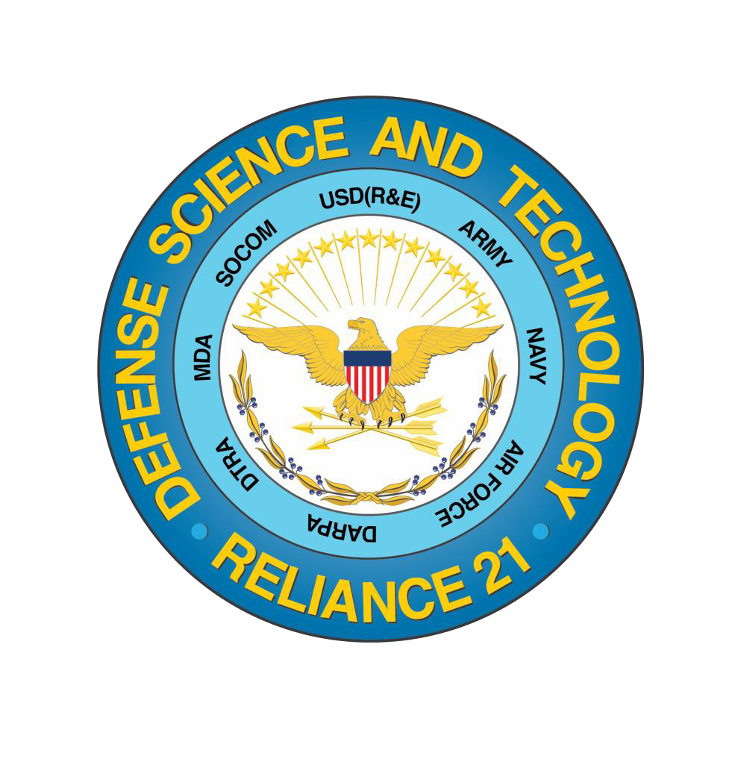
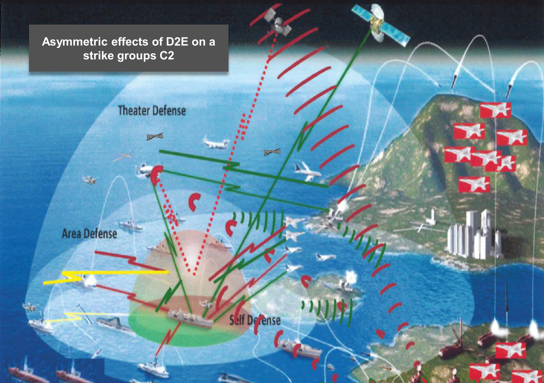
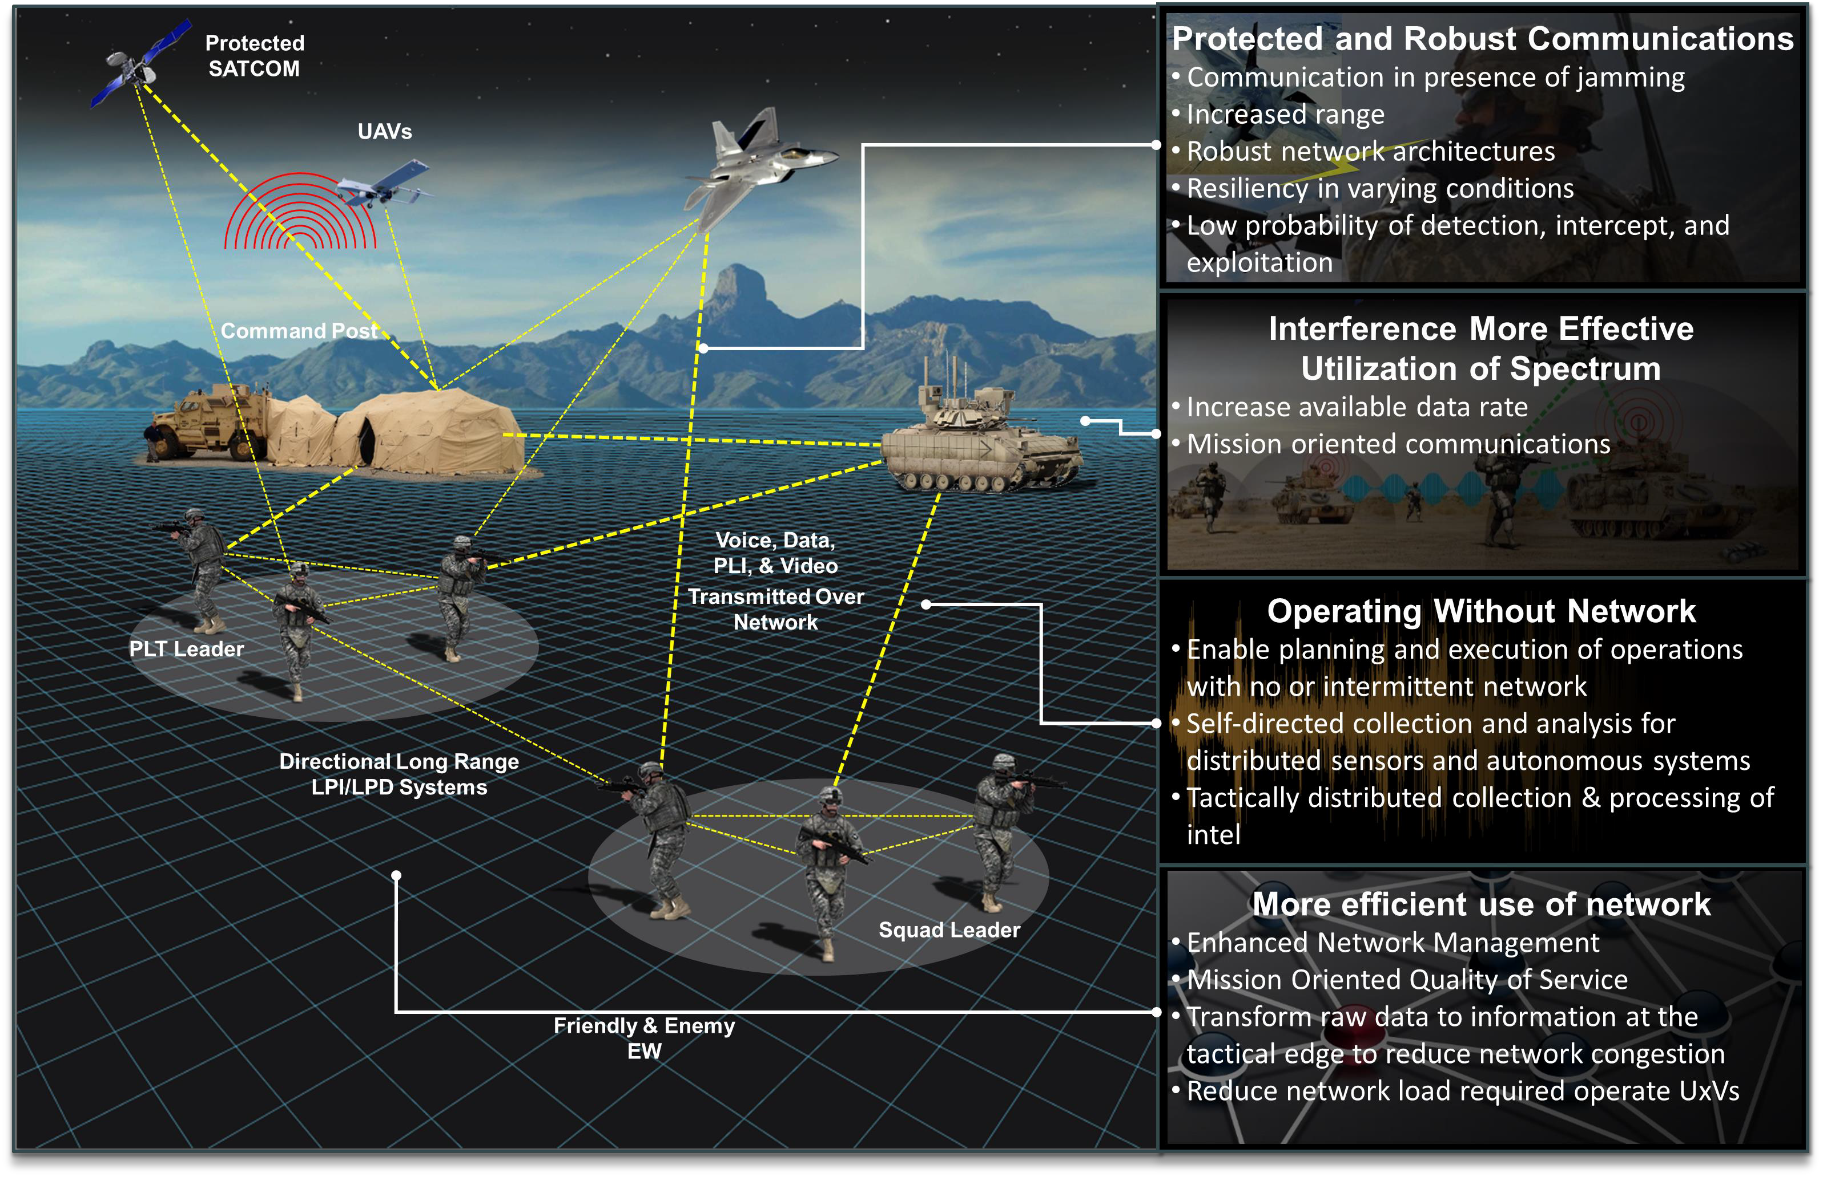
Command, Control, Communications, Computers & Intelligence (C4I)
Scope/Trust Areas
Impact on Capability Needs
Information Systems Technology
Algorithmic Warfare
Behavioral Cyber (Integrates human and sensor observations by
illustrating cognition and behaviors of friendly/adversary actors): Emerging Partnerships (ARL, CYBERCOM, AFRL, Army Cyber Institute, Naval Surface Warfare Center-Crane)
Autonomy Research Pilot Initiative (C4I-Autonomy) (ARL-AFRL- SPAWAR) resulted in two brain-computer interface demonstrations in ARL MIND Lab
ARL/NRL scientist exchange to strengthen collaboration on ARL’s Internet of Battlefield Things (IoBT) Collaborative Research Alliance
Delivered an early prototype of an Emissions Control (EMCON) conflict detection Tactical Decision Aid (TDA) for the U.S. Navy’s Operational Planning Tool (OPT)
Data Access, Architectures,
HW, and SW
Complex Data Processing, Decision Making and Reasoning for Planning, Execution & Assessment
Optimizing Human Decision Making
Networks and Communications
Effective, Natural Human-Machine Collaboration
Adaptive, Resilient Fully-Networked Comms
Success Stories
Numerous technologies demonstrated/transitioned (i.e. Android
Tactical Assault Kit/TAK Server Technology; Open Standards for Unattended Sensors (OSUS) to PdM EOIR; Tactical Cloud Reference Implementation transitioned to CANES PoR and deployed; Secure Cross-domain Orchestration Engine; … )
Demonstrated a cost effective phased-array through 3D printing
Delivered Automated Test and Analysis capability to Marine Corps Tactical Services Oriented Architecture (TSOA) POR. Using the NRL-developed Sentry Agent Framework (SAGE), demonstrated a 90% reduction in test planning, setup, and execution time. Ongoing SAGE extensions by ARL.
Engagement Opportunities for Industry
Numerous Broad Agency Announcements
DoDIIS Worldwide Conference
Air Warfare Symposium/AFA
GeoInt Conference
WorldComp Conference
SPIE Defense and Commercial Sensing
Military Communications Conference (MILCOM)
Int'l Conf on Computing, Networking and Comms
AFCEA New Horizons
Wright Dialogue with Industry
I/ITSEC (http://www.iitsec.org/)
Others
Focus Going Forward
Assess the current portfolio, identify gaps, establish priorities, and maintain a set of S&T roadmaps to guide DoD research program investments, and provide future resource recommendations to leadership
Trends include:
  Increasing application of AI to intelligence and C2, including focus on data
  Increasing demands for rapid prototyping
  Emergence of the Internet of Battlefield Things (IoBT)
Establish mechanisms to encourage coordination between researchers to facilitate information exchange, and promote collaboration
Distribution A: Approved for public release: distribution unlimited. Case #19-S-0974
Notes:
AFA, AFCEA, Next generation ISR Symposium, Wright Dialog with Industry

