Slide 1
OUSD(R&E)/DDRE(R&T)
Research, Technology and Laboratories
Dale Ormond
Director, Science and Technology
NDIA 20th Annual Science & Engineering
Technology Conference
April 3, 2019

Slide 2

Reliance 21
Reliance 21 is the overarching framework of the DOD’s S&T joint planning and coordination process
Joint Planning - S&T Oversight
Mitigate existing or emerging threats
Generate affordability in the systems the Department acquires and operates
Develop technology based surprise for our adversaries
Joint Coordination - S&T Delivery
17 Communities of Interest (CoIs)
CoI S&T Roadmap Reviews
CoI Information Exchange Meetings
CoI Steering Groups
  All Services and DoD Agencies Represented

Slide 3
Reliance 21 Overview
    Reliance 21 is led by the S&T Executive Committee (S&T ExCom)
Comprised of the major Department Components (Services, Agencies, Commands)
Provides executive oversight and overarching guidance on S&T investments
Ensures a collective understanding of the priorities, capability gaps, and opportunities of the DoD organizations that manage critical S&T resources
Established in 2009 as a mechanism for multi-agency coordination and collaboration
Comprised of S&E subject matter experts in specific technology areas where there is substantial investment across multiple components
Produces S&T Roadmaps and Reports in their technical area detailing program goals and objectives, capability gaps, and leveraging opportunities
    Reliance 21 is implemented through the Communities of Interest (CoIs)

Slide 4
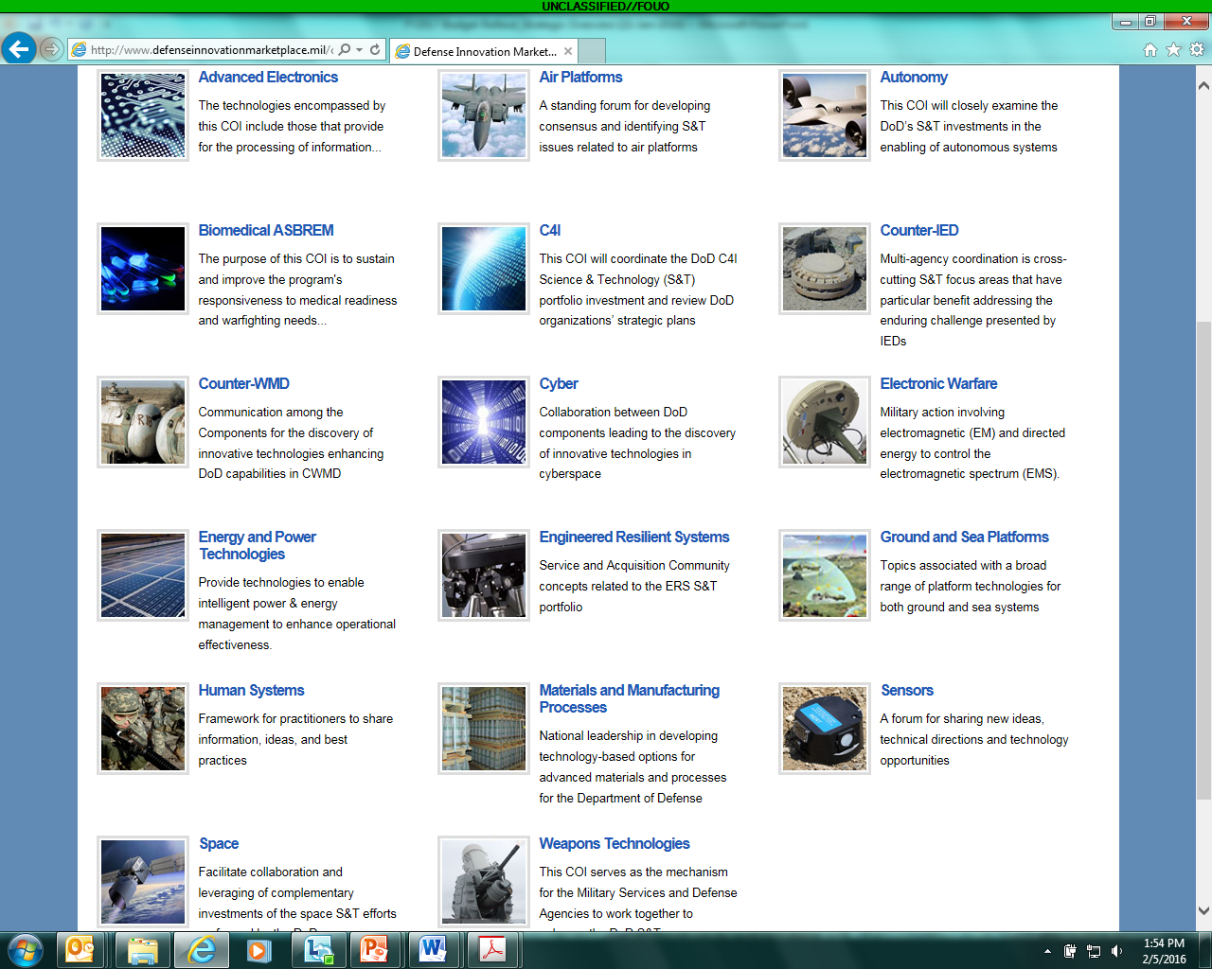

Communities of Interest
CoIs lead the innovation and the acceleration of advanced concepts and prototypes across three main focus areas:
Mission Focus Capabilities enabled by advanced technologies & systems |  |  | ASBREM: Armed Services Biomedical Research Evaluation and Management
Systems / Capability Focus Multiple technologies are integrated into complex systems to achieve mission impact Air Platforms |  |  | Human Systems |  | Sensors |  | Space
 |  |  | Ground and Sea Platforms |  | Electronic Warfare |  | Kinetic Weapon Technologies
 | Autonomy |  | Cyber |  | Command, Control, Communication, Computers and Intelligence (C4I) |  | Directed Energy/ Non-Lethal Weapons (DE-NLW)
Technology Focus Technology goals with multiple applications |  |  | Energy and Power Technologies |  | Advanced Electronics |  | Materials and Manufacturing Processes
Alumni CoIs: Engineered Resilient Systems; Counter-Improvised Explosive Devices (C-IED); Counter-Weapons of Mass Destruction (C-WMD)
Notes:
75% all S&T 90% BA2/3
17 S&T CoIs creates strong internal and external partnerships. De-conflict service and agency investments
Developed technical roadmaps to ID capability gaps, enabling DoD to share the problem space and tackle needs from many angles.
Today, these COI’s evaluate about 75% of the DoD S&T budget and about 90% of our applied research and advanced technology research. $12½B for S&T = 68% external, 32% internal
$5.6B = BA3 $4.8B = BA2 $2.1B = BA1
Reliance 21 established the S&T COIs, continually renewed and refreshed; emphasis on coordinated research planning is a key strength of DoD’s S&T Enterprise. Cross-cutting collaborative teams provide strategic and technical leadership.

Slide 5
The Role of the CoIs
Enable the defense of the Department’s S&T investments
Create multi-Service / Agency collaborative efforts to reduce duplication
Develop joint S&T roadmaps
Monitor key technology developments and engagement opportunities
Provide technology options and advice to DoD S&T senior leadership
  Provide recommendations to Service S&T Executives regarding opportunities to leverage other Services’ investments
Facilitate engagement across the spectrum of stakeholders
  Combatant Command (CCMD), Intel Community, Academia, Industry

Slide 6

Defend the Department’s S&T Investments
Describes the Department’s S&T investment in detail
Identifies opportunities and efficiencies that allow the Department to achieve maximum return on investment
Provides data that confirms that the Warfighters are receiving the greatest benefit from DoD S&T resources and efforts

Slide 7
Create Collaborative Opportunities to Mitigate Unnecessary Duplication
Examine, comprehend, and quantify Service operational needs and explore multi-Service/ Agency collaborative opportunities
Organize working groups across different organizations to investigate and understand inner connections and/or overlaps within the technology areas
Create clear multi-Service/ Agency program dependencies - identified by ‘Lead, Shape, or Follow’ roles

Slide 8
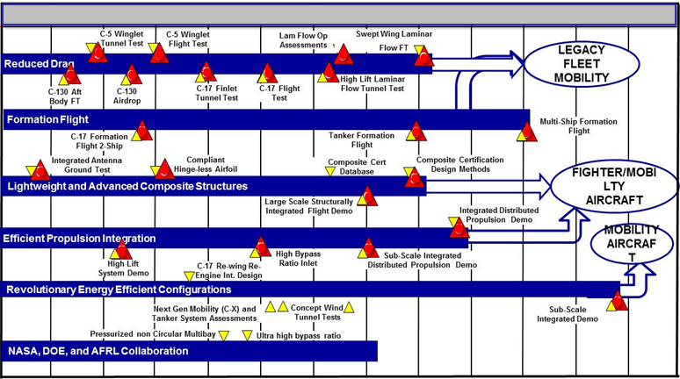
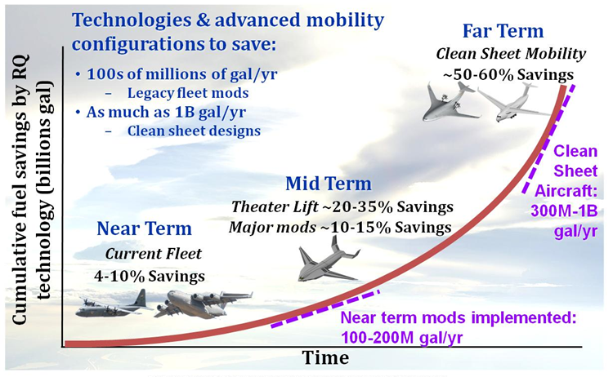
Develop Joint S&T Roadmaps
Roadmaps project a shared vision of DoD’s S&T Portfolio
Describe program objectives and key technical challenges
Assess and address capability gaps and operational impact
Indicate the capability gap timeline and threat development
Propose potential Prototypes/Experiments to address the most challenging technology development needs

Slide 9
S&T Priorities Program
Program is executed out of the USD(R&E) - Research
S&T Priorities program exists to:
  Enable high-payoff, cross-Component technology efforts
  Develop integrated program execution plans (roadmaps) across the DoD
  Execute Applied Research for Advancement of Priorities (ARAP) programs
    Three-year programs, $10M-$15M/yr; two or three in each budget year
  Fund seedlings to buy down risk in integrated plans
  Allow fast start-ups in other areas
Augment Reliance 21 to foster increased collaboration
Grow workforce in emerging technology areas
Major program decisions involve all Components

Slide 10
Applied Research for the Advancement of Priorities (ARAP)
ARAP enables high-payoff, cross-Component technology efforts
  Three-year programs, $10M-$15M/year; two or three in each budget year
  Allows for fast start-ups in other areas
Fosters Joint-Service research focused on common elements of cross-cutting S&T areas
Facilitates concept exploration efforts and studies of alternative concepts
Strengthens in-house laboratory research efforts and workforce
ARAP Portfolio
NEW: Enhanced Energetic Effects (EEE)
Defense Optical Channel Program (DOC-P)
Synthetic Biology for Military Environments (SBME)
Quantum Science and Engineering Program (QSEP)
Data To Decision (D2D)*
Autonomy Research Pilot Initiative (ARPI)*
Engineered Resilient Systems (ERS)*
*Completed program
Notes:
Below reflects year that the efforts were funded out of the ARAP PE, which was started in FY14. There's a few other notes on the year's each was funded for consideration. We chose not to put the specific funding years on the slide since it already says that efforts are 3 year programs.
Major projects:
- Autonomy Research Pilot Initiative (ARPI) FY14-FY16 (holdback funding in FY13??)
- Quantum Science and Engineering Program (QSEP) FY15-FY18 (late start FY15)
- Synthetic Biology for Military Environments (SBME) FY16-FY19 (late start FY16)
Other large areas/efforts funded under ARAP PE:
- Data to Decisions (D2D) FY14-FY15 (previously funded under its own 6.2 and 6.3 PEs from FY10-FY13)
- Engineered Resilient Systems (ERS) FY14-FY15 (moved to under Systems Engineering Directorate, PE 0603833D8Z, in FY16)

Slide 11
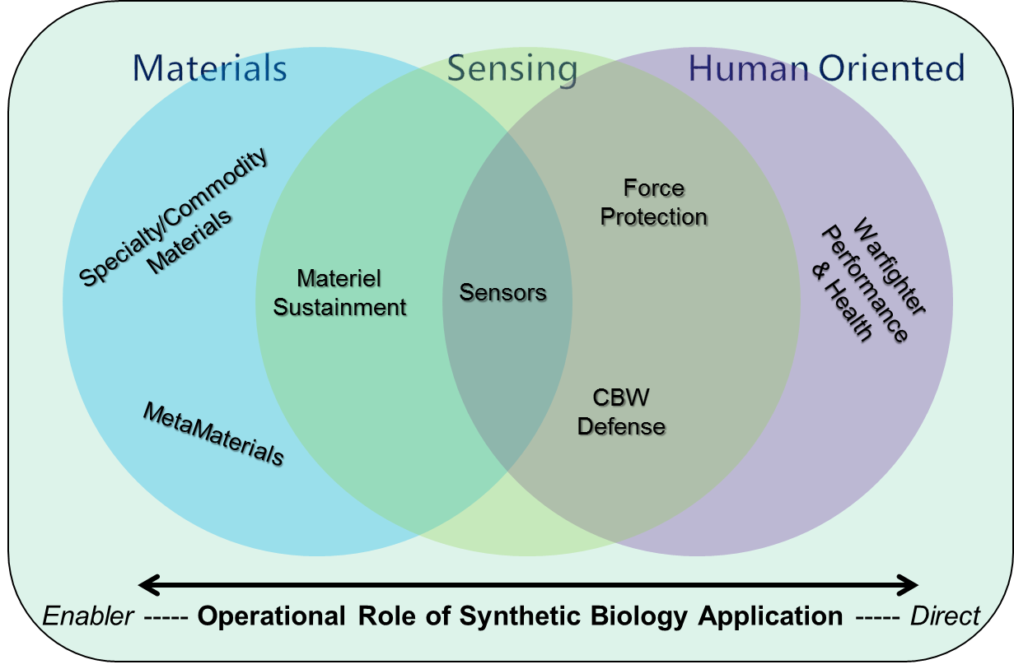
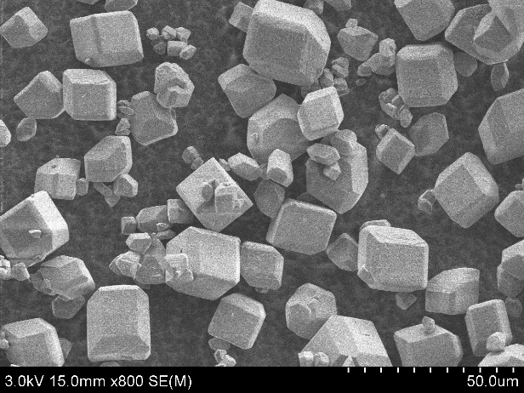
A Winning ARAP Proposal
Meets the definition of Budget Activity 2 (Applied Research) funded work
A new, emerging area of science and/or engineering where the potential exists to develop future capabilities that will give the joint warfare a technological edge in the fight
Technically sound but pushes the leading edge(s) of science/engineering with reasonable risk to achieve success
Multiple Services/Labs working together
Majority of the work will be performed by DoD scientists and engineers
Synthetic Biology for Military Environments (SBME)
Defense Optical Channel Program (DOC-P)
Enhanced Energetic Effects (EEE)

Slide 12
Maintain Vital Engagements to Maximize Capability Development
CoI engagements are vital to addressing wide-ranging S&T needs
Combatant Command (CCMD) S&T Advisors (Operator Community)
  Provide a forum to articulate S&T priorities and investments with the potential to address CCMD capability gaps
Intelligence Community
  Evaluate intelligence information regarding current and future threats as well as emerging technologies to best align research and acquisition priorities
Basic Research Community (Academia, DoD Labs and Centers)
  Review Basic Research priorities and identify opportunities to engage future scientists and engineers
Industry Independent Research and Development
  Industry can use CoI Roadmaps to identify technical challenges

Slide 13
Basic Research Community Engagement
(Academia, DoD Labs and Centers)
Ensure an understanding of DoD’s Basic Research investment priority in basic science
Maintain awareness of emerging opportunities for transition to applied research and the CoIs
Inform Basic Research of potential areas for investment that could resolve technical challenges in capability development (e.g., materials and hypersonics)

Slide 14
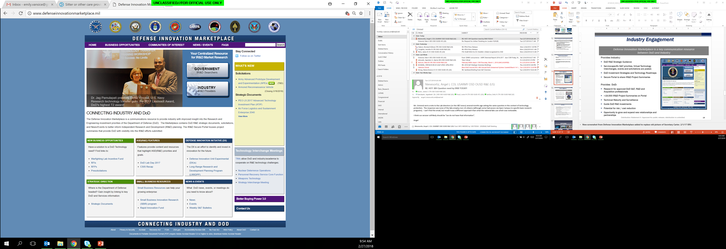
Defense Innovation Marketplace
Provides Industry:
DoD R&E Strategic Guidance
Service-specific S&T priorities, Virtual Technology Interchanges, events and solicitations are posted.
DoD Investment Strategies and Technology Roadmaps
Secure Portal to share IR&D Project Summaries
Provides DoD:
Research for approved DoD S&T, R&D and
Acquisition professionals
>19,000 IR&D Project Summaries on Portal
Technical Maturity and Surveillance
Guide DoD R&E investments
Potential for risk / cost reduction
Opportunity to grow and expand new relationships and partnerships
Communities of Interest (CoI) (Distro A) pages available at: http://www.defenseinnovationmarketplace.mil/coi.html
Notes:
New screenshot from Defense Innovation Marketplace added to replace old picture of Secretary Carter. 2/1/17 ERV.

Slide 15
Access to DoD
One of the great strengths of DoD is our distributed network of program managers across various different Components
All DoD funding opportunities are posted to: https://www.grants.gov/
  Each opportunity will have the name and contact information of a person associated with the program.
OSD and all of the Components have websites that detail their programs and all of the pertinent information including topics of interest, funding cycles, calls for proposals, etc.
  OUSD: http://basicresearch.defense.gov
  AFOSR: http://afrl.dodlive.mil/funding
  ARO: https://www.arl.army.mil/www/default.cfm?page=29
  ONR: https://www.onr.navy.mil/en/Contracts-Grants
  DARPA: https://www.darpa.mil/work-with-us/opportunities
OUSD Basic Research office communication strategy aims to improve access and navigation in these various websites to make the most of community engagement.
Program officers are afforded the flexibility to develop outreach strategies to identify scientific communities of interest and broadcast their program goals
DoD has representation at many of the professional societies and symposia and is eager to engage

Slide 16



Finding Grant and Cooperative Agreement Funding Opportunities
Grants.gov is the common website for Department of Defense (DoD) and the other 25 federal grant-awarding agencies to post discretionary funding opportunities and for entities to search and apply for them.
Searching for Funding Opportunities on Grants.gov
Any member of the public may search for funding opportunities at Grants.gov.
Users who register with Grants.gov also have the ability to save their searches, and have updated search results emailed to them by signing up for subscriptions. Registered users may also subscribe to receive notifications about Grants.gov news, all new funding opportunities, and when changes are made to specific funding opportunities they identify.
Applying for Funding Opportunities
Registered users must be associated with an organization and be assigned the proper applicant roles in order to apply for a funding opportunity. Users should contact their organization’s business office to determine the process used in their organization.
DoD Grants.gov Manager:
Ms. Barbara Orlando, barbara.j.orlando.civ@mail.mil, 571-372-6413
https://blog.grants.gov/
@grantsdotgov
https://www.youtube.com/user/GrantsGovUS

Slide 17
Summary
Established in 2009, CoIs have grown from mechanisms of information sharing and multi-agency coordination to an infrastructure that identifies opportunities for collaboration to reduce duplication
CoIs enable the S&T ExCom to deliver maximum S&T impact with reduced risk:
  Coordinate S&T strategies
  Share new ideas, technical directions, and technology opportunities
  Jointly plan programs
  Measure technical progress
  Report on the general state of health of technology areas
Joint S&T Roadmaps project a shared vision of the Department’s S&T portfolio, showcase joint activities, and enable defense of investments
CoIs are in a unique position to engage with industry through NDIA to promote innovation in DoD and maintain awareness of the rapid technology development taking place in the commercial sector

Slide 18



DoD R&E Enterprise
Solving Problems Today – Designing Solutions for Tomorrow
DoD Research Enterprise
https://www.acq.osd.mil/rd/
Twitter
@DoDInnovation

