Slide 1
Dean Ridgely, Acting Assistant Director for Space, OUSD(R&E)
NDIA S&ET Conference
San Diego, CA | April 3, 2019
Space – Assistant Director Perspectives

Slide 2
Introduction
The United States must maintain our leadership and freedom of action in space
The threat is evolving
We must take a new approach to equipping the Space Force to maintain U.S. competitive advantage …
“It is not about speed of discovery, it is about speed of delivery to the field.”
USD(R&E) Michael D. Griffin, February 2019

Slide 3
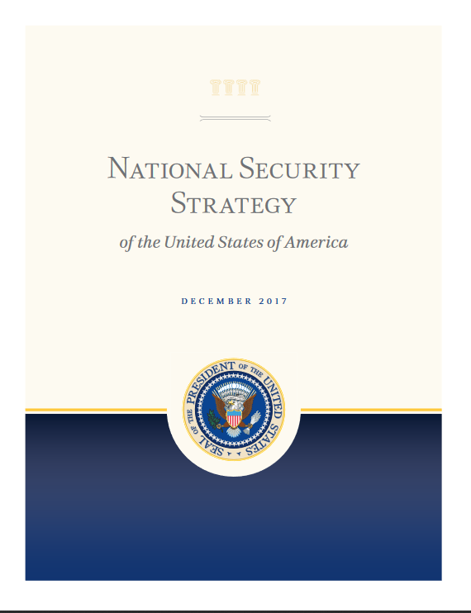

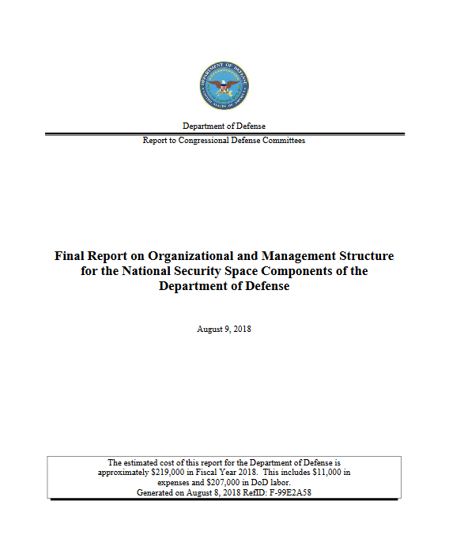
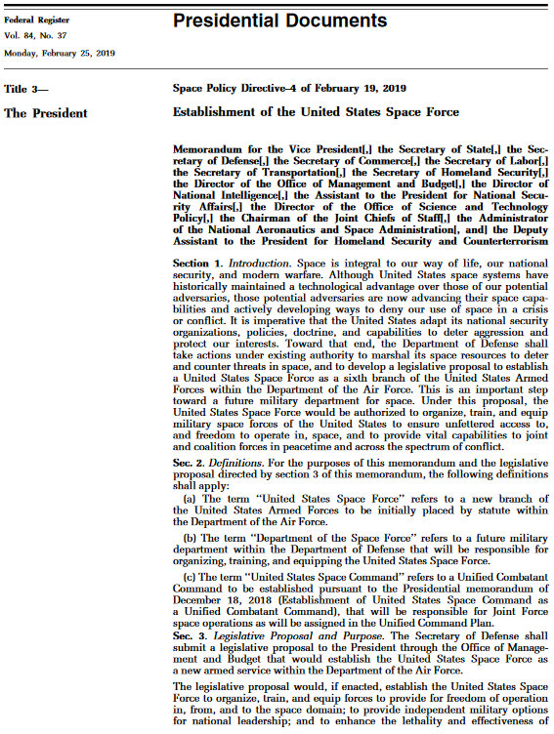
Strategic Space Guidance
National Security Strategy
The United States must maintain our leadership and freedom of action in space
Advance space as a priority domain
Promote space commerce
Maintain lead in exploration
National Defense Strategy
Today, every domain is contested – air, land, sea, space, and cyberspace.
The Department will prioritize investments in resilience, reconstitution, and operations to assure our space capabilities.
Investments will prioritize ground, air, sea, and space forces that can deploy, survive, operate, maneuver, and regenerate in all domains while under attack.
Section 1601 Report*
Transform to more resilient space architectures
Strengthen deterrence and warfighting options
Improve foundational capabilities, structure, and processes
Foster conducive domestic and international environments for space development
Space Policy Directive 4
Space is integral to our way of life… national security, and modern warfare.
Potential adversaries are now advancing their space capabilities and actively developing ways to deny our use of space in a crisis or conflict.
Imperative that the United States adapt its national security organizations, policies, doctrine, and capabilities to deter aggression and protect our interests.
Directs DoD to develop a legislative proposal to establish a U.S. Space Force
*Final Report on Organizational and Management Structure for the National Security Space Components of the Department of Defense, August 9, 2018 in response to National Defense Authorization Act for Fiscal Year 2018 Section 1601.

Slide 4

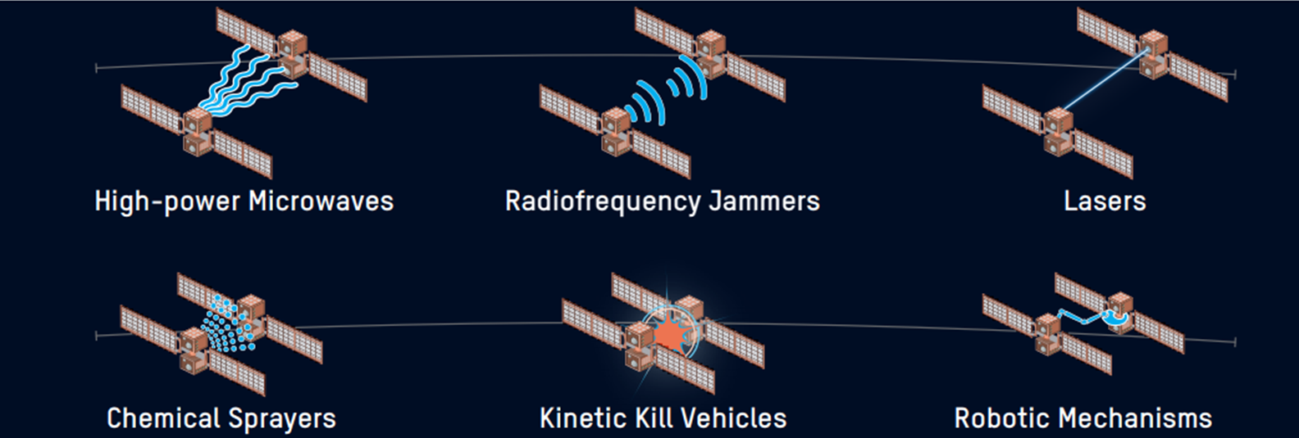
Evolving Threat
China and Russia “view counter-space
capabilities as a means to reduce U.S. and allied
military effectiveness.” (“Challenges to Security in
Space,” U.S. Defense Intelligence Agency, 2019)
“China and Russia, our strategic competitors, are explicitly pursuing space warfighting capabilities to neutralize U.S. space capabilities during a time of conflict. Other potential adversaries are also pursuing counter-space capabilities such as jamming, dazzling, and cyber-attacks.” (1601 Report)

Slide 5
New Approach
Today’s space threat environment and commercial space ventures are driving the Department to think differently
Space architectures with small number of large, exquisite satellites are not responsive to expanding space capability needs and emerging space threats
DoD sees great potential in diversified and proliferated small satellite constellations to provide a cost effective approach for:
  Inserting new space capabilities
  Timely responsive solutions to changing threats
  A resilient approach to assuring space capabilities for the joint warfighter
The emerging threat environment drives the need for a new, focused approach to equipping tomorrow’s Space Force more quickly, at lower cost than offered by legacy approaches.

Slide 6
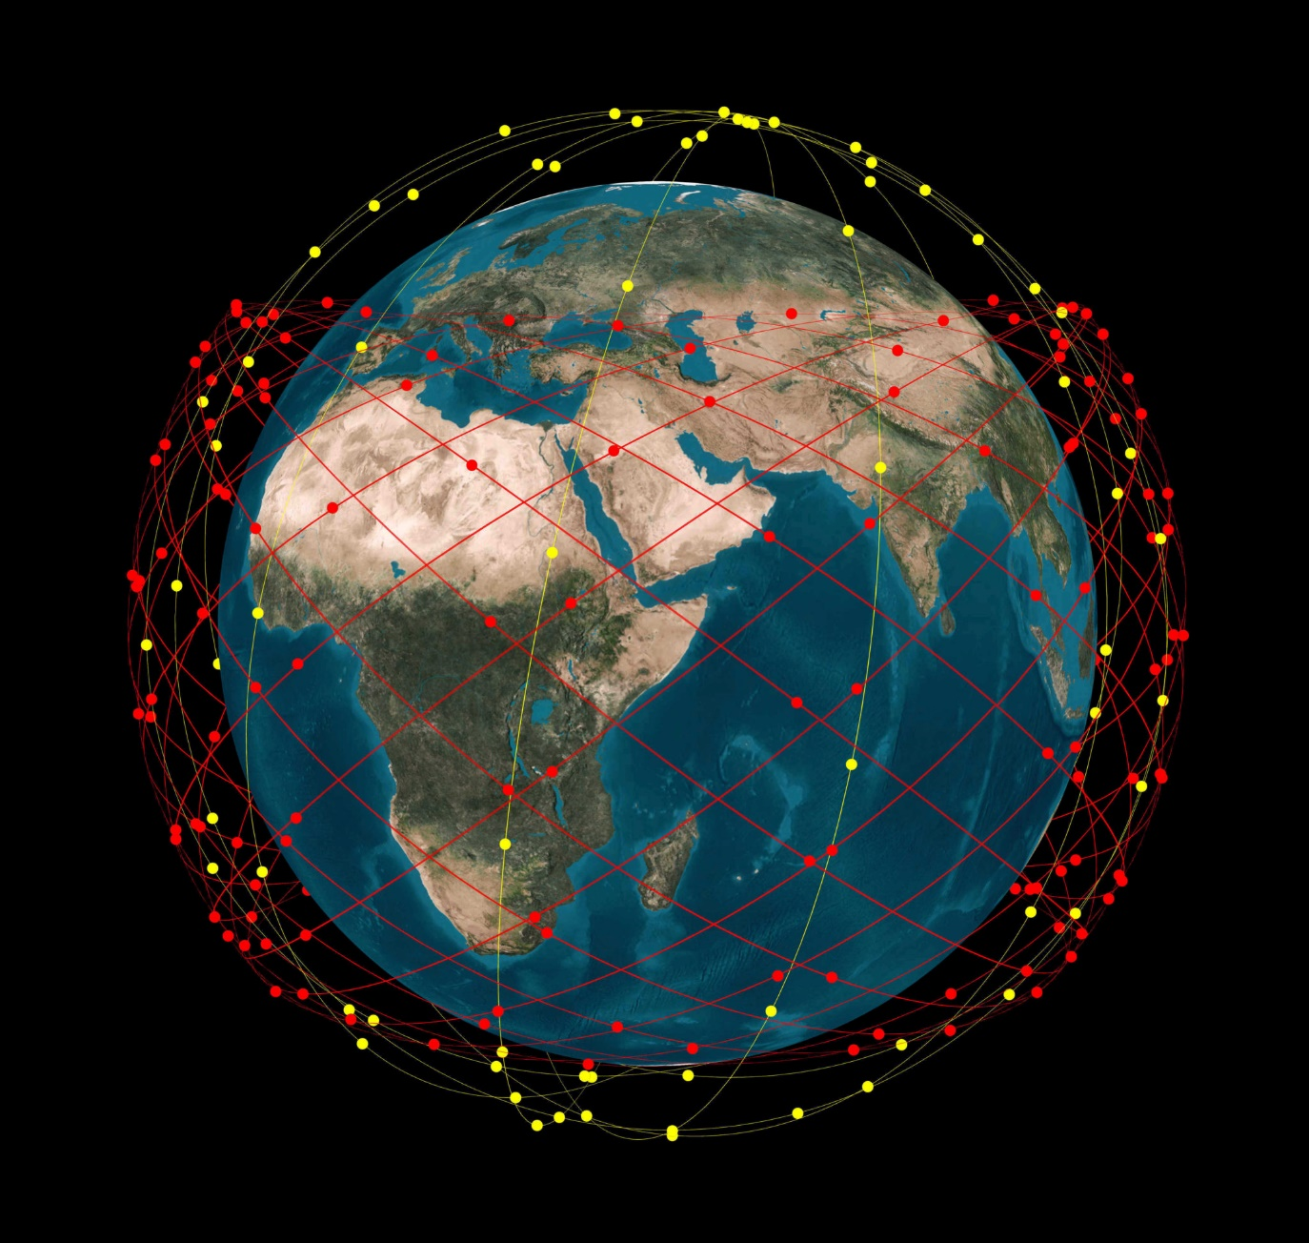
DoD Space Vision
Persistent Global Surveillance for Advanced Missile Targeting
Highly-scaled, low-latency, persistent, Artificial-Intelligence Enabled Global Surveillance
Indications, Warning, Targeting, and Tracking for Defense Against Advanced Missile Threats
Cross-Domain, Fully Networked, Node-Independent Battle Management C3
Alternate Position, Navigation, and Timing for GPS-Denied Environment
Common, Proliferated Ground-based Space Support Infrastructure
Global and Near Real-time Space Situational Awareness (SSA)
Strong Deterrent Capability
Source: Section 1601 Report to Congress

Slide 7

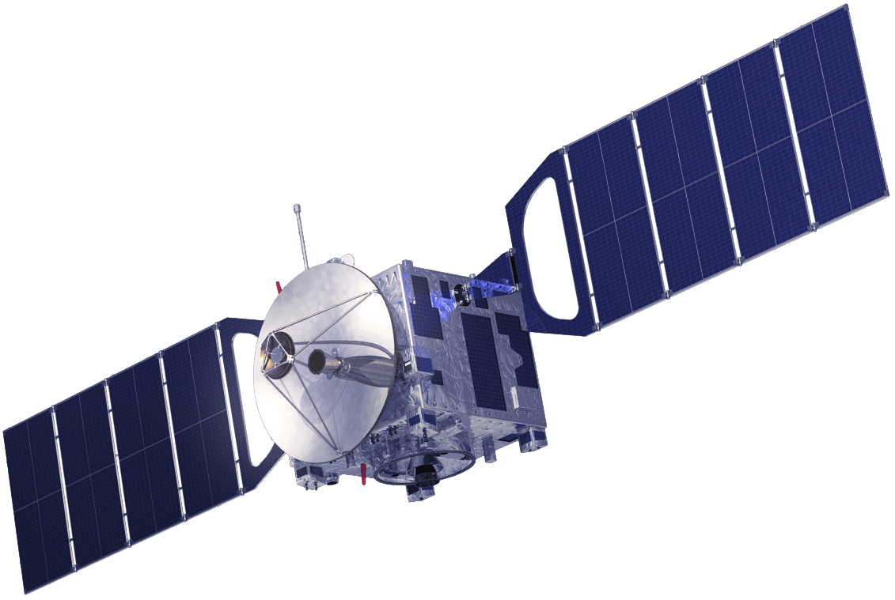

Closing the Business Case:
DoD and Commercial Shared Interest
Future Architectures
Legacy Architectures
Mega-constellations of low-cost satellites
Few, exquisite satellites
Distributed, automated network & enterprise management
Flexible, dynamic network configuration; mesh networking
Cross-links
Reconstitution approaches
On-demand launch
ARCHITECTURE
CHANGES
Project Blackjack
SPACE
VEHICLE
CHANGES
Future Spacecraft:
Minimize Commercial Differences
Software-defined radios & networking
Mass-produced commodity hardware
Optical and hybrid RF/optical communications
Standardized components and interfaces
Spacecraft hosted battle management and navigation
Threat environment
Radiation hardening
Assured cyber-resiliency

Slide 8
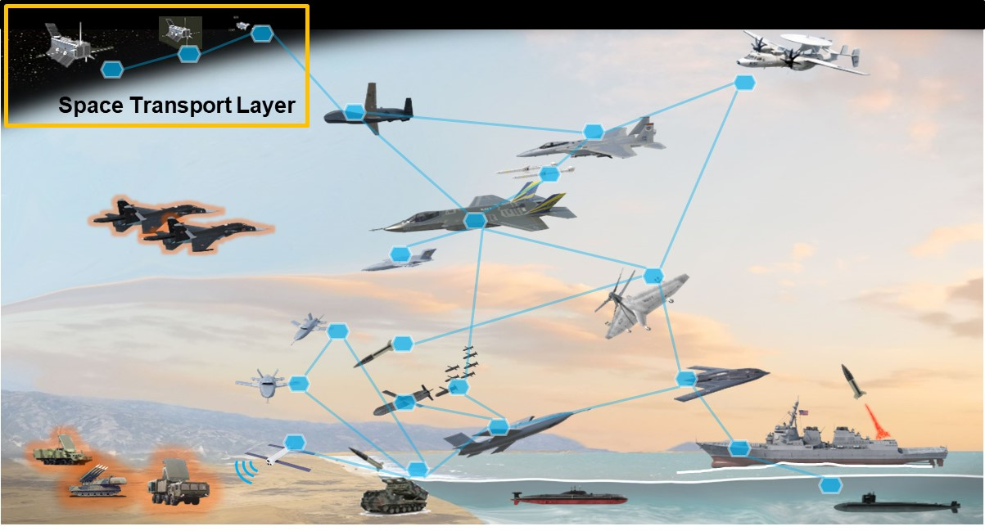
Communications Vision
Fully Connected Interoperable Multi-Domains
Open architecture and standards ensure interoperability between DoD networks, our partner systems, and the commercial services we use
Each owner’s networks meet their Quality of service and security requirements

Slide 9
Space Development Agency Mission
Develop and deploy a new threat-driven space architecture to preserve and extend our military advantage in space
Scope:
  Collaborate with the joint warfighter to address
  operational requirements
  Establish the next-generation space architecture
  Unify and integrate space capability development and deployment
  Reduce overlap and inefficiency
  Foster growth in the U.S. space industrial base
  Leverage commercial and allied space technology, where practical
SDA established by SecDef memo
March 12, 2019
A joint organization to develop and field next-generation military space capabilities for the DoD Space Vision

Slide 10


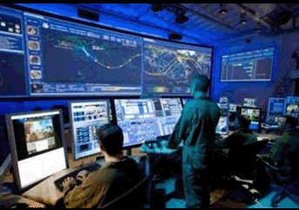
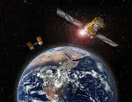
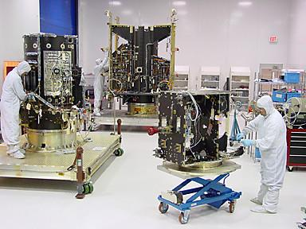
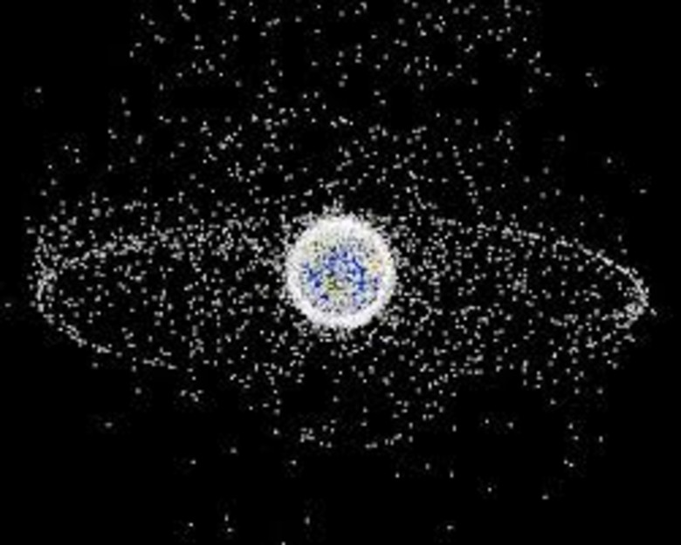
Mature Technology to Capability Paradigm
Transition Capability to Warfighter
Demonstration Phase
Concept Design Study
Phase
White Paper & Quad Chart Phase
Review Strategic Priorities
Gaps Identified, Concepts Developed, Technologies Matured, Prototypes Demonstrated, Capability Transitioned!
Identify Critical Gaps
ONGOING
30 DAYS
90 DAYS
24 MONTHS
ASAP!
New paradigm accelerates impact on lethality and combat readiness

Slide 11
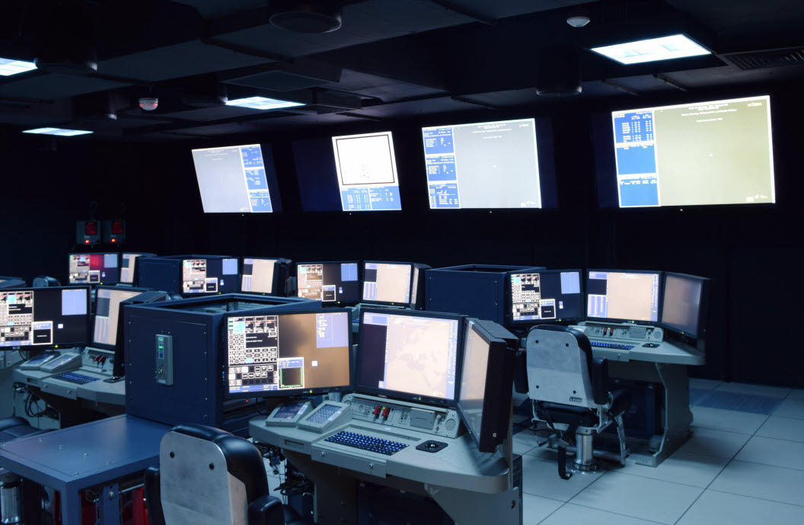


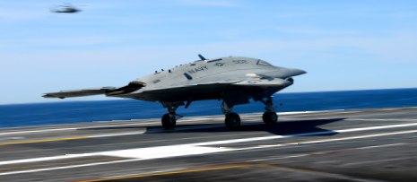
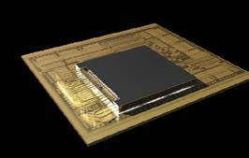

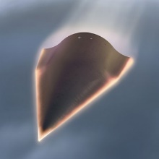


USD(R&E) Modernization Priorities
Quantum Science
Networked C3
Space
Micro-Electronics
Directed Energy
Autonomy
Artificial Intelligence
Hypersonics
Cyber
Align prototyping and experiments to modernization priorities
Rapid Prototyping Program
Rapid Prototyping Fund
Rapid Innovation Fund
Defense Innovative Unit
Small Business Innovative Research
Joint Capability Technology Demonstration
…Others…

Slide 12
Example: Recent Broad-Area Announcement:
Time-Sensitive Target Mission Payloads Demonstration
Advance space-based or high altitude-based sensor concepts or enabling technologies to support operations against time sensitive targets through analysis, experimentation, and demonstration
Mission payload solutions that support Services long-range fires development and testing by 2021
Creative, non-traditional approaches
Individual offerings that solve or contribute to the end-to-end mission
Industry cost sharing mutual investment in the mission
Phase 1: White Paper submission and assessment (complete)
Phase 2: Concept Design - 90-day, in-depth analysis
Phase 3: Demonstration - Two-year effort to demonstrate payload concepts

Slide 13
Summary
Space is now a Warfighting Domain
We need architectures and capabilities that are responsive to expanding space capability needs and emerging space threats
We need to work together to address the challenges
  Relying on our industry partners to bring innovative solutions
  Lots of opportunities to get involved through rapid prototyping

Slide 14
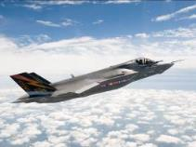
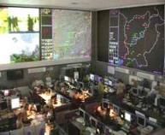
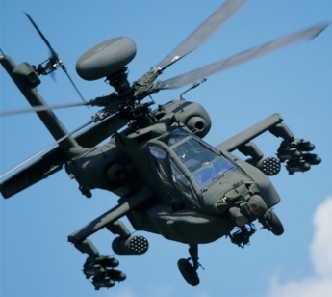
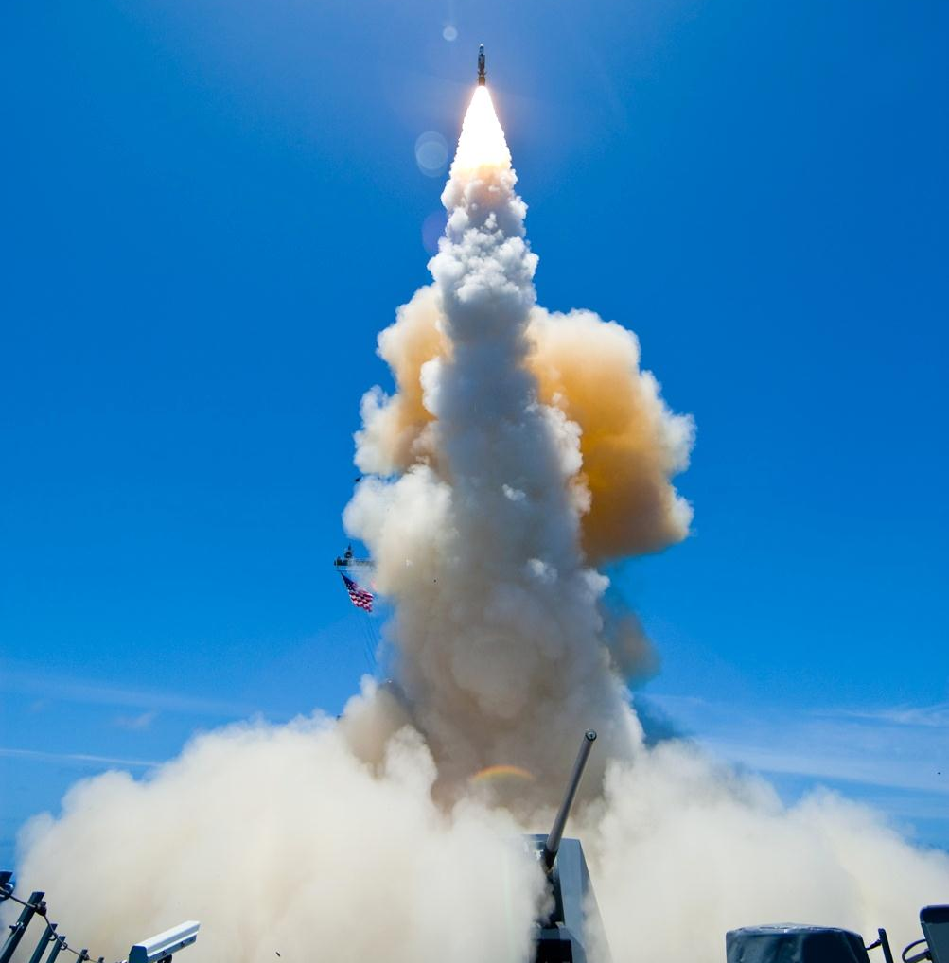

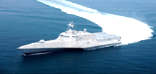
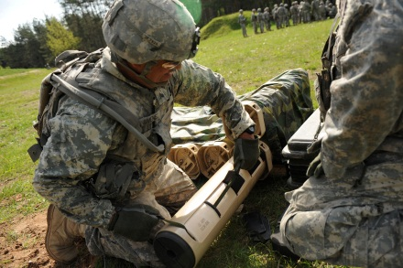
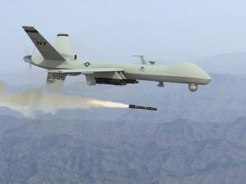
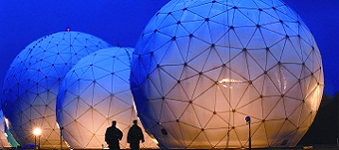
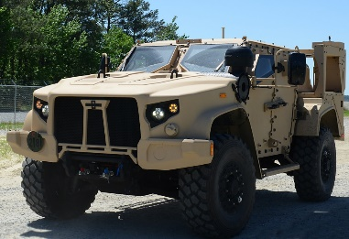
DoD Research and Engineering Enterprise
Solving Problems Today – Designing Solutions for Tomorrow
DoD Research and Engineering Enterprise
https://www.acq.osd.mil/chieftechnologist/
Defense Innovation Marketplace
https://defenseinnovationmarketplace.dtic.mil
Twitter
@DoDInnovation

Slide 15
For Additional Information
Mr. Dean Ridgely
Acting Assistant Director, Space
DDR&E(AC)
Office of the Under Secretary of Defense
for Research and Engineering
osd.atl.asd-re.se@mail.mil

