Slide 1
34th Annual T&E Conference
Modernized T&E: Critical Enabler of the National Defense Strategy
May 14, 2019
Jim Faist Director, Defense Research and Engineering for Advanced Capabilities
and
Director, Test Resource Management Center

Slide 2
DDRE(AC) & TRMC: Roles and Goals
DDR&E(AC) Role: Accelerate Modernization; Mature Technology to Capability, from Prototyping to Acquisition
DDR&E(AC) Goals:
Establish Mission Integration Analytics
Support Assistant Director roadmap development and execution
Drive system-level projects that close gaps in joint missions
Assess Technical Risk in major programs
Enhance policy to accelerate modernization (remove barriers)
Test Resource Management Center (TRMC) Goals:
Develop Strategy to Address Future Test Infrastructure Needs
Modernize Test Infrastructure
Ensure Adequate Resources to Maintain National Test Assets

Slide 3
How We Operate: High-level Development Cycle
Analysis & Architectures
New Technology Awareness and Development
Assistant Director Roadmaps
Mission Integration
Engineering Policy & Systems
CCMDs & LNOs
Operational Use
Prototyping & Demonstration
Developmental Test, Evaluation & Prototyping
Testing
Legend
USD Acquisition & Sustainment
Test Resource Management Center
Functions
Development and Production in Industrial Base
DDR&E (AC)/TRMC
Portfolio
CCMDs: Combatant Commands
LNOs: Liaison Officers
Other Organizations

Slide 4
Modernization Priorities
“We cannot expect success fighting tomorrow’s conflicts with yesterday’s weapons or equipment.”
– National Defense Strategy
DDRE Advanced Capabilities
Hypersonics
Fully Networked Command, Control, & Communication
Space
Autonomy
DDRE Research & Technology
Directed Energy
Cyber
Quantum Science
Microelectronics
Biotechnology
USD Research & Engineering
Machine Learning / Artificial Intelligence
There is a Portfolio Manager (Assistant Director) who is responsible for establishing the DoD-wide, mission-focused strategy and execution plan for each modernization priority

Slide 5
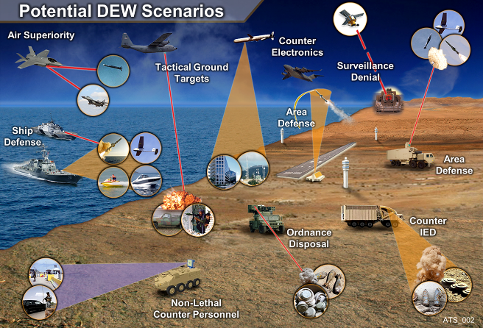
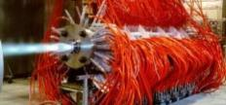
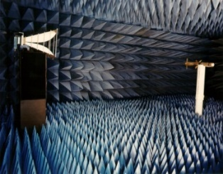
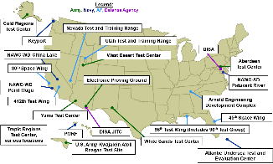
Test Resource Management Center
Ensures that DoD test ranges and facilities have the infrastructure, capabilities, funding, and workforce in place to support the development, acquisition, fielding, and sustainment of Defense systems.
Strategize future test needs
Aligned to R&E Priorities
Prioritize capabilities needed
Lower the cost of testing
Modernize test infrastructure
New technologies & capabilities
Multi-facility integration
Enhance cyber test ranges
Ensure adequate resources to maintain National test assets
Certify Service T&E budgets

Slide 6
Test Technology Modernization Drivers
Warfighter Capabilities
Improve Lethality
Hypersonics
Cyber / Electronic Warfare
Directed Energy
Autonomous Systems
Improve Resilience
Cyber / Electronic Warfare
Improve Interoperability
System of Systems
Mission-Level Effectiveness
Acquisition Programs
Reduce the Cost of Testing
Improve the Quality of Testing
T&E Needs
Optimize Spectrum Usage
Mitigate Range Encroachment
Improve the T&E Workforce
Test Technology Areas
High Speed Systems Test
Cyberspace Test
Electronic Warfare Test
Directed Energy Test
Autonomy and Artificial Intelligence Test
C4I & Software Intensive Systems Test
Spectrum Efficiency Technology
Advanced Instrumentation Systems Technology

Slide 7
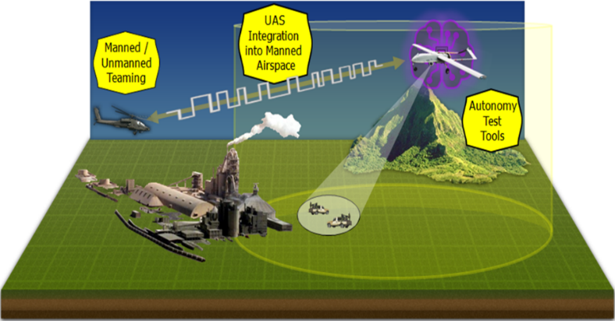
Autonomy, Integration, and Teaming (AIT) – TRMC
Improved Capabilities for Testing UAV Autonomy, Controlled Airspace Integration, and Distributed Manned-Unmanned Teaming

Slide 8
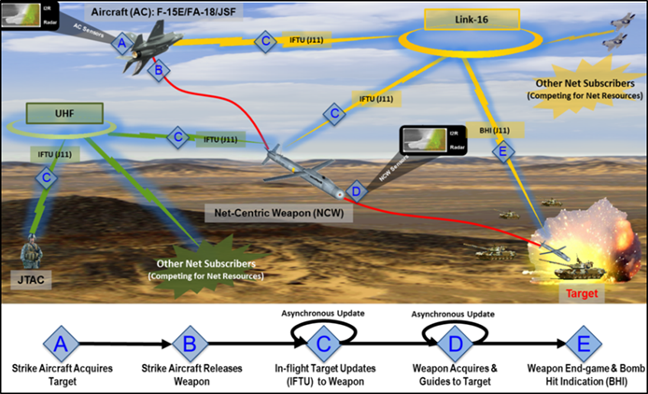
Net-Centric Weapons Test and Evaluation Environment (NCWTEE) – TRMC
Operationally Representative M&S Environment to Evaluate Full Net-Centric Weapon Kill Chain – Realistic Network Loading and Radio Frequency Effects

Slide 9
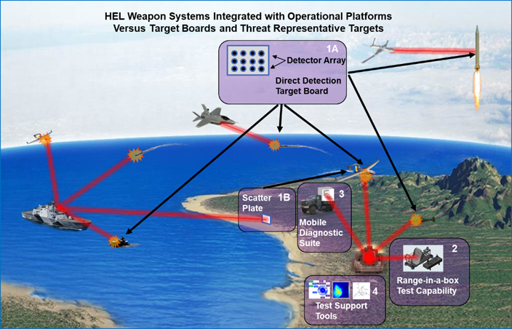
Mobile High Energy Laser Measurement (MHELM) – TRMC
Target Boards and Test Tools to Measure High Energy Laser Irradiance on Targets

Slide 10
Advanced Weapons Effects Test Capability (AWETC) – TRMC
More Accurate Data Collection and Measurement Capability of Fragment-Producing Warhead Damage and Safety Zones

Slide 11
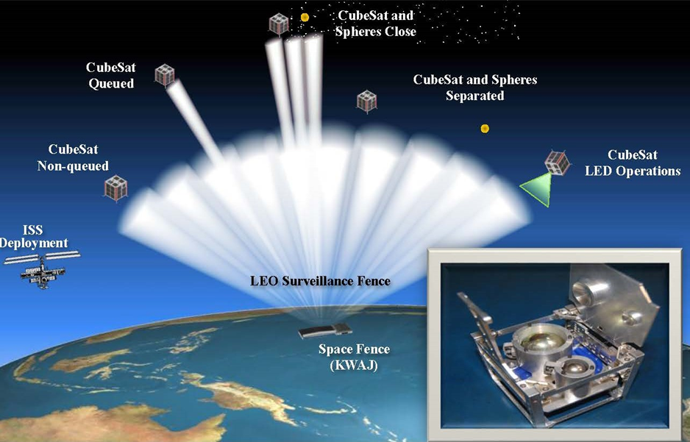
Space Fence Evaluation of Radar EffectivenesS (SFERES) – TRMC
Calibrated, Threat-Representative Targets for Live Test and Evaluation

Slide 12
Common Range Integrated Instrumentation System (CRIIS) – TRMC
Modern Range Data System – Increased Capacity, Accuracy, Speed

Slide 13
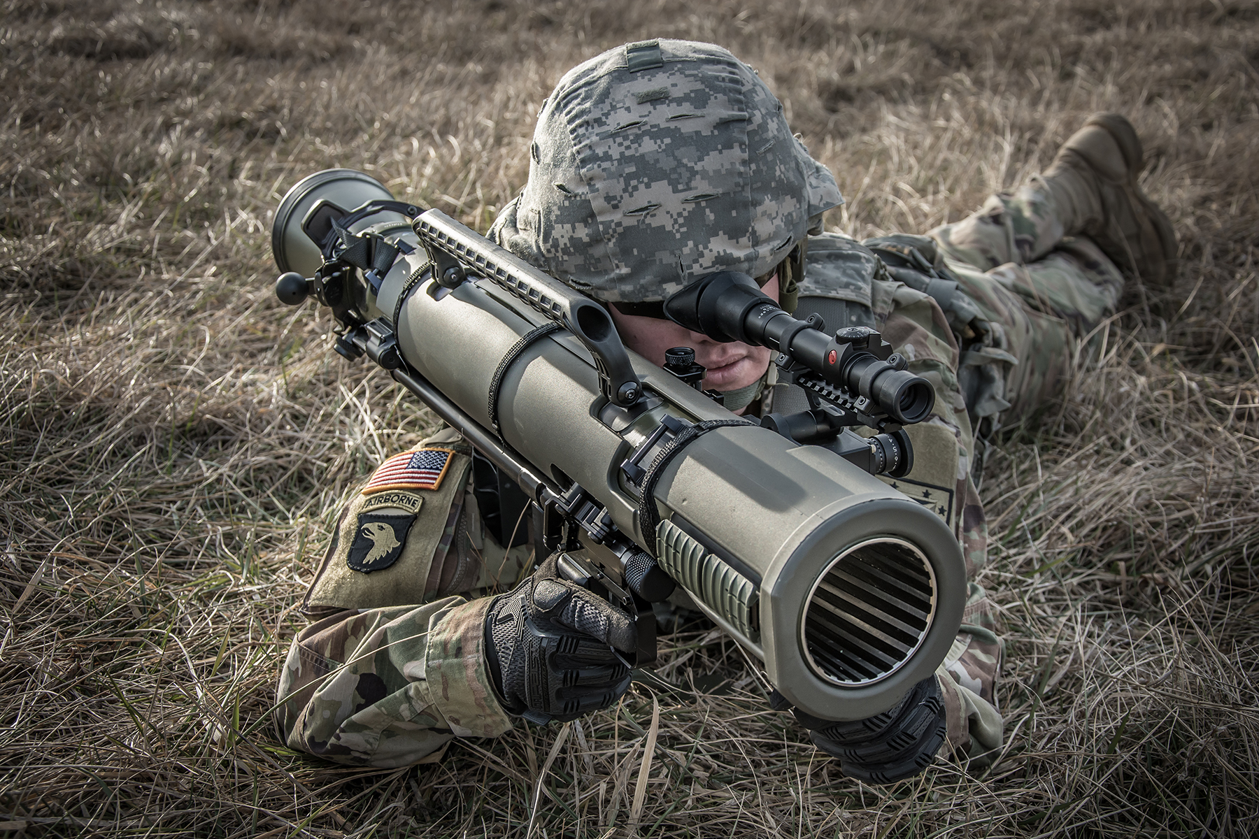
Questions?

