Slide 1
Enabling Speed in Test & Evaluation
14 May 2019
Presented to: NDIA T&E Conference
Presented by: Mr. Robin Locksley, SES
NAVAIR, Director of Flight Test Engineering
Integrated Systems Evaluation, Experimentation and Test (ISEET) Department
NAWCAD Public Release 2019-376 Approved for Public Release; distribution is unlimited.

Slide 2
The Case for Revising Test Design
“Test takes too long and costs too much!”
Classic test and evaluation (T&E) methodology is necessary, but insufficient
To accelerate delivery, we must evaluate and assess early in the acquisition life cycle – long before systems are aggregated
The tools, insight, workforce, and training have changed – it’s time to act!
Initial Operational Capability
POM-08
POM-17
Standard Missile - 6
High Altitude Anti-Submarine Warfare Weapon
Next Generation Jammer
Naval Integrated Fire Control -Counter Air
Air and Missile Defense Radar
Joint Strike Fighter (F-35)
CG(X)
Maritime Strike Tomahawk
Notional acquisition program schedules
NAWCAD Public Release 2019-376 Approved for Public Release; distribution is unlimited.

Slide 3
The T&E Vision Quest…
Driven by changing demographics
Imperative to maintain warfighter connection
Assembled a diverse group of T&E professionals to illuminate our “secret sauce” and identity – the “Credo Team”
Outcomes: One, Seven, and Five …
Our Tagline:
ISEET – A unified military and civilian team swiftly evaluating current and future naval aviation capabilities
NAWCAD Public Release 2019-376 Approved for Public Release; distribution is unlimited.

Slide 4
CREDO Team Results
1
MISSION ISEET provides naval aviation and the Naval Air Systems Command with premier and innovative test, evaluation and experimentation expertise, as vigilant advocates of the warfighter. We are focused on rapidly and safely delivering effective capability for our Sailors and Marines.
ISEET – A unified military and civilian team swiftly evaluating current and future naval aviation capabilities
CORE PRINCIPLES
WAYS TO ACHIEVE OUR VISION
7
5
We evaluate with integrity We strive for excellence We are committed to the mission We work together We balance our commitments We are diverse and inclusive We are leaders
Maximize the use of robust, distributed modeling and simulation
Test like we fight
Master our craft
Measure ourselves
Learn from our competitors
Our Vision:
To be the world’s leader in aviation and weapons systems test and evaluation
4

Slide 5
Robust Modeling and Simulation
Technology has enabled impressive gains in capability to replicate true battlespace complexity
NAWCWD “Gemstone” Project - executing priority operational mission scenarios using Live Virtual Constructive (LVC)
Develop enduring concepts of operation, processes, and procedures
Changing the culture and training the workforce
Mission relevant exposure and proficiency
Treat LVC events with the same criticality as flight events
Accelerating Modeling and Simulation (M&S) implementation
M&S database of accreditation plans
Refine models and validate/verify system performance
Interface standardization-AMIE
Architecture Management Integration Environment (AMIE)
Common nonproprietary method to integrate models and simulations
Neutral Data Exchange Model
Promotes reuse and efficiency across the acquisition life cycle
There is no better way to evaluate complex systems given current constraints
NAWCAD Public Release 2019-376 Approved for Public Release; distribution is unlimited.

Slide 6
Test Like We Fight
Capabilities-Based Test and Evaluation (CBTE)
Warfare Analysis
Red Forces and Blue Forces
CONEMPs
Top Down
System of Systems Rqmts
 | SURVEIL | DETECT | TRACK | ID | ENGAGE |  | ASSESS
 |  |  |  |  | LAUNCH | WEAPON
AA MISSILE
F-35
F/A-18
E-2D
NOTIONAL
Integration with COMOPTEVFOR's
Mission-Based Test Design (MBTD)
Bottom Up
CBTE evaluates the effects chain
in a mission context
Weapons Schools
LEGEND
CDD - CAPABILITY DEVELOPMENT DOCUMENT
CONEMP - CONCEPT OF EMPLOYMENT
CONOP - CONCEPT OF OPERATION
CPD - CAPABILITY PRODUCTION DOCUMENT
POE - PROJECTED OPERATIONAL ENVIRONMENT
ROC - REQUIRED OPERATIONAL CAPABILITY
TEMP - TEST AND EVALUATION MASTER PLAN
Add Mission Context (CONOPs, ROC/POE)
Platform Rqmts (CDD, CPD, TEMP, specs)
NAWCAD Public Release 2019-376 Approved for Public Release; distribution is unlimited.

Slide 7
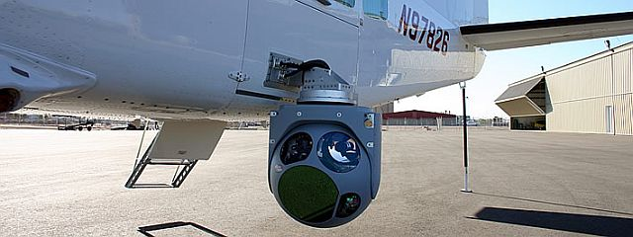
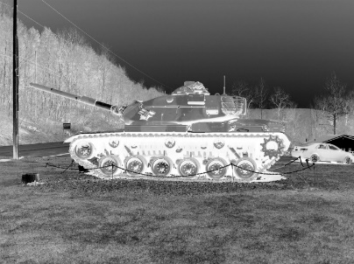
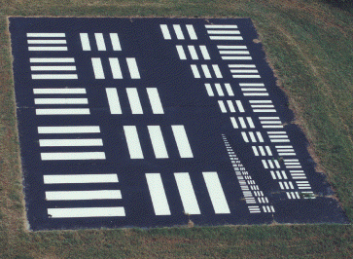
Specification-Based Test Approach
1. Gather specifications
2. Determine test requirements
3. Develop test matrix and write test plans
4. Execute test plan
5. Evaluate results
6. Document deficiencies in context of “Mission Relation”
Critical flaws with this approach:
Vague connection to mission tasks…
Knowledge of mission sometimes limited…
Can drive retest to validate mission related deficiencies…
Might miss what warfighter really cares about – mission capability!
NAWCAD Public Release 2019-376 Approved for Public Release; distribution is unlimited.

Slide 8
CBTE Based Approach
1. Gather Warfare Analysis Data
2. Gather System Specifications
3. Complete MBTD 12 Step Process
4. Execute test plan
5. Evaluate Mission Capability
6. Document results and deficiencies
CBTE approach:
Connects item under test to mission tasks…
Provides knowledge of mission impact
Minimizes retest to validate mission related deficiencies…
Focuses on what warfighter really cares about – mission capability!
Mission Thread
Prepare/ Configure 5.1 | Transit/ Navigate/ Communicate 5.2 | Combat Assault Transport 5.3 | Defend 5.4 | Post Mission 5.5
NAWCAD Public Release 2019-376 Approved for Public Release; distribution is unlimited.

Slide 9
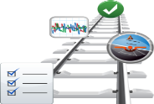
CBTE Reporting in the Future
Implementing CBTE methodologies into test design and reporting process enables:
Assessment of ability to execute a mission
Traceability from test point to mission thread
Traceability of deficiencies to mission tasks
More accurate assessment of mission impact (as opposed to traditional specification compliance approaches)
iPlan
iTrack
iReport
T&E TEST PLANNING TOOL
Test Project Introduction Documents
Project Planning Memos
Test Plan Routing and Repository
Support Test Plans
Standard Planning Metrics
T&E EXECUTION TOOL
Test Requirement Traceability
Test Plan/Point/Event Tracking
Test Dailies and Watch Items
Standard Execution Metrics
T&E REPORTING TOOL
Deficiency Reports
Quarterly Status Reports
Reports of Test Results
Interim Summary Reports
DT/OT Transition Reports
Test Engineering Data Reports
Technical Information Memos
Standard Reporting Metrics
Report Routing and Repository
NAWCAD Public Release 2019-376 Approved for Public Release; distribution is unlimited.

Slide 10
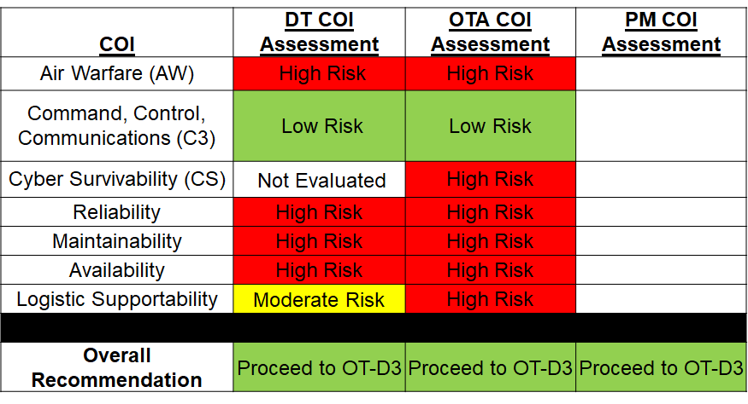
CBTE Enables Mission-Based Decision Making
From:
“We’ll be done with the test program when we’ve executed a mountain of test points and provided a Red/Yellow/Green assessment of performance against critical operational issues (COIs)…”
To:
“As you can see from the Mission threads and tasks, we can go to Operational Test when we can deliver the capability requested and complete a mission from start to finish…”
Prepare/ Configure 5.1 | Transit/ Navigate/ Communicate 5.2 | Combat Assault Transport 5.3 | Defend 5.4 | Post Mission 5.5
Navigate
5.2.1
Communicate
5.2.2
Transit to PZ or Objective
5.2.3
Conduct Voice Communications
Provide Communications to Troop Commander
NAWCAD Public Release 2019-376 Approved for Public Release; distribution is unlimited.

Slide 11
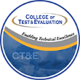
Master Our Craft
Reinforcing knowledge of test techniques AND mission threads – at the subtask level
Collaborating to build the mission threads of our warfare areas
Classroom and experiential training
T&E University
Weapons schools
Implementing high velocity learning
If you don’t know – ask. If you do know – teach. Have the courage to do both.
NAWCAD Public Release 2019-376 Approved for Public Release; distribution is unlimited.

Slide 12
Learn From Our Competitors
Paying attention to the “Business of T&E”
Collecting and analyzing data about the test process
“Instrumenting” the T&E process to gather value stream information
Going “digital”! Using tools to collect, evaluate, and disseminate decision-quality data
NAWCAD Public Release 2019-376 Approved for Public Release; distribution is unlimited.

Slide 13
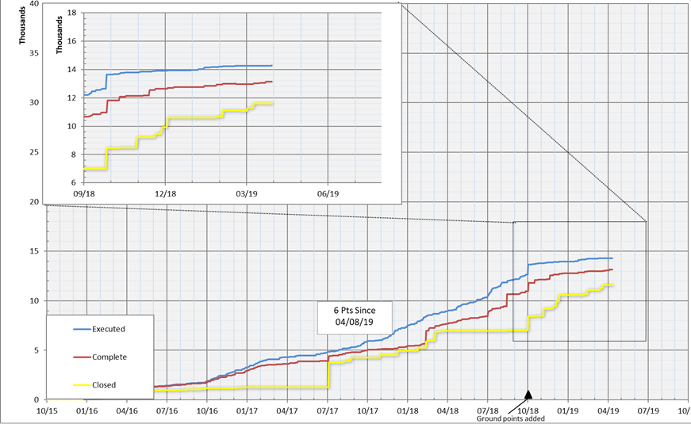
Measuring Ourselves
Integrated T&E Management System (iTEMS) - an enterprise digital suite of tools for:
Test Planning and Resourcing
Test Point tracking and Test Plan execution
Test Reporting
Seamlessly enables development of the “Standard T&E Metrics Slide Deck”
iTEMS provides the ability to completely trace test points through effects chain tasking
Program X Test Point Burn-Up
iTEMS provides ready access to decision quality data
NAWCAD Public Release 2019-376 Approved for Public Release; distribution is unlimited.

Slide 14
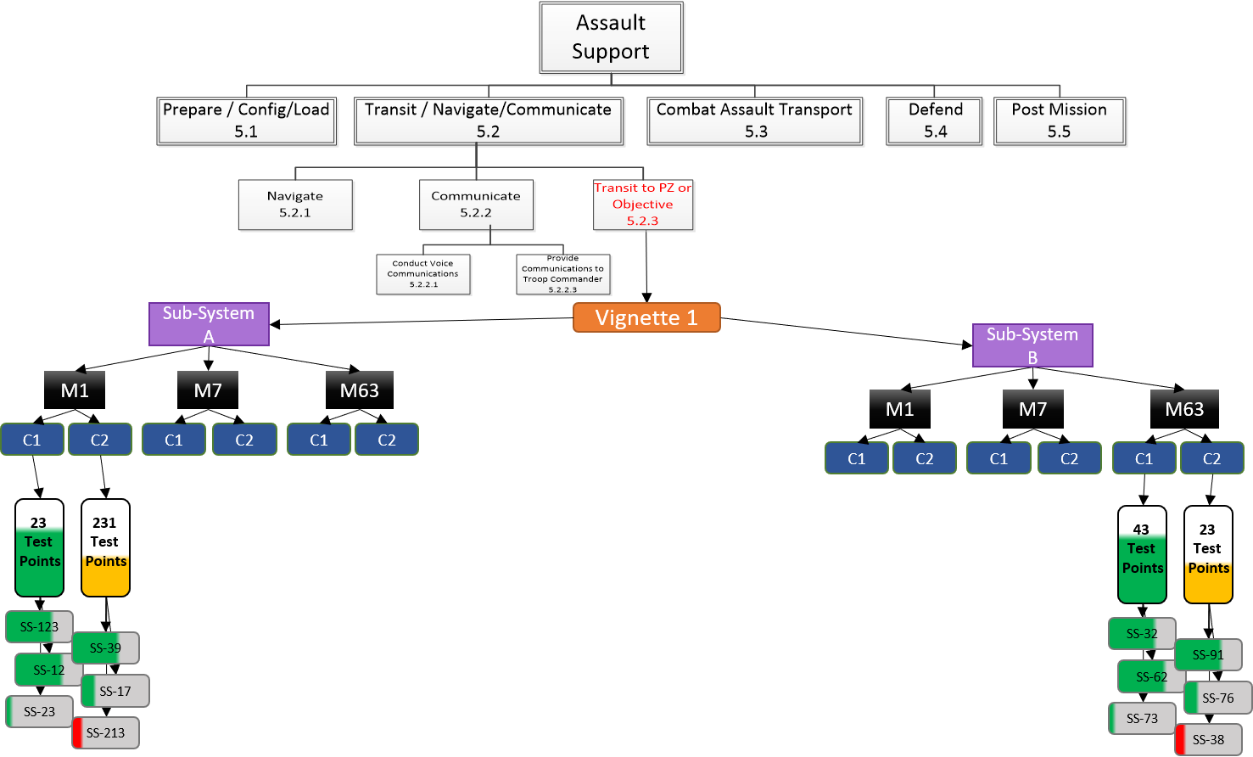
Delivering Speed by Focusing on Capability
Mission
Missions decompose to Tasks and Subtasks
Task
Subtasks are performed by Subsystems
Subtasks and
Subsystems
Subtasks and Subsystems are evaluated in Vignettes and Sub-Vignettes
Vignettes
Subsystem
Subsystems evaluations comprised of Measures
Measures
Measures are effected by Conditions
Conditions provide assessment of variables that effect ability to perform Measures and are tested through Test Points
Conditions
Test Points
Specifications (SS-) are linked to Test Points
Linked data analytics and visualization tools shows the progress of capability development accelerating decision making
NAWCAD Public Release 2019-376 Approved for Public Release; distribution is unlimited.

Slide 15
Questions?
NAWCAD Public Release 2019-376 Approved for Public Release; distribution is unlimited.

