Slide 1
Cost of T&E: Implementation of TEMP Part Four Web-Based Application
Michael Said
Department of the Navy Test and Evaluation
May 2019

Slide 2
Ice Breaker: How Does Each Stakeholder View T&E?
Warfighter
SAE
Systems Engineer
OSD
Program Manager
Contractor
Notes:
Slide Title: How Does Each View T&E?
Learning Objective:
Get the class to discuss their views of the stakeholders.
Builds/Animation: N/A
Instructions:
For each stakeholder ask the class what the stakeholders T&E Interest and T&E Concerns
Color Commentator Notes:
References:
Have the members of the class spend some time thinking about how each of the above view T&E. Once complete review with the class and lead into the next slides.
Role in the acq process
Responsibility
T&E interest
T&E Concerns

Slide 3
T&E Myths on Cost and Schedule
T&E costs too much
Truth: The cost of T&E is very small in the big picture; DT&E is usually ~ 8-10% and OT&E ~1.5% of program acquisition costs
Testing takes too long
Truth: Very few programs are significantly delayed by testing; mostly, system performance problems and fixes cause the delays; only in a few cases, have testing issues led to delays
Industry should do all the testing
Truth: We tried this before and a government/industry test team is best to meet program requirements with proper oversight
Summary based on past DON and OSD studies
A Better Understanding of T&E Costs is Needed!

Slide 4
DON T&E Optimization Campaigns
Purpose
Reduce T&E costs
Increase T&E speed/agility
Address T&E of new technologies
Process
Look at three different sets of inquiries
High Level
Supply and Demand
Supporting
FY2018 Start
Continue as needed
Decision Framework
Inquiries • Data Discovery • Decisions
INQUIRIES
Level I
High Level
Inquiries
Level II
Supply/
Demand
Inquiries
Level III
Supporting
Inquiries
DATA
Data Required
Data Available
Data Gaps/Needs
Data Analysis
Data Discovery Process
Better Inquiries, Better Data, Better Decisions!
DECISIONS
Capability • People • Cost • Policy
Notes:
Slide Title: T&E Optimization Campaigns
Learning Objective:
Describe what DON T&E is doing to try and ensure healthy infrastructure and test capability
Builds/Animation: N/A
Instructions:
Go over bullets, note timeline
Color Commentator Notes:
References:

Slide 5
Examples of DON T&E Inquiries
High Level Inquiries (Level I)
How do we go faster?
How can we reduce costs? T&E should cost…
How do we better understand the demand for T&E resources/capabilities?
Optimization - T&E Board of Directors Inquiries (Level II)
Are we fully leveraging M&S to reduce the cost of T&E?
How can we better understand and capture T&E costs?
What constitutes our Undersea test and training ranges enterprise?
What constitutes our Air test and training ranges enterprise?
Specific/Tactical Inquiries (Level III)
Are there opportunities to integrate/consolidate test and training ranges?
Can we go to a single solution to modernize certain range tracking systems?
Why do we have multiple program offices managing test and training ranges?
Better Inquiries, Better Data, Better Decisions!
Notes:
Slide Title: Levels of Inquiries for the T&E Optimization Campaigns
Learning Objective:
Note how big questions filter down to specific questions.
Builds/Animation: N/A
Instructions:
Go over each level and a few of the lines in each level.
As an example. Describe the focus on usage of under sea warfare (USW) test ranges and training ranges (is there better way to make use of these for combined test and training purposes.
Color Commentator Notes:
References:

Slide 6
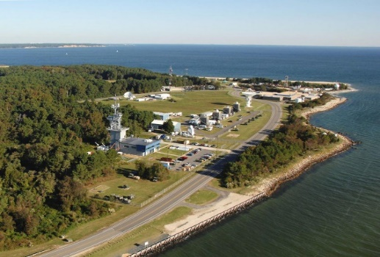
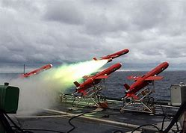
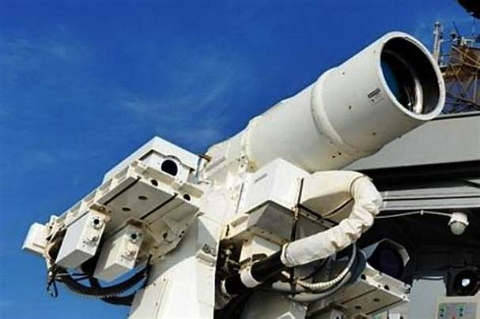
T&E Optimization Campaigns
Assessment efforts to date:
Open Air Range Enterprise
Undersea Range Enterprise
Electronic Warfare Test and Training
ACB20/AMDR Cross Functional Team
Cost of T&E (TEMP Part Four (TP4))
Targets Assessment
High Energy Laser Test Capabilities
Deliverables: Campaign Leads and stakeholders identified, POA&Ms, gap analyses, roadmaps and identification of key products
Notes:
Slide Title: Focus Areas for T&E Optimization Campaigns
Learning Objective:
This section is for awareness, testers may get pulled into supporting effort.
Builds/Animation: N/A
Instructions:
Describe the different focus areas, ask if anyone has been involved.
Color Commentator Notes:
References:

Slide 7
OSD/Service Cost of T&E Efforts
Section 839b NDAA 2018
Requirements for Collection of Cost Data on T&E
May 2018 - DOT&E efforts with Chief Management Officer Test Reform Management Group on T&E Cost Fidelity (TE-7)
April 2019 - DOT&E established Cost of T&E Working Group
Involves DD,DTE&P and DTRMC
Support requested from Services and Agencies
In Early FY2018 DON T&E Embarked On Its TEMP Part Four Tool

Slide 8
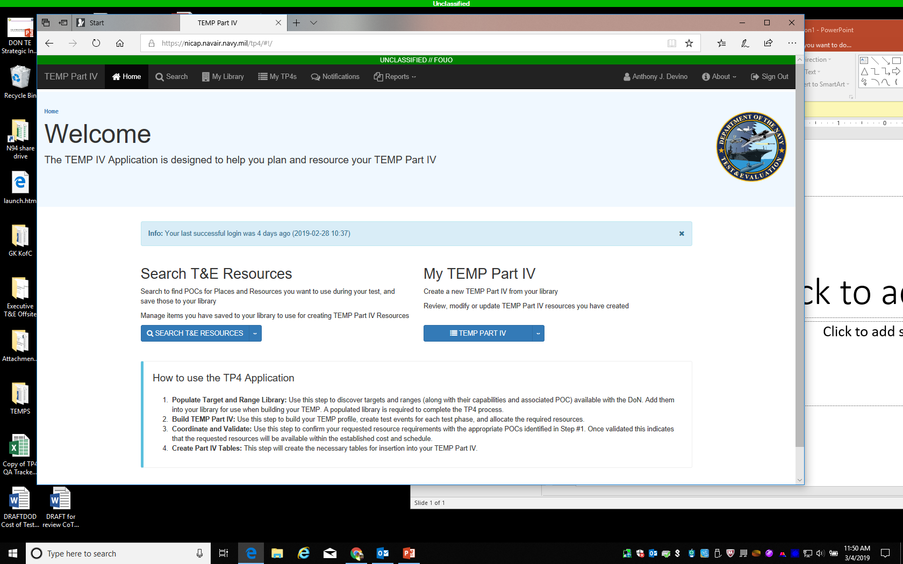
What is TEMP Part Four (TP4) Tool?
Web tool for capturing program T&E resource requirements in the TEMP
Labs / Facilities / Ranges / Manpower / Targets / Test Assets / Test Articles
Programs can search for T&E capabilities
Better coordination with T&E infrastructure management
Captures and provides improved cost estimates for T&E
Identify T&E costs elements (L/F/R, Targets, Assets, Personnel, Program)
Aligns T&E costs with T&E budget program elements
Creates a T&E demand forecasting capability across the DON
Provides real-time aggregated data of T&E demands across all programs
Enables investment insight to the T&E Capability needs and shortfalls
Identify Target demands and move away from Target needs estimating

Slide 9
T&E Financial Life Cycle
Does Our T&E Cost Match Budget?
ACTUAL
COST
BUDGET
PLAN/EXECUTE
Mechanism
PBIS
TP4
ERP
What we have to date
Create T&E Serial
Program Element (PE) Number
T&E Funding (PEs)
What we are working on
T&E Planned Cost
Test Phase (DT/OT/LFT&E)
Test Event
Test Resources
T&E Management
Program Office
Targets
T&E Execution
MIL-STD-881D
Current MIL-STD doesn’t line up with T&E practice
Organizations are not consistent in implementing MIL STD
Test Articles
Test Assets
Fleet Forces/Manning

Slide 10
TP4 Structural Breakdown
Level 1 | Total T&E Costs
Level 2 | Test Phase (DT/OT/LFT&E)
Level 3 | Test Management Test planning and execution staff COTF/MCOTEA planning support Reliability Engineering analysis
 | Test Resources (applied for each Test Event) Lab / Facility / Range (L/F/R)– Creates/Identifies the program demand of our T&E Test Capabilities Program Office (costs for individual test events) Travel Additional Test Personnel Training Targets Identifies N94 target/payload requirements Smaller target – Program funded Test Article System/Sub-System Under Test Test Assets Instrumentation needed for test Additional systems needed for test Fleet Forces Manning Fleet personnel needed to support test event
Safety engineering analysis
Travel
Training
Provides a common structure to input costs and aggregate the data

Slide 11
Two Parts of TP4
CAC-enabled, Web-based, Secure Access, Resource Tool for DON Users

Slide 12
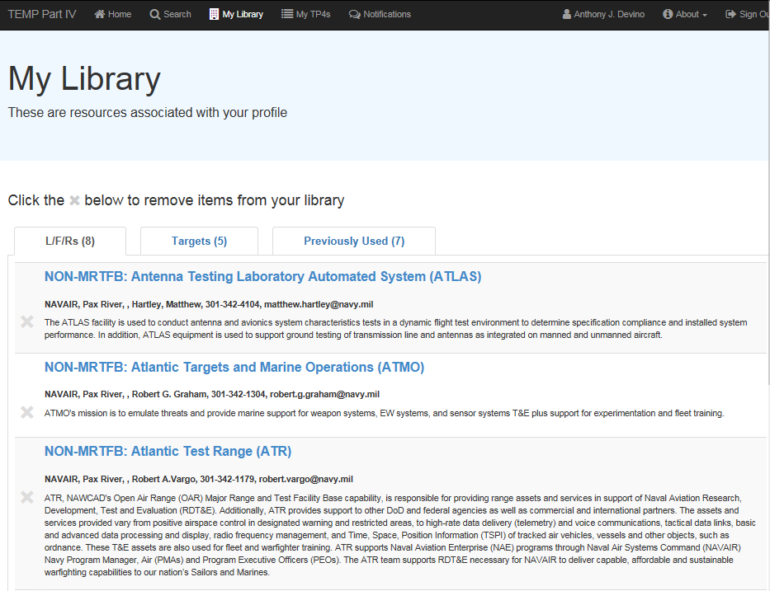
Search T&E Resources
Search: ATR
POC Info
POC Info
POC Info

Slide 13
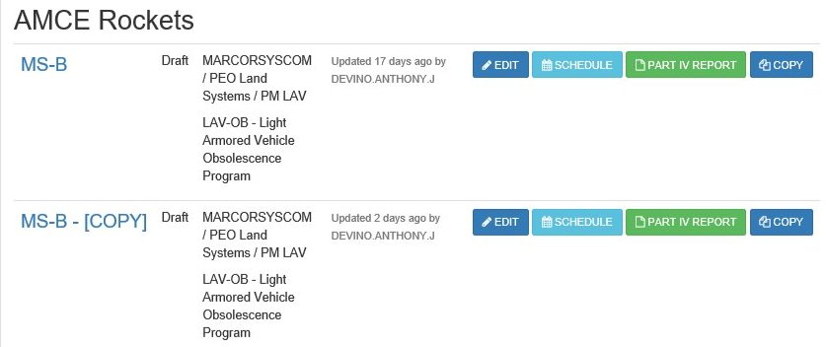
My TEMP Part IV
ACME Vehicle Program
Over 88 Programs have TEMP data recorded
Chain of Command can view all TEMPs within their organization
T&E WIPT members have access to information
Note: Default is View mode, programs can authorize Edit mode authority

Slide 14
Data Analysis Example
Search levels: SYSCOM, PEO and Programs

Slide 15
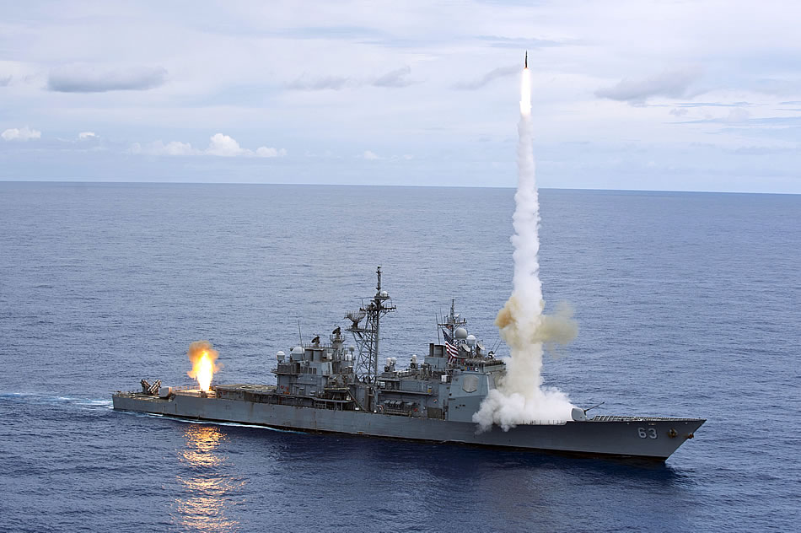
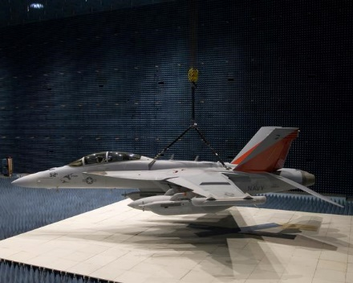
Summary and Conclusions
TP4 integrates T&E resource demands across programs
The tool is a significant enabler for DON programs to search, coordinate and identify their T&E resource requirements
SECNAVINST 5000.2E now mandates programs with TEMPs to develop resource summary inputs using TP4
TP4 Will Enable DON T&E To Better Forecast And Use Its Limited Resources Wisely

Slide 16
Questions?
?
Notes:
Slide Title:
Learning Objective:
Builds/Animation: N/A
Instructions:
Color Commentator Notes:
References:

