Slide 1
Capabilities Based
Test & Evaluation (CBTE)
Kenneth senechal
NAWCAD Release 2019-277. Distribution Statement A - Approved for public release; distribution is unlimited.

Slide 2
What is CBTE?
Warfare Analysis
Red Forces and Blue Forces
CONEMPs
Top Down
System of Systems Rqmts
 | SURVEIL | DETECT | TRACK | ID | ENGAGE |  | ASSESS
 |  |  |  |  | LAUNCH | WEAPON
AA MISSILE
F-35
F/A-18
E-2D
Integration with COTF's
Mission Based Test Design (MBTD)
NOTIONAL
Bottom Up
CBTE evaluates the effects chain
in a mission context
Weapons Schools
Add Mission Context (CONOPs, ROC / POE)
Platform Rqmts (CDD, CPD, TEMP, specs)

Slide 3
NDIA Tabletop Exercise
Jointly hosted by CBTE & NDIA
Objectives
Emphasized an open forum and non-attributional dialogue
Generate baseline RFP and Proposal Guidebook
Participation
Navy Enterprise
COTF, NAVSEA, NAVAIR
Major Primes
Boeing, Lockheed Martin, Raytheon, Northrop Grumman
Representing industry not their specific company
Facilitated
R-Squared Solutions – Bill “Roto” Reuter
Pivotal Insight – Cary Paul & Emily Knight

Slide 4
Tabletop Early Takeaways
Moment of Truth Feedback
Extremely positive feedback on the event from all participants
Consensus that CBTE is a highly effective approach
Product Delivery
Comment/Feedback adjudication is still in progress
What contractors need:
Provide previous test data as GFI to industry to help them VV&A their models
Need to stop doing things the current way and start doing them the new way
Level setting contractor bids so that each prime approaches with same assumptions
What CBTE needs:
Contractor understanding of govt LVC infrastructure
Using a mission focus to incentivize contracts
Define overarching test strategy that includes LVC (LVC isn’t a stand alone strategy)
MBTD / Mission thread focused (security issues)
What we both need:
Need a common vernacular and industry understanding of our tools/process/policy
Identified new specific SOO/SOW elements
Pairing a weapon system SME with a DoE SME is critical for success
Balance of defining need/requirement so it doesn’t stifle innovation
Proper balancing of spec requirement verification in a mission construct

Slide 5
NDIA Way Ahead
Continue Data & Feedback Adjudication
NDIA T&E Conference Out-brief (13-15 May 2019)
N94 Sponsored NAVAIR hosted Cross SYSCOM TIM (5-6 Jun 2019)
Common processes across Navy SYSCOMs
Follow on Tabletop Sessions desired
Notionally planning for end of Summer
Product Delivery
Projecting Year End CBTE RFP and Proposal Guidebook
Brief guidelines to NAVAIR/PEO Leadership

Slide 6
Back Up

Slide 7
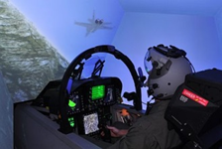
CBTE Enablers
Live-Virtual-Constructive (LVC)
Mission Based Test Design (MBTD)
Design of Experiments (DoE)
Mission T&E During System Development
System of Systems Testing
Human Performance
Mission Analysis
Mission Training

Slide 8
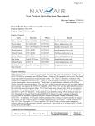
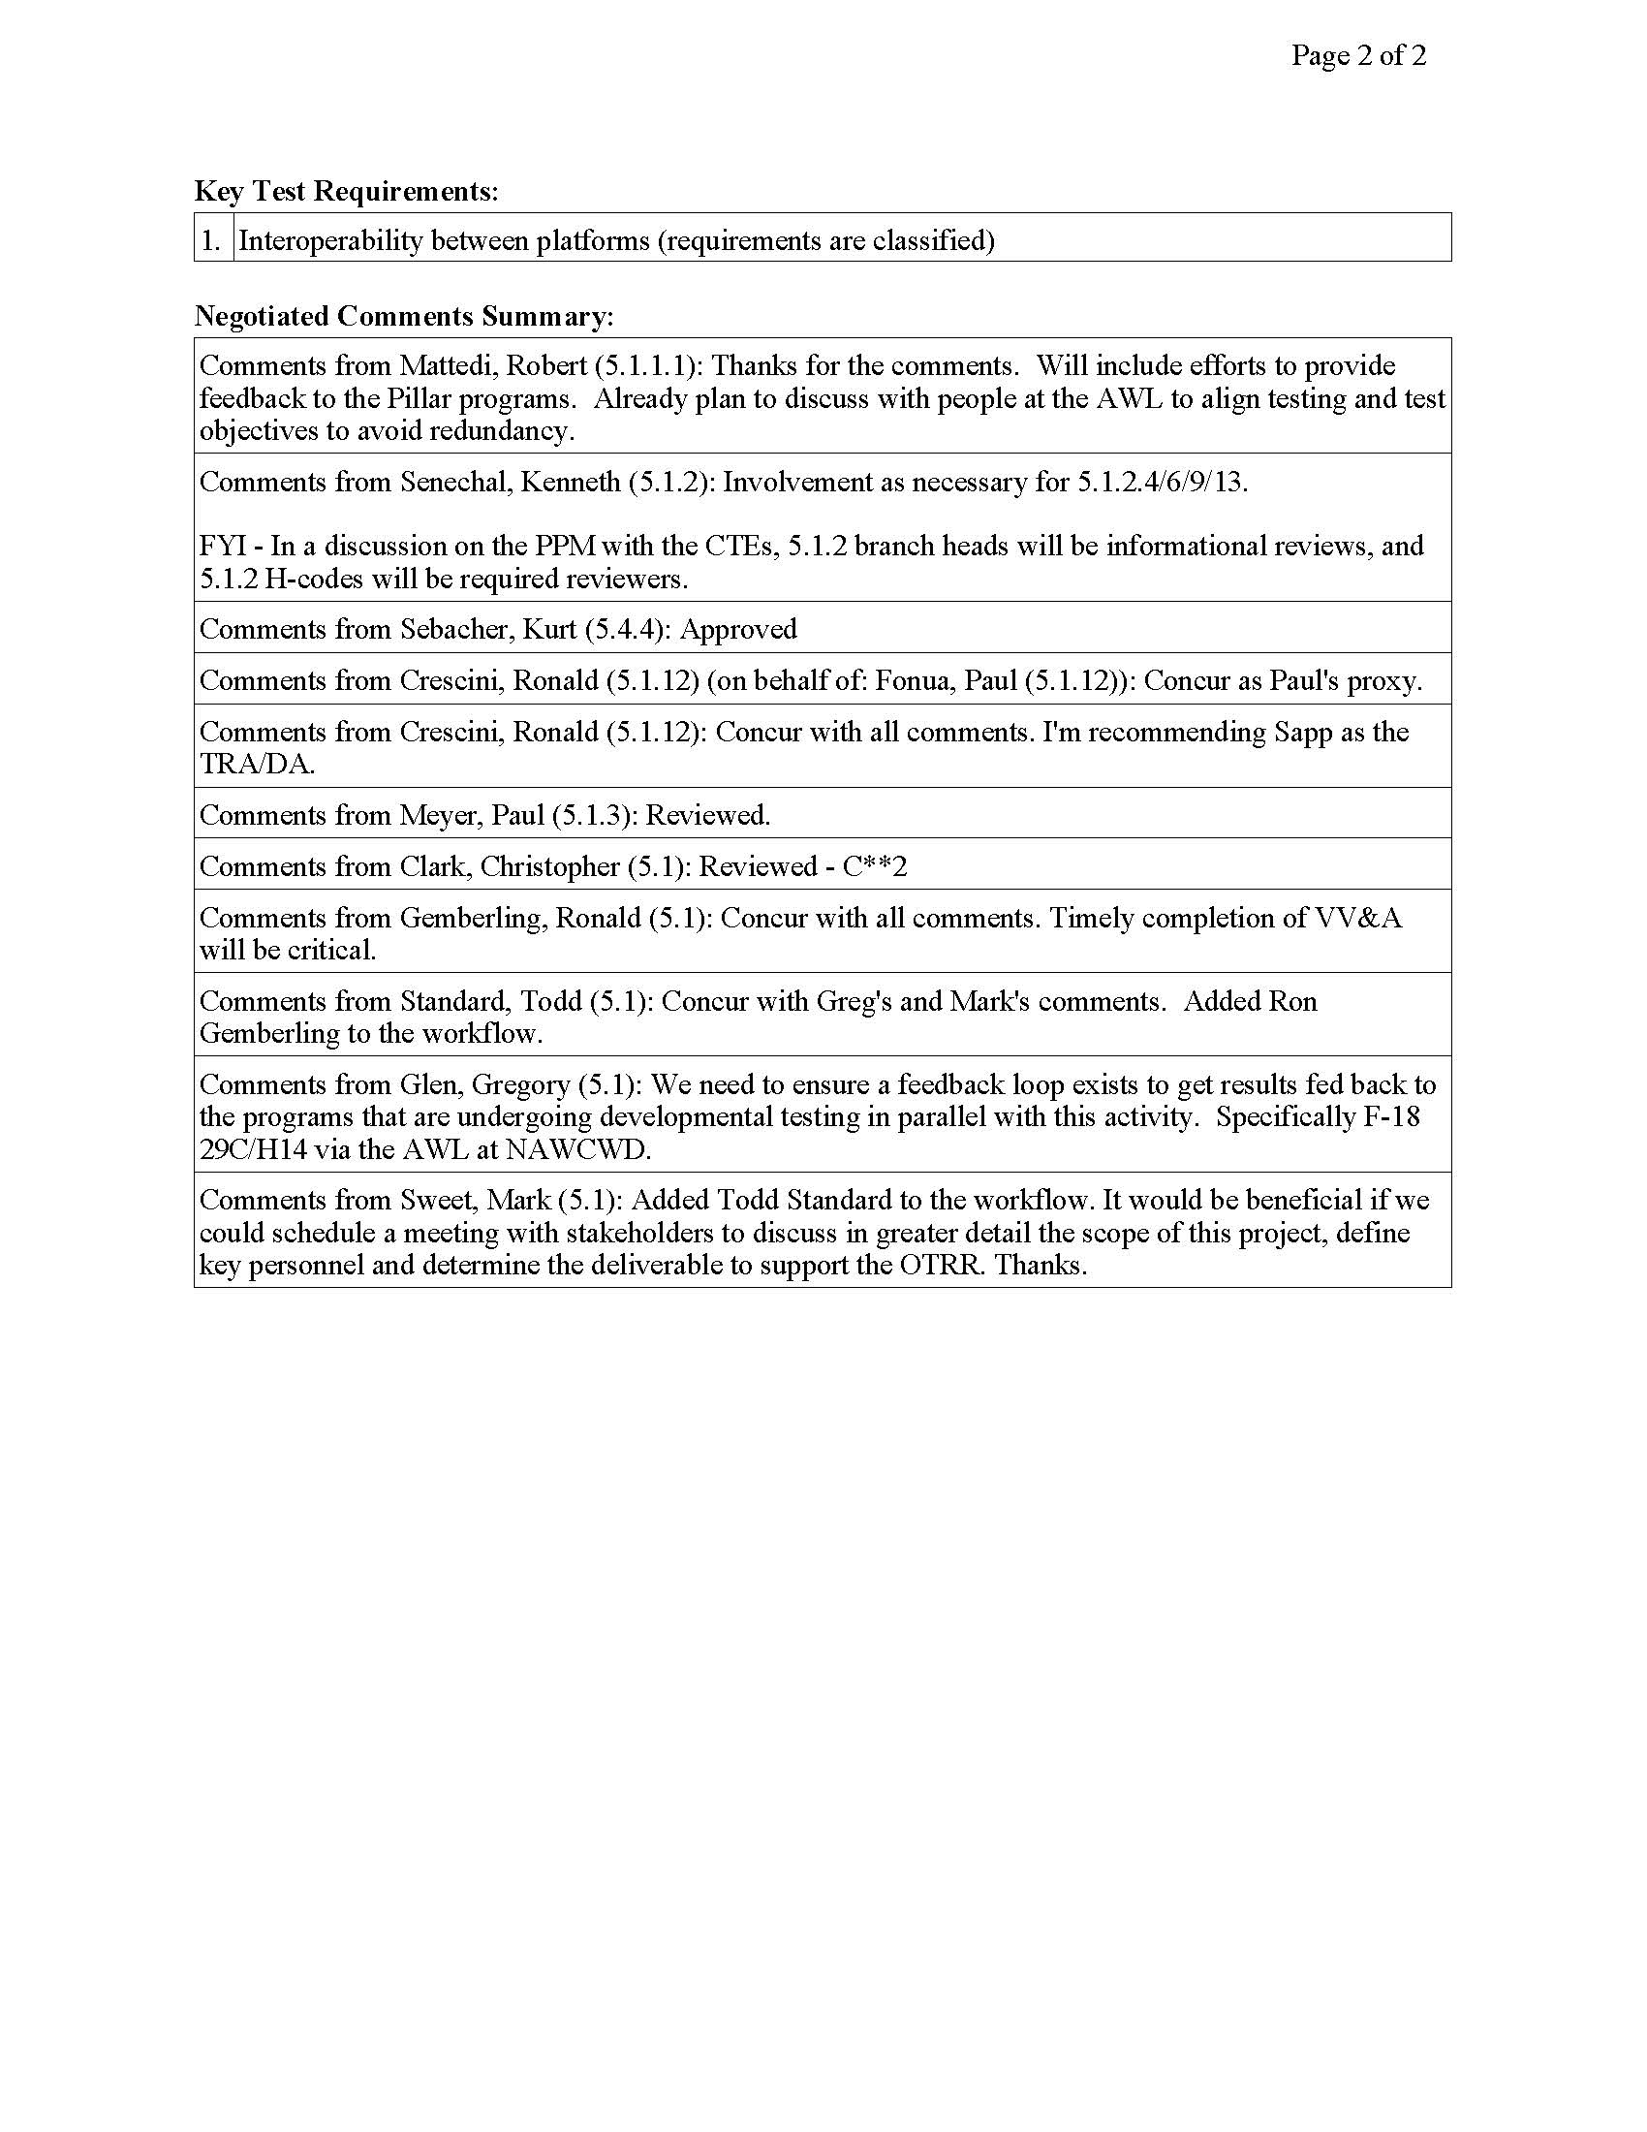
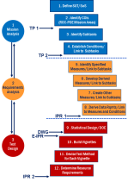
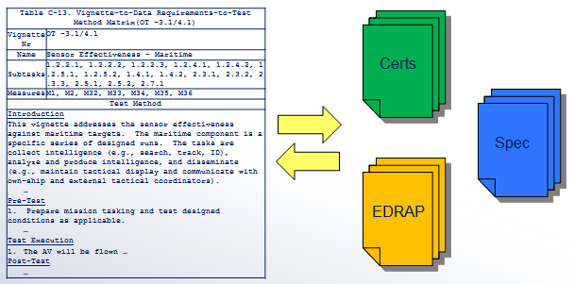
CBTE “Strategy”
Test Program Introduction Document
Mission Based Test Design
Engineering / Test
Collaboration
Test
Planning
Strategy Meeting
5.1 / 5.2 / 5.3 / 5.4 / COTF/DOT&E
Early identification of LVC, range, and target needs
NAWCAD Release 2019-277. Distribution Statement A - Approved for public release; distribution is unlimited.

Slide 9
Capabilities-Based Acquisition
Integrated
Warfare Analysis
Fleet operators work
with engineering to develop concepts of employment
(CONEMPS), effects-chains
& required attributes
System Model
Systems are developed
in a model-based integrated digital environment
(SE Transformation)
Capabilities-Based T&E
Virtual
Constructive
Live
Industry Models
Hardware
In the loop
Integration Laboratory
Installed
Systems
Test Facility
001010
1010
0001
010
Digital
Modeling
Flight Test
Single Source
of Truth
CONEMPS and
effects-chains are
modeled at the
System of Systems
(SoS) level
010
1010
00010
010010
System models form
“Constructive”
Basis for LVC
M&S environment
SoS Models
Data
Feedback
Loop
LVC-based
Training
SoS Model
Required for Fleet Integrated Ops
Results in optimized capability development document
Results in optimized capability development document

