Slide 1
Capabilities Based
Test & Evaluation (CBTE)
Kenneth senechal
NAWCAD Release 2019-277. Distribution Statement A - Approved for public release; distribution is unlimited.

Slide 2


USN vs PLA(N)
Capability Fielding Trends
DF-21D Anti-Ship Ballistic Missile
Anti-Satellite Capability
Hypersonics
Fielding
Initial Estimate
Observed/Expected
YJ-12/18 Anti-Ship Cruise Missile
Cooperative Engagement Capability
J-15 Carrier Based Strike Fighter
LUYANG III
Type 055 Cruiser
How? Acquiring Designs – No DOD 5000 – No Bureaucratic Process Requirements
We’re Slower!
Standard Missile - 6
High Altitude Anti-Submarine Warfare Weapon
Initial Operational Capability
POM-08
POM-17
Next Generation Jammer
Naval Integrated Fire Control -Counter Air
Air and Missile Defense Radar
Joint Strike Fighter (F-35)
CG(X)
Maritime Strike Tomahawk
Open Source Information
USN Warfighting Advantage Against PLA(N) has Steadily Eroded

Slide 3
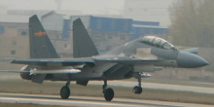
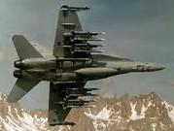
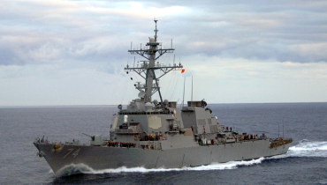
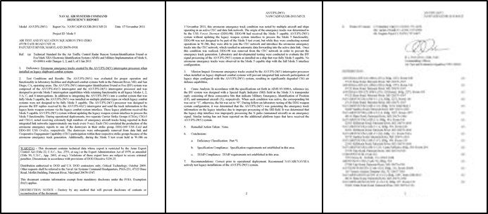
The Reality of Urgency & Complexity
VLRAAM
China is testing a new long-range,
air-to-air missile that could
thwart U.S. plans for air warfare
The hypersonic missile reaches can
take down aircraft from 200 miles.
The J-16 carries two VLRAAM for a test firing.
In November 2016, a Chinese J-16 strike fighter test-fired a gigantic hypersonic missile, successfully destroying the target drone at a very long range.
Looking at takeoff photos, we estimate the missile is about 28 percent of the length of the
J-16, which measures 22 meters (about 72 feet). The puts the missile at about 19 feet, and roughly 13 inches in diameter. The missile appears to have four tailfins. Reports are that the size would put into the category of a very long range air to air missile (VLRAAM) with ranges exceeding 300 km (roughly 186 miles), likely max out between 250 and 310 miles. (As a point of comparison, the smaller 13.8-foot, 15-inch-diameter Russian R-37 missile has a 249-mile range).
This is a big deal: this missile would easily outrange any American (or other NATO) air-to-air missile. Additionally, the VLRAAM's powerful rocket engine will push it to
Mach 6 speeds, which will increase the no escape zone (NEZ), that is the area where a target cannot outrun the missile, against even supersonic targets like stealth
fighters. (Source: Popular Science)
AMRAAM
Engine | Solid-fuel rocket motor
Wingspan | 20.7 in (530 mm) AIM-120A/B
Operational Range | • AIM-120A/B: 55–75 km (30–40 nmi)[3][4] • AIM-120C-5: >105 km (>57 nmi)[5] • AIM-120D (C-8): >180 km (>97 nmi)[6] [full citation needed]
Speed | Mach 4 (4,900 km/h; 3,045 mph)
Guidance System | Inertial guidance, terminal active radar homing
(Source: Wikipedia)
AEGIS
DESTROYER
Deficiency Report
Simple problem….
…impacted the whole network!

Slide 4
Warfighting Has Changed
Increasing Complexity
Network Centric
Digital Wpns
Digital Wpns
Multi-Role A/C
Multi-Role A/C
Multi-Role A/C
Digital FBW A/C
Digital FBW A/C
Digital FBW A/C
Digital FBW A/C
TACTICS
TACTICS
TACTICS
TACTICS
TACTICS
How We Fight – Today
60’s
70’s
80’s
90’s
00’s
Task 1
P1
P2
Task 2
P1
P2
Task 3
P1
P2
P3
P3
P3
Task 4
P1
P2
P3
Task 5
P1
P2
P3
Task 6
P1
P2
P3
E-2
F/A-18
Increased weapon system complexity enables changes in warfighting requiring evolution in testing across platform boundaries
Weapon
Example: Multiple Platforms performing Mission Tasks in an Integrated Fashion

Slide 5
What is CBTE?
Warfare
Analysis
Red Forces and
Blue Forces
CONEMPs
Top Down
System of
Systems Rqmts
 | SURVEIL | DETECT | TRACK | ID | ENGAGE |  | ASSESS
 |  |  |  |  | LAUNCH | WEAPON
AA MISSILE
F-35
F/A-18
E-2D
Integration with COTF's
Mission Based Test Design (MBTD)
NOTIONAL
Bottom Up
CBTE evaluates the effects chain
in a mission context
Weapons Schools
Add
Mission Context (CONOPs, ROC / POE)
Platform Rqmts
(CDD, CPD, TEMP,
specs)

Slide 6
COTF’s Commitment
Truly Integrated Test is the goal—a single process defining the data needs supporting independent assessments using side by side execution
Better Test Designs, More Efficient Execution,
More Meaningful Results—Faster!

Slide 7
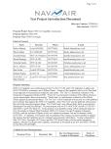
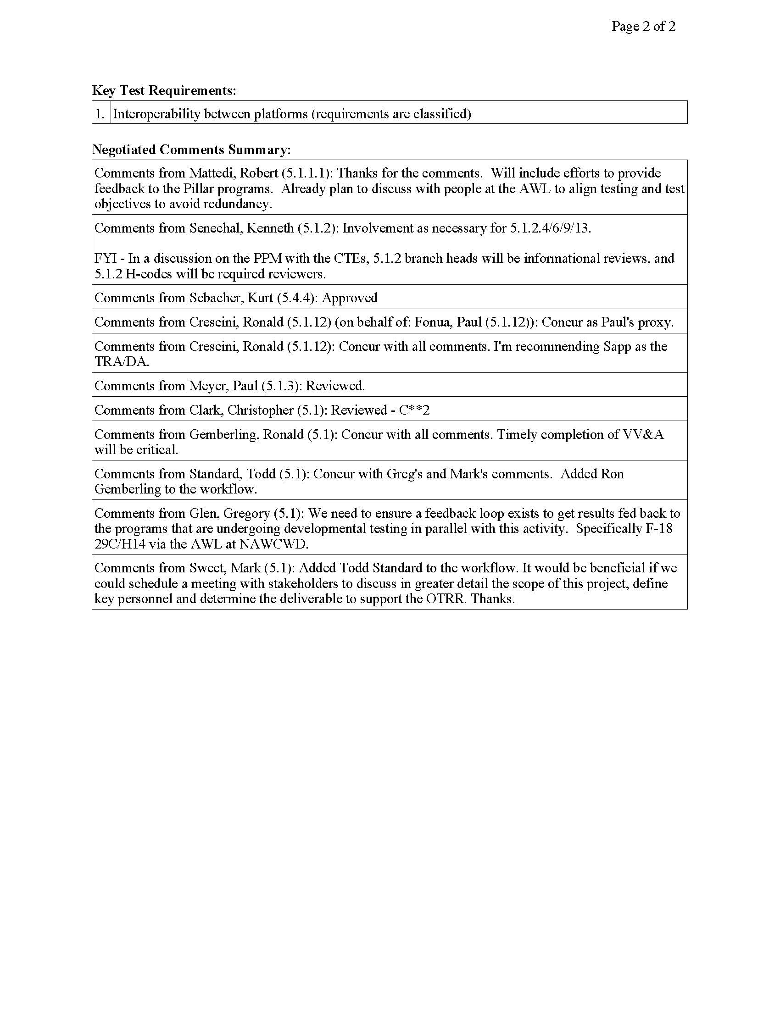
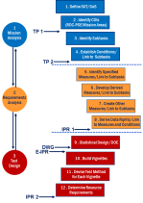
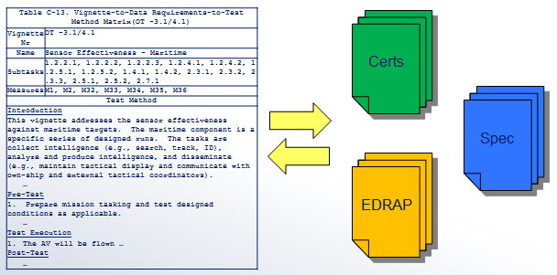
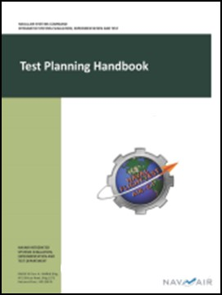
CBTE “Strategy”
Test Program Introduction Document
Mission Based Test Design
Engineering / Test
Collaboration
Test
Planning
  Strategy Meeting
    5.1 / 5.2 / 5.3 / 5.4 / COTF/DOT&E
    Early identification of LVC, range, and target needs
NAWCAD Release 2019-277. Distribution Statement A - Approved for public release; distribution is unlimited.

Slide 8
Mission Based Test Design Process
  Test this system’s capability
1 – Define SUT/SoS
  To execute these missions...
2 – Identify Mission Areas
1
Mission
Analysis
  Performing these tasks...
3 – Decompose Subtasks
  Under these conditions...
4 – Establish Conditions/ Link to Subtasks
  Assessed by these measures…
5 – Identify Specified Measures
6 – Collect Derived Measures
2
Requirements
Analysis
7 – Create Other Measures
  By collecting this data…
8 – Derive Data Requs/Link to Measures and Conditions
9 – Statistical Design/DOE
3
Test
Design
  Data collection organized into vignettes
10 – Build Vignettes
  using these methods …
11 – Devise Test Method for Each Vignette
  and these resources.
12 – Determine Resource Requirements

Slide 9
Capability View (Conceptual)
6.1 - Prepare/ Configure | 6.2 - Search | 6.3 - Detect | 6.4 - Track | 6.5 - ID | 6.6 - Engage | 6.7 - Assess | 6.8 - Defend | 6.9 - Post Mission Tasks
6.1.1 - Plan Mission | 6.2.1 - Patrol/ Maneuver | 6.3.1 - Detect with Organic/ Onboard Sensors | 6.4.1 - Track with Organic/ Onboard Sensors | 6.5.1 - ID with Organic/Onboard Systems | 6.6.1 - Conduct Long Range Missile Strikes | 6.7.1 - Perform Battle Damage Assessments | 6.8.1 - Conduct Evasive Maneuvers | 6.9.1 - Conduct Special Evolutions
6.1.2 – Prepare for Movement | 6.2.2 - Manage and Employ Sensors | 6.3.2 - Cue | 6.4.2 - Track using Offboard/ Inorganic Data | 6.5.2 - ID using Offboard/ Inorganic Data from Surveillance Assets | 6.6.2 - Conduct Air to Ground Engagement(s) |  | 6.8.2 – Detect and ID Threats | 6.9.2 - Transit/ Navigate
6.1.3 - Arm | 6.2.3 - Provide Electronic Protection (EP) | 6.3.3 - Acquire with Organic/ Onboard Sensors From Cue | 6.4.3 - Correlate Organic/Onboard and Offboard/ Inorganic Tracks | 6.5.3 - Correlate Organic/ Onboard and Offboard/ Inorganic ID | 6.6.3 - Execute Surface/ Submarine Cruise Missile Strike(s) |  | 6.8.3 - Conduct Electronic Attack (EA) | 6.9.3 - Land A/C
6.1.4 - Take-off/ Launch |  |  |  |  | 6.6.4 - Conduct Surface Major Caliber Gun Engagement(s) |  | 6.8.4 - Provide ID in Support of Combat Identification | 6.9.4 - De-arm
6.1.5 - Transit/ Navigate |  |  |  |  | 6.6.5 - Maintain Positive Control/ Terminate Engagements |  | 6.8.5 - Deliver Suppressing/ Neutralization Fires | 6.9.5 - Conduct Post-Flight Checks and Maintenance
6.1.6 - Conduct Special Evolutions (In-Flight Refueling)
6.1.7 - Initialize and Configure Systems

Slide 10
Closing the Loop
Warfare Analysis
Desired Capability
Projected Capability
Delivered Capability
Actual Performance
Intelligence Gaps
Evolving Technologies

Slide 11
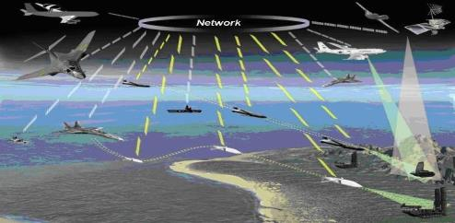
Benefits of CBTE
Speed to the Fleet
Reduce development time and cost through early discovery of mission-related technical issues
Reduce overall test time by collaboratively testing with COTF
Systems of Systems Testing
Specifically addressed via test design and planning
Closing the Loop with Warfare Analysis
Answers the big “so what” question on whether the delivered system meets fleet needs
1
2
3

Slide 12
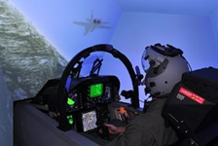
CBTE Enablers
Live-Virtual-Constructive (LVC)
Mission Based Test Design (MBTD)
Design of Experiments (DoE)
Mission T&E During System Development
System of Systems Testing
Human Performance
Mission Analysis
Mission Training

Slide 13
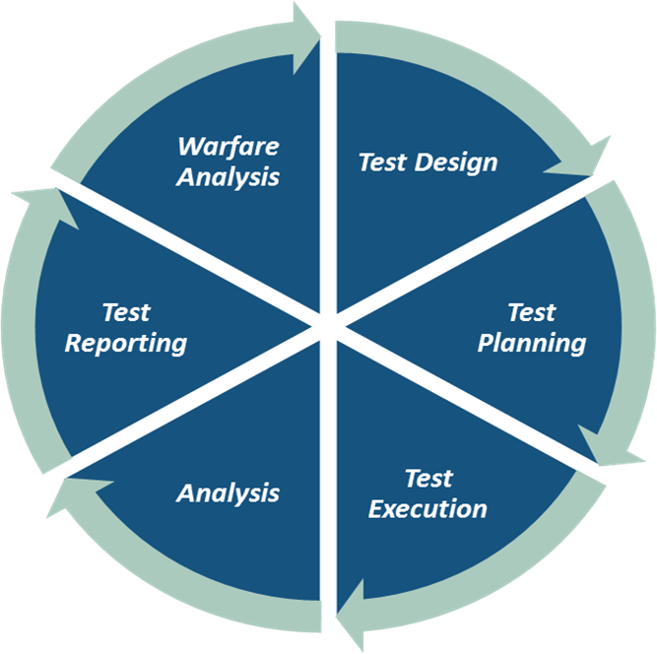
On-Ramping Opportunities
ON-RAMP
Full or Hybrid MBTD
ON-RAMP
Mission Thread Subtask Mapping
Effects Chains with performance measures mapped in Test Plans
ON-RAMP
Provide feedback loop to 4.0M for System of Systems and/or Platform or Weapons System Performance Shortfalls as it related to their Warfare Models
ON-RAMP
Map IEF Measures and Conditions to the signed Test Plans
ON-RAMP
Identify Mission Subtasks in the DRs
Map the DRs to Mission Threads/Effects Chains
ON-RAMP
Use Data and Deficiency Reports to conduct an initial System of Systems Analysis
Use CBTE enablers

Slide 14






Capabilities-Based Acquisition
Integrated
Warfare Analysis
Fleet operators work
with engineering to develop concepts of employment
(CONEMPS), effects-chains
& required attributes
System Model
Systems are developed
in a model-based integrated digital environment
(SE Transformation)
Capabilities-Based T&E
Virtual
Constructive
Live
Industry Models
Hardware
In the loop
Integration Laboratory
Installed
Systems
Test Facility
001010
1010
0001
010
Digital
Modeling
Flight Test
Single Source
of Truth
CONEMPS and
effects-chains are
modeled at the
System of Systems
(SoS) level
010
1010
00010
010010
System models form
“Constructive”
Basis for LVC
M&S environment
SoS Models
Data
Feedback
Loop
LVC-based
Training
SoS Model
Required for Fleet Integrated Ops
Results in optimized capability development document
Results in optimized capability development document

Slide 15
Memo From DOT&E to ASN(RDA)

Slide 16
Points of Contact
CBTE
Director
Kenneth Senechal
301-757-9530
kenneth.senechal@navy.mil
Deputy
Alex Ordway
805-989-3653
Alex.ordway@navy.mil
(WD duty station)
CBTE
Execution
Paul Fonua
805-989-0434
paul.fonua@navy.mil
Ron Crescini
301-757-5706
ronald.crescini@navy.mil
Jen Daniel
301-342-0141 jennifer.daniel@navy.mil
CBTE
Analyst
Amanda Wood
301-342-6666
amanda.m.wood@navy.mil
CBTE
LVC Lead
Lori Jameson 301-757-2736
lori.jameson@navy.mil
WD LVC Lead
Viki Prusia
760-939-8069
Viki.prusia@navy.mil
CBTE
Processes
Jim Carroll
301-757-6496
james.n.carroll@navy.mil
COTF
Dave Beyrodt
757-282-5546 x3168 david.beyrodt@cotf.navy.mil
CAPT
Wade Harris
757-282-5546 x3388
benjamin.harris@cotf.navy.mil

