Slide 1
DDR&E Advanced Capabilities Overview & FY21 Priorities
James A. Faist Director of Defense Research & Engineering for Advanced Capabilities
and
Director, Test Resource Management Center NDIA Webinar 22 June 2020

Slide 2
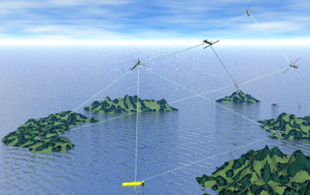
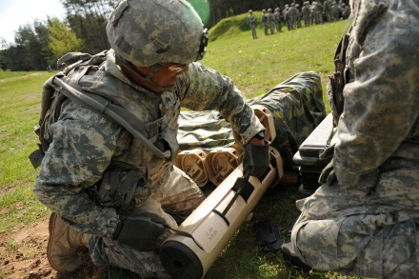
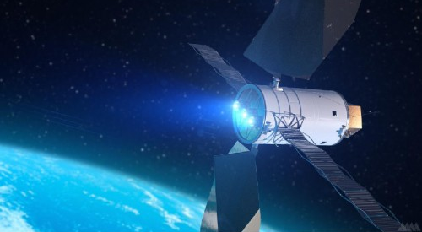
USD(R&E) Mission
Ensure Technological Superiority for the U.S. Military
Set the technical direction for the Department of Defense
Champion and pursue new capabilities, concepts, and prototyping activities throughout the DoD research and development enterprise
Independent technical risk assessment
Bolster Modernization
Focus on Modernization in Highly Contested Environments
Accelerate capabilities to the warfighter
“Our mission is to foster technological dominance across the Department of Defense and ensure the advantage of the American warfighter.”
– Under Secretary Griffin, April 2018

Slide 3
Regaining Technological Superiority
These modernization priority areas magnify the Department's technical dominance and support the objectives set forth by the Secretary of Defense and the National Defense Strategy.
Modernization Priorities
Hypersonics (HS)
5G
Biotechnology
Microelectronics (ME)
Directed Energy (DE)
Space
Cyber
Quantum Science (QS)
Machine Learning / Artificial Intelligence (ML/AI)
Autonomy
Fully Networked Command, Control and Communication (FNC3
Each focus area is assigned an Assistant Director or Technical Director who functions as the Under Secretary’s lead expert on that technology priority

Slide 4
USD(R&E) Operational Vision
Strategic Analysis
Integrated intel/acquisition analysis capability to inform technology, engineering, and acquisition decisions
S&T Investment
and Strategy
Mission Engineering
Prototyping and
Experimentation
Establish joint architectures and ensure integrated efficient capabilities meet warfighter needs
Ensure focused S&T investment and transition for dominant military capability
Identify and mitigate interoperability issues, inform requirements, and accelerate capability transition to the warfighter
Strategic Technology Policy
Coordinated DoD-wide policy, standards, and designs for resiliency and cross-cutting enabling capabilities

Slide 5
DDRE AC Organization
Director of Defense
Research and Engineering
(Advanced Capabilities)
/
Director, Test Resource
Management Center
Principal Deputy Director
(AC)
Deputy Director, Engineering
Deputy Director, Prototyping & Software
Principal Deputy
Director, Test Resource
Management Center
Dir, Mission Integration
Dir, Engineering Policy & Systems
Dir, Prototypes & Experiments
Dir, Global Capability Programs
Test Resource Governance
Dir, Joint Hypersonics Transition Office
Dir, Strategic Intelligence Analysis Cell
Dir, Software Prototyping & Strategy
Test Resource Modernization
Dir, Developmental Test, Evaluation & Assessments

Slide 6
DDR&E AC: Aligned to the National Defense Strategy
National Defense Strategy (NDS) Focus: Era of Great Power Competition, Modernization Priorities in Response
Lethality, Partnerships, Reform
USD(R&E) Mission: Creating the Technologies of the Future Fight
Ensure Technological Superiority for the U.S. Military
Focus on Modernization
DDR&E Advanced Capabilities Role:
Accelerate Modernization for Dominance
Mature Technology to Capability, from Prototyping to Acquisition
Develop New Pathways for Allied Partnerships
Revitalize Engineering Practice within DOD and Industry

Slide 7
DDR&E AC FY21 Focus Items
Accelerating Electronic Warfare (EW) Dominance
Nuclear Modernization Efforts
Accelerating Hypersonics Technology Development and Enabling Transition
Fully Networked Command, Control, and Communications (FNC3) Development
Test and Evaluation (T&E) Infrastructure

Slide 8
Accelerating EW Dominance
Tying EW to the National Defense Strategy
Lethality: focus on EW as a many-on-many, offensive capability viable in Highly Contested Environments
Allies & Partners: Advance relationships to have sustainable, actionable capability at strategic, operational, and tactical levels
Changing Business: EW in the fabric of all modern sensing and communications technology, pre-planned for improvement
FY21 Focus – Weave Modernization Priorities into EW Products
Artificial Intelligence to adapt and integrate mission at relevant speeds
Autonomy for multi-echelon, layered, and collaborative effects
Cyber to augment attack vectors
Fully Networked C3 to disseminate knowledge gleaned at the edge
Quantum for PNT resilience
Emphasis on operational demonstrations
Rigorous modeling, simulation, and analysis as a predicate
Not just the happy paths
Restoring the attention of the Warfighter to making the important decisions

Slide 9
Nuclear Modernization Efforts
In 2019, DepSecDef tasked assessment of test capability and capacity:
Identify needed test infrastructure investments for nuclear modernization
Ensure alignment with nuclear modernization program test plans, as well as deconflict needs across multiple programs (including hypersonics and missile defense)
Nuclear Effects Enhancements
Already Planned (In Development) | Under Consideration
Demonstrating 14MeV pulse neutrons through Dense Plasma Focus Replacing Fast Burst Reactor core at White Sands Missile Range (WSMR) Increasing x-ray capacity with Quad-Eagle at West Coast Facility (WCF) Short Pulse Gamma at WCF, Crane, and WSMR Ramping up university Single Event Effects for microelectronics beginning in FY21 | Accuracy and capacity for x-ray testing (Pithon-II and Gamble-III) Increase 14MeV pulse options EMP improvement for 2169D standard Blast/Thermal/Overpressure Cold x-ray Impulse Multiple combined effects: Electromagnetic Pulse Delayed Neutron, Debris Gamma and Beta Gamma Dose and Dose Rate
TRMC annually updating assessment with new/matured requirements (10-year horizon)

Slide 10
Accelerating Hypersonics Technology Development and Enabling Transition
Hypersonics Road to Dominance – Capability Pillars:
Defeat Time Critical And Heavily Defended Land and Sea Targets From Survivable Standoff Range
Defeat Adversary Near Space Hypersonic Threats
Leverage Near Space for Responsive ISR/Strike and Space Access
Joint Hypersonics Transition Office (JHTO): Accelerate hypersonics technology development and transition to advanced hypersonics capability
Established in Advanced Capabilities based on the 2020 National Defense Authorization Act (NDAA) with $100m budget
Focused on 6.3, but funds 6.1 to 6.5
Hypersonics execution and engineering element in R&E
Close collaboration with AD, Hypersonics to ensure activities support the DoD Hypersonics Roadmap
Top JHTO initiatives
Advanced Concept Development: hypersonic cruise missile concept engine risk reduction and PDR
Workforce Development and S&T Acceleration:
University consortium
Develop and maintain S&T strategy and roadmap
Enhancing and accelerating promising S&T efforts in top priority areas
Allied engagement: Australia Hypersonic Working Group and UK Next Generation Combat Capability

Slide 11
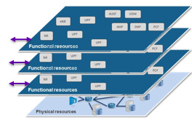
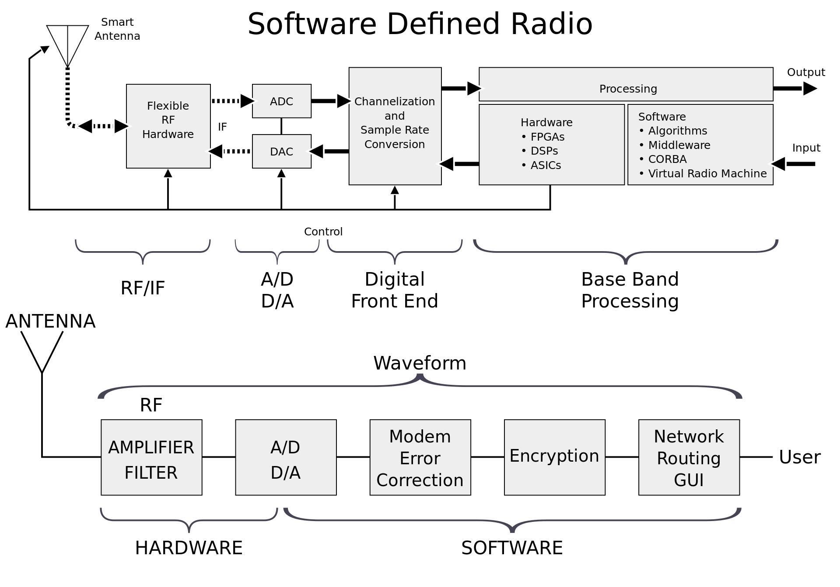
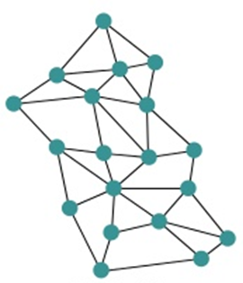
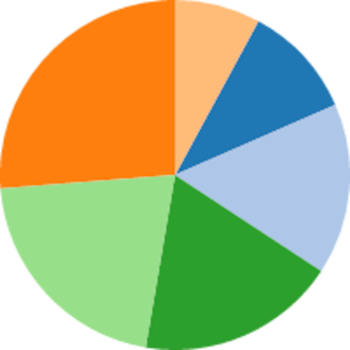
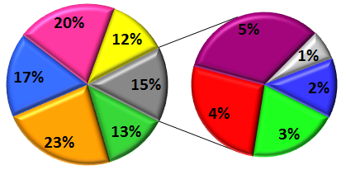
FNC3 Development
Approach | Technologies & Techniques | Status
Universal Command & Control |  | UC2 standard under development FY’21 UC2 CUAS demonstration
Fully Networked Link Diversity |  | Initial networking efforts in place (USA, DARPA). Other efforts (USAF, USN) starting New OSD R&E (AC) spatial & spectral diversity efforts beginning. Many SDR & DAESA efforts
Physical Layer Convergence |  | Initial fielding of some systems Several development programs across Dept.
Common M2M ICD
Common Functional Architecture
Legacy System Interpreters
Spectral & Spatial Diversity
Tactical Network Slicing
Soft. Def. Radio
& Digital AESAs
Multifunction Design
System Resource Management
System of Systems Res. Mgmt.

Slide 12
Test & Evaluation Infrastructure
Hypersonics
Improving ground test facilities for true flight temperatures and conditions
Directed Energy
Establishing a Special Use Space Range (SUSR) over White Sands & Point Mugu
Electronic Warfare
Cyber
Autonomy
Developing SkyRange (instrumented UAVs); additional long-range corridors
Developing HEL and HPM mobile diagnostics suites
Expanding the National Cyber Range Complex (NCRC) to new Service facilities (Orlando, Charleston, PAX River, Eglin, Huntsville)
Delivering multi-source, high-density ground test stimulators
Developing safety and risk analysis tools for cognitive software assessments
Expanding open-air range threat systems
Prototyping digital engineering tools on a cloud computing environment
Developing critical test capabilities
to advance the National Defense Strategy

Slide 13
Current Opportunities
Hypersonics - Consortium Manager for National University Consortium for Applied Hypersonics
2020 NDAA has directed the establishment of the Joint Hypersonics Transition Office and a competitive process to establish a University Consortium related to hypersonics
Virtual Industry Day for Consortium Manager for National University Consortium for Applied Hypersonics: 1JUN
https://beta.sam.gov/opp/b599403306cf4557933a7a8d75d60814/view
Other current opportunities are classified

Slide 14
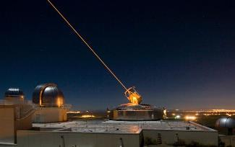
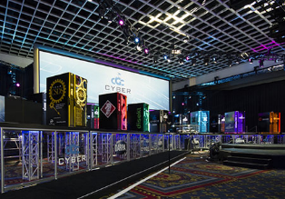
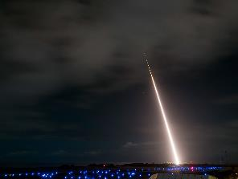
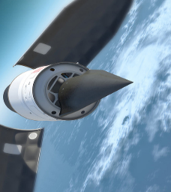
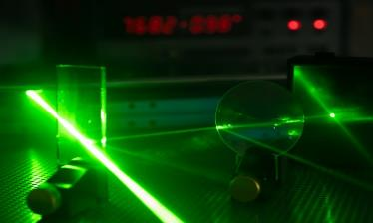
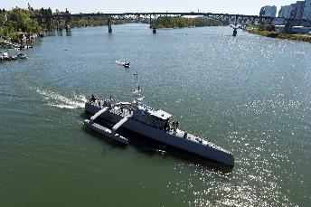
DoD Research and Engineering Enterprise
Creating the Technologies of the Future Fight
DoD Research and Engineering Enterprise
https://www.CTO.mil/
Twitter
@DoDCTO

